Slide 1

The Presentation Pillar of Hospitality:
At Home with “Otherness”

Slide 2
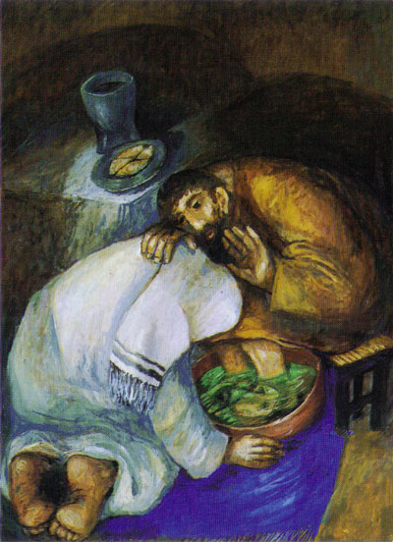
Love bade me welcome. Yet my soul drew back
guilty of dust and sin.
But quick-eyed Love, observing me grow slack
from my first entrance in,
drew nearer to me, sweetly questioning,
if I lacked any thing.
A guest, I answered, worthy to be here:
Love said, You shall be he.
I the unkind, ungrateful? Ah my dear,
I cannot look on thee.
Love took my hand, and smiling did reply,
Who made the eyes but I?

Slide 3
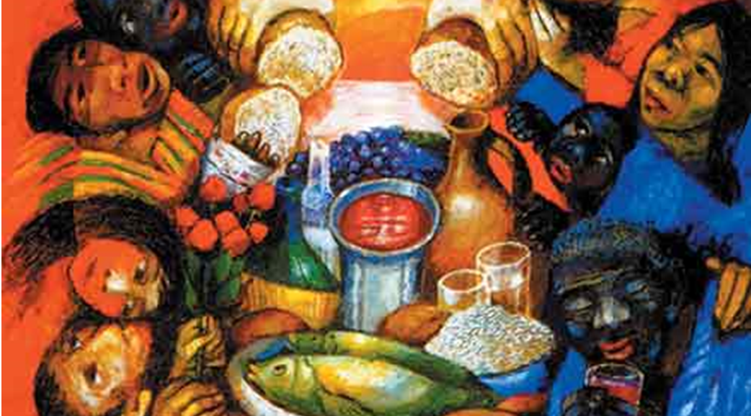
Truth Lord, but I have marred them: let my shame
go where it doth deserve.
And know you not, says Love, who bore the blame?
My dear, then I will serve.
You must sit down, says Love, and taste my meat:
So I did sit and eat.

Slide 4
The Presentation Pillar of Hospitality:
At Home with “Otherness”

Slide 5
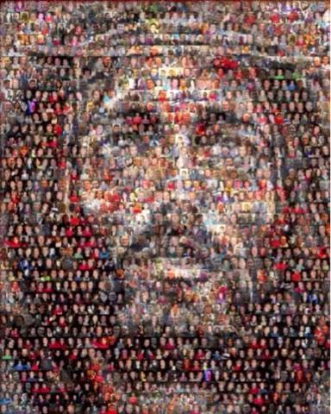
“With a joyful expression our Good Lord looked at his wounded side and contemplated it with joy; and with his sweet gaze he led the understanding of this creature through the same wound into his side, right inside it.
And there he showed me a beautiful and enjoyable place, big enough to contain all humankind that shall be saved that they might rest there in peace and in love” (Julian of Norwich, Revelations of Divine Love).

Slide 6

As leaders, what does living the hospitality of the Sacred Heart look like in your school, parish, social and family communities, and what are you perhaps called to do to enable that hospitality to flourish?

Slide 7
What, from your perspective as leaders, does it look like, or could it look like, actually to live this vision of kinship, compassion, and hospitality in
your school, parish, and family communities?
Jesus says it pretty clearly: That you may be one. That’s the whole thing. That’s the hope, anyway.
All of us are called to be what Alice Miller, the great child psychologist, calls “enlightened witnesses”: people who, through kindness and tenderness and focused attentive love, return people to themselves. And in the process, you’re returned to yourself.
You don’t hold the bar up, and ask anybody to measure up. You just show up and you hold the mirror up and you tell people the truth. You say, you are exactly what God had in mind when God made you, and then you watch people become that truth, you watch them inhabit that truth. And no one can touch that truth. No bullet can pierce it. No four prison walls can keep it out. And death can’t touch it because it is huge. But sometimes you have to reach in and dismantle messages of shame and disgrace
that get in the way so that the soul can feel its worth.

Slide 8
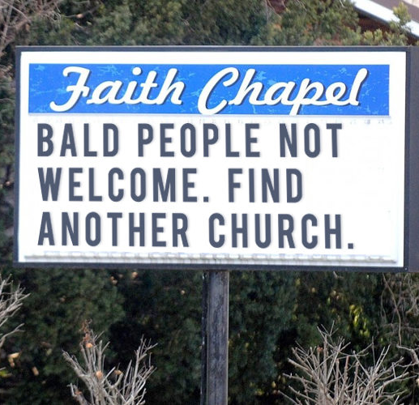
“Our culture is becoming ever more narcissistic and idiosyncratic, that is, more and more we have the attitude that things are our own. We speak of my space, my time, my family, my home, my community, my room, my plans, my agenda, my friendships, my effectiveness, and even, in a way, of my church.
In such a context we allow other persons into our lives, our homes, our communities, and our churches, most selectively. We are hospitable to our own, to those who meet our standards and our timetables. This invariably excludes the poor from our hearts, homes, and churches, since they have no sense of our standards and timetables. Their problems are neither antiseptic nor conveniently scheduled.

Slide 9
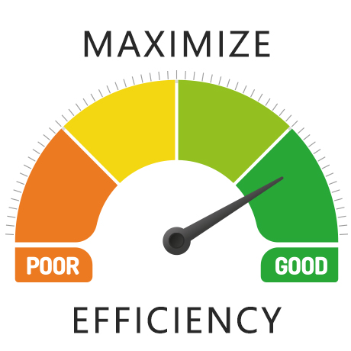
Compounding this is the problem of efficiency. Thomas Merton was once asked what he thought the worst problem was facing Western civilization. Instead of answering with something like ‘injustice,’ ‘moral decay,’ or ‘lack of interiority,’ he simply replied: ‘Efficiency!’
Our problem in the Western world, everywhere from the Pentagon to our monasteries, is that the plant must run! The classes must be taught, the crops must be sown and harvested, the kids need to be driven for their lessons, the meeting must run as scheduled, the supper must be cooked, the essay needs to be written, the mortgage needs to be paid, the plane needs to be caught, things must keep running, there is no other way, the show must go on, we need to do what we need to do!

Slide 10

In all that, partly, we are losing our souls because in it there is no space or time for hospitality and hospitality is the mark of a truly gracious soul.
Would that the hallmark of our Christian homes and churches be the graciousness of our welcome and would that when we die, each of us, might be most remembered for that, our hospitality, the graciousness of our welcome!” (Ron Rolheiser, “Make Your Welcome Hearty”)

Slide 11

From your perspective as leaders, what are the various obstacles you face – personally, communally and ecclesiastically – to living the hospitality of the
Sacred Heart?

Slide 12
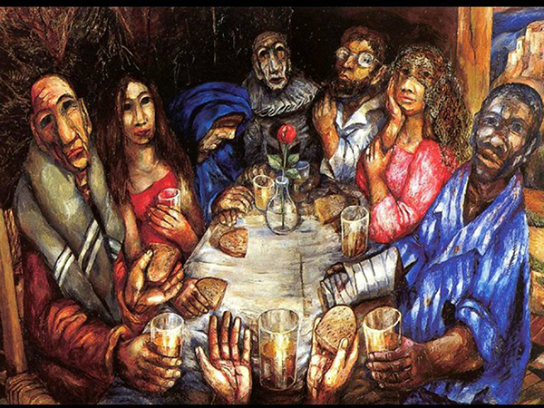
Sieger Koder, “All Are Welcome”

Slide 13
At This Table
Idina Menzel
At this table, everyone is welcome
At this table, everyone is seen
At this table, everybody matters
No one falls between
At this table, you can say whatever
At this table, you can speak your mind
At this table, everything’s forgiven
There’s enough for everyone

Slide 14
“
So come as you are
Remember that the door is always open
Yes, come as you are
The perfect gift that you can bring is your heart
So, come, come as you are
At this table, there will be no judgement
At this table, mercy has a seat
At this table, we’re all sons and daughters
There’s no place I’d rather be
“

Slide 15

So come as you are
Remember that the door is always open
Come as you are
The perfect gift that you can bring is your heart
So, come, come as you are
At this table, everyone is welcome
At this table, everybody cares
At this table, everybody matters
So, come, pull up a chair
THANK YOU

