Slide 1

The All-Consuming Simplicity
of Nano Nagle:
Inspiration for Becoming Who We Are

Slide 2

How Nano’s simplicity and clarity of purpose can inspire us to be who we most deeply are.

Slide 3
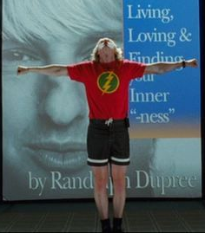
The “personal vocation” is “my unrepeatable uniqueness, the ‘name’ by which God calls me, my truest or deepest self.”
“The personal vocation is precisely a person's unrepeatably unique way of giving and surrendering self – not of closing in on self. In other words, the personal vocation is precisely a person’s unrepeatably unique way of opening out onto community – opening out onto social reality, social responsibilities, social commitment” (Herbert Alphonso, Discovering Your Personal Vocation).

Slide 4

Can you identify people in your life – whether people you know personally or not – who seem to be living from the simplicity of their deepest, truest self?

Slide 5
“We are all yearning for unity and integration, especially we active apostles. The deepest cry of the heart that I hear from active apostles in my ministry of spiritual direction is the cry for unity and integration: ‘I have so many things to do during the day – this, that, and the other – that at the end of the day I am all broken up, scattered, dispersed. How I wish I could be doing only one thing in depth!’ Is it not true that the more mature we become, the more simple we become – a simplicity not of impoverishment, but of concentrated richness in depth? We could, in fact, be doing only one thing in depth.”
“The personal vocation is, in fact, the secret of unity and integration at the heart of a whole life precisely because it is the unique God-given meaning in life. For nothing so unifies and integrates in depth as meaning; we spontaneously shed what is meaningless to remain with and interiorize and assimilate what is meaningful” (Alphonso, Discovering Your Personal Vocation).

Slide 6
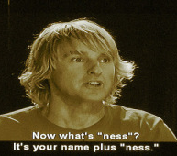
What is my “ness” (or my “deep and inscrutable singular name,” my “personal vocation”)?
Do I experience that deepest part of me as the principle of integration within my life? How?
What does all of this mean for my life and fruitfulness as a leader?

