Slide 1

crayner@cst.tas.edu.au

Slide 2
I thank God, our creator, for the Tasmanian Aboriginal people as the traditional custodians of this land.
I acknowledge and value their rich culture, history and strength. I pay respect to Elders – past, present and future.

Slide 3
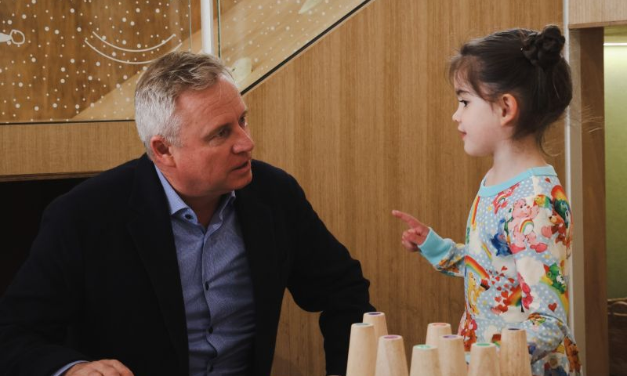
Notes:
“Sometimes in this job, negotiations can get heated 😂
First item on the agenda?
More snacks.
Number 2?
More Centres like this for Tasmanian families.
I'm happy to report we reached a deal on both 🤝”
https://www.linkedin.com/posts/jeremy-rockliff-48544914_sometimes-in-this-job-negotiations-can-get-activity-7086648423654846464-RQrP?utm_source=share&utm_medium=member_desktop

Slide 4
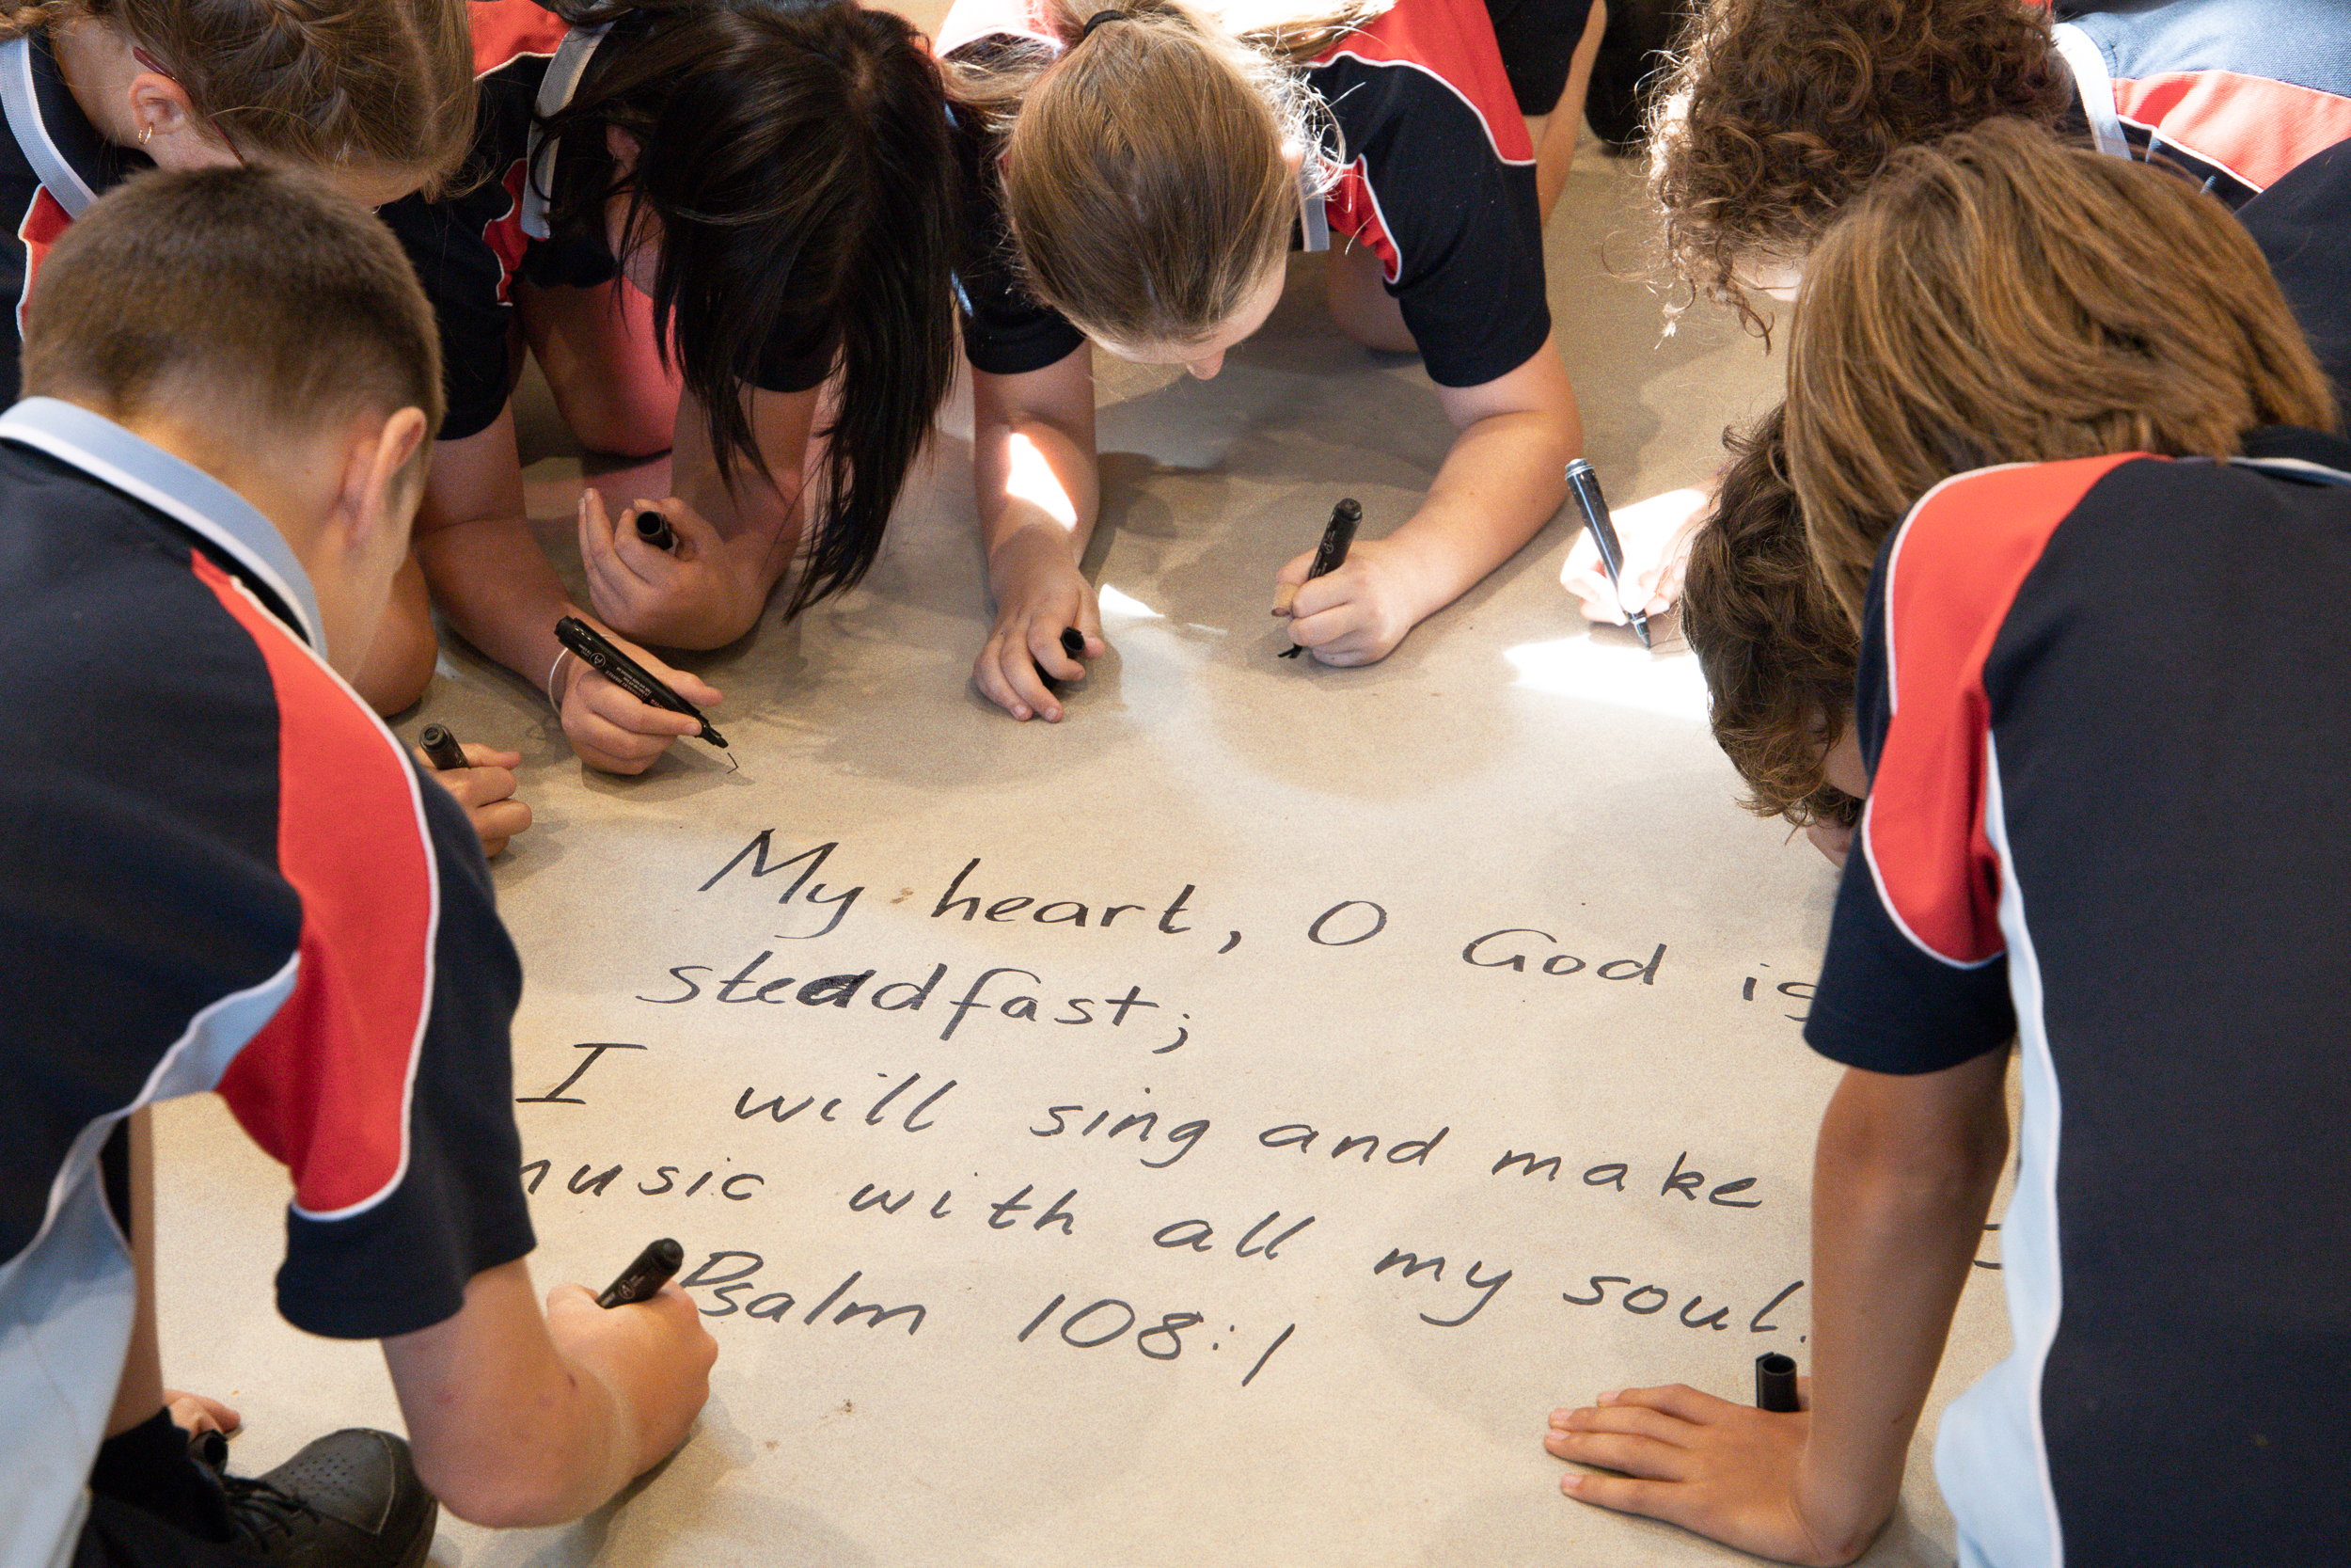

Slide 5
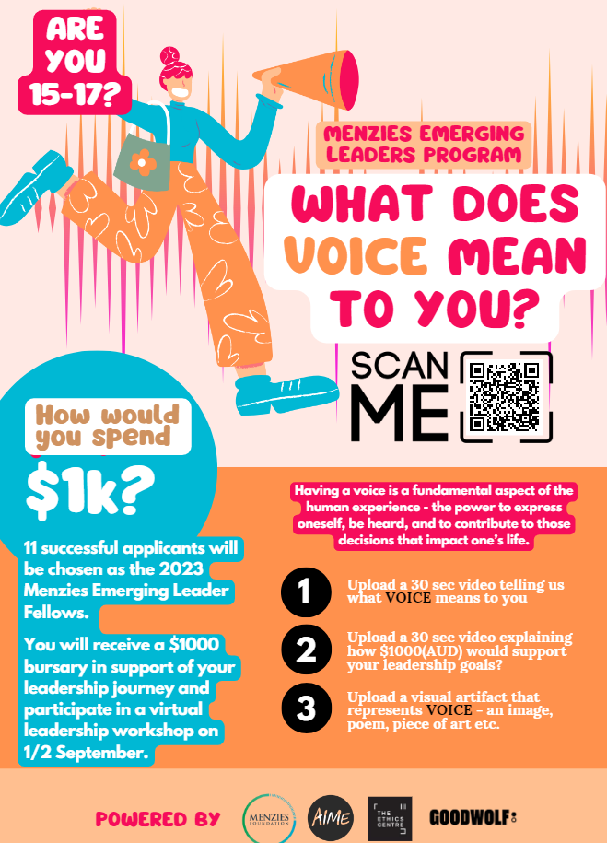
“Having a voice is a fundamental aspect of the human experience – the power to express oneself, be heard, and to contribute to those decisions that impact one’s life.”
(Menzies Foundation, 2023)
Notes:
Menzies Foundation. (2023). Menzies Emerging Leaders Program. Retrieved from https://www.menziesfoundation.org.au/2023melpvoice/

Slide 6
Research has shown that student voice can:
Improve student wellbeing
Improve student engagement
Develop students’ personal and social capabilities
Encourage collaboration between students and their teachers
Create and maintain a positive environment and school culture
Build respectful relationships, connections and belonging
Lead to positive whole school changes
Promote civic engagement
Notes:
Department of Education and Training, Victoria. (2019a). Amplify: Empowering students through voice, agency, and leadership. Retrieved from https://www.education.vic.gov.au/Documents/school/teachers/teachingresources/practice/Amplify.pdf
NSW Government. (2023). Student wellbeing: Why student voice matters. Retrieved from https://education.nsw.gov.au/student-wellbeing/student-voices/student-voice-and-leadership/why-student-voice-matters
Youth Coalition of the Australian Capital Territory (2023). Ask us: Student voice in the ACT. Retrieved from https://www.education.act.gov.au/__data/assets/pdf_file/0009/1251981/Student-Voice-Resource-Kit-Web.pdf

Slide 7
Student voice is a means and an end.

Slide 8
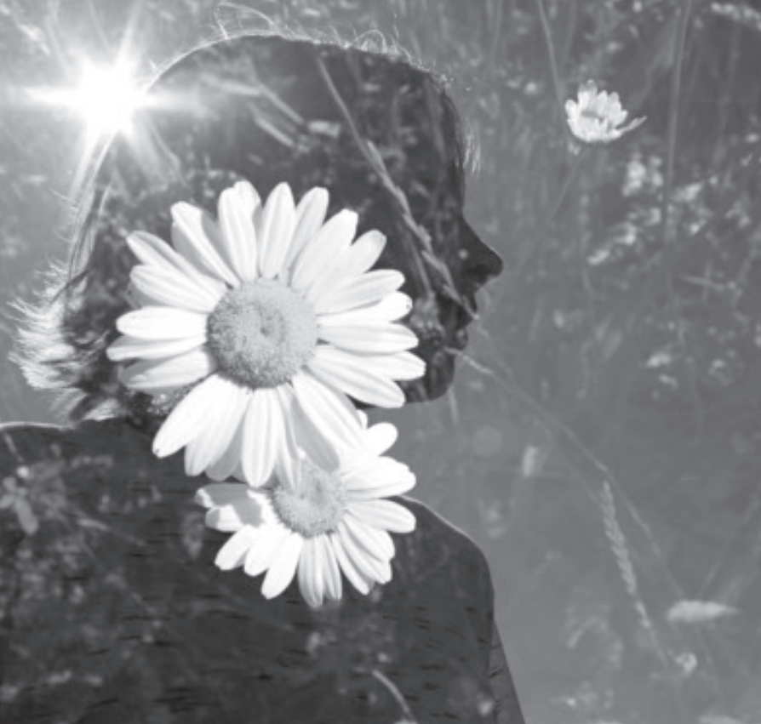
‘…the number one cornerstone of that work was the emphasis put upon the fact that all learners are image-bearers of God…’
Graham (2022, p. 16)
Notes:
Graham, D. (2003). Teaching redemptively: Bringing grace and truth into your classroom. Purposeful Design Publications.
Graham, D. (2022). The evolution of teaching redemptively. Christian Teachers Journal, 30(3), 14-16.

Slide 9
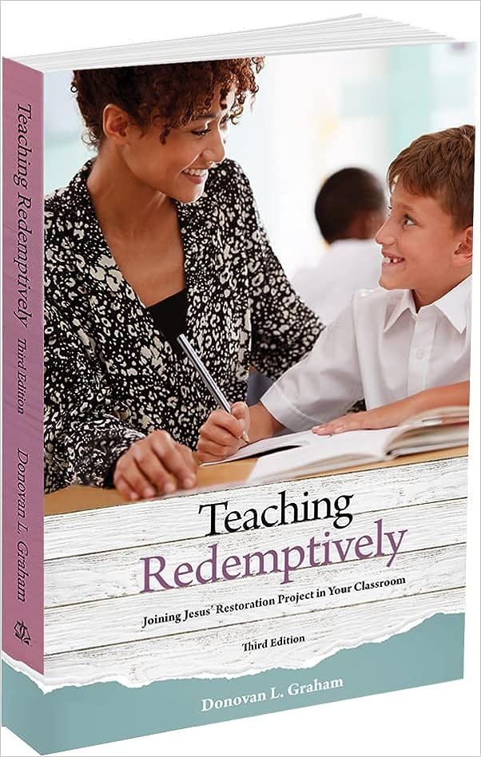

Slide 10
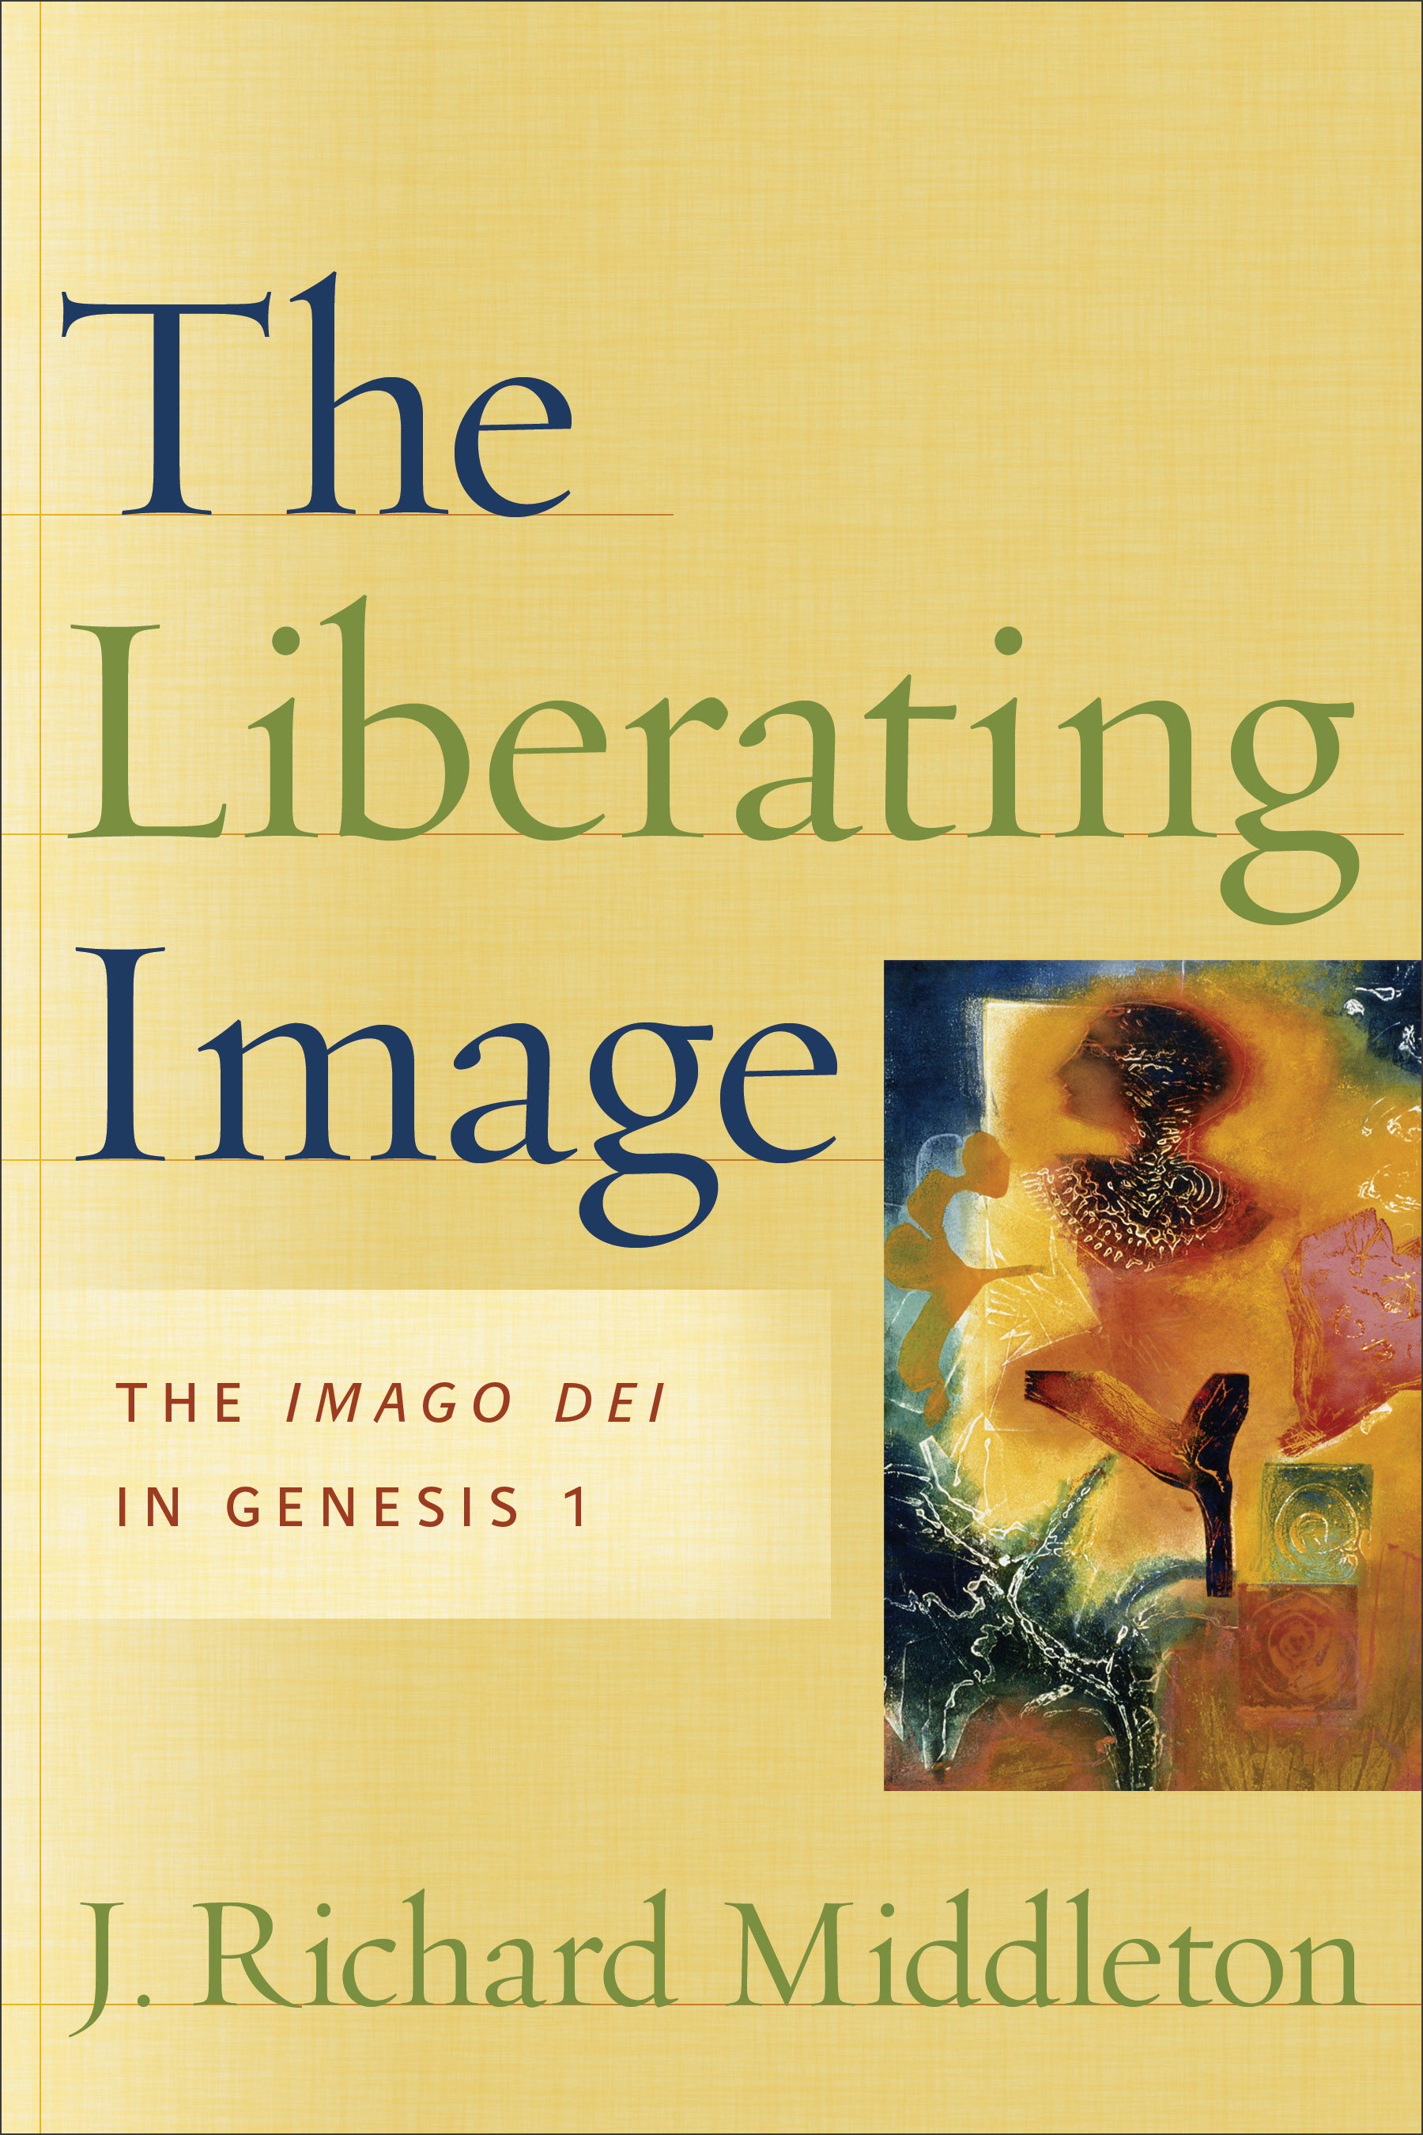

Humanity 1.0, the ‘imago Dei’
Genesis 1
Psalm 8
Notes:
Middleton, R. (2005). The liberating image: The Imago Dei in Genesis 1. Brazos Press.
Imes, C. (2023). Being God’s image: Why creation still matters. InterVarsity press.

Slide 11
imago Dei
= humanity as God’s image

Slide 12
Three things the imago Dei teaches us about God
God shares – He is generous and seeks partnership
God cares – His motives and methods are the definition of love
God frees – He honours choice and values liberty

Slide 13
Three main interpretations of the imago Dei
Substantialistic: as an analogy of being, e.g. having intellect, emotions, and will - humanity is like God
Relational: a yearning for community and capacity for divine relationship - humanity is for God
Functional: an identity and purpose grounded in stewardship - humanity mediates God

Slide 14

‘The image is a vocation, a calling. It is the call to be an angled mirror, reflecting God’s wise order into the world and reflecting the praises of all creation back to the Creator. That is what it means to be the royal priesthood: looking after God’s world is the royal bit, summing up creation’s praise is the priestly bit. And the image is, of course, the final thing that is put into the temple.”
N. T. Wright (2015, p. 175)
Notes:
Wright, N. T. (2015). Excursus on Paul’s use of Adam. In J.H. Walton, The lost world of Adam and Eve: Genesis 2-3 and the human origins debate. IVP Academic. Retrieved from https://zoboko.com/text/9o0ejlnq/the-lost-world-of-adam-and-eve-genesis-2-3-and-the-human-origins-debate/55
PICTURE FROM https://www.homesdirect365.co.uk/images/full-length-mirror-in-black-the-elizabeth-floor-standing-mirror-p59469-83022_zoom.jpg
So, what does it mean to be God’s image? Lots of things! Although many popular translations of Genesis 1 describe humans as being made in God’s image (for example, NIV, NKJV, NASB, AMP), Imes (2023, pp. 4-6) argues that, because of the Hebrew used in those key texts and considering the context in which they are applied, being made ‘as’ God’s image might be a more accurate phrasing. I agree and will use this phrasing in conjunction with the imago Dei concept from here.
According to Middleton (2005), there have been three main ways the imago Dei has been interpreted. In the substantialistic interpretation, the image is an analogy of being. Imes (2023) describes this as the YMCA model, because it focuses on three elements shared by God and humans: intellect, emotions, will. In contrast, the relational interpretation focuses on the image as (inter)personal encounter and the humanity capacity for divine relationship – a capacity that God exercises in Trinity through eternity. Although those interpretations are not without merit, Middleton (2005) prefers a functional interpretation: the image as mediation of power.
For Imes (2023), the functional interpretation of what it means to be made as God’s image affirms our embodied identity and is central to understanding why creation still matters. In Genesis 1, God reveals Himself as the model King (forming, filling, and bringing order) and the model worker (giving us the pattern for a 6-day working week). Here, before sin, God affirmed the dignity of work and the importance of rest – not that He was tired! Authors such as Middleton (2005), Wright (2015), and Imes (2023) have also showed that the Bible presents creation as a cosmic temple in which the crown of God’s creation, humanity, is placed as His ‘image’: the same Hebrew word also translated ‘idol’ in the Old Testament. Wright (2015) explained it like this:
“The notion of the “image” doesn’t refer to a particular spiritual endowment, a secret “property” that humans possess somewhere in their genetic makeup, something that might be found by a scientific observation of humans as opposed to chimps. The image is a vocation, a calling. It is the call to be an angled mirror, reflecting God’s wise order into the world and reflecting the praises of all creation back to the Creator. That is what it means to be the royal priesthood: looking after God’s world is the royal bit, summing up creation’s praise is the priestly bit. And the image is, of course, the final thing that is put into the temple.” (p. 175)
Although the imago Dei language of ‘God’s image’ or ‘God’s likeness’ appears explicitly in Scripture in only a few places (e.g. Genesis 1, Genesis 9, Psalm 8, & James 3), the functional interpretation of the imago Dei concept runs like an underground stream through the whole of the Biblical metanarrative, flowing out in expressions such as God’s desire for his people to be a kingdom of priests (e.g. Exodus 19:6, 1 Peter 2:9, Revelation 1:6) (Middleton, 2005).

Slide 15
‘image’ same word as ‘idol’
Notes:
Refer also to Exodus 20: First commandment about who God is to us, second commandment about who we are to God

Slide 16
Three essential features of the imago Dei
Unconditional and life-long – it can’t be earned, and it can’t be lost.
Individual and collective – it is something I am (you are) personally, and something we are collectively.
Universal and democratic – no human being is made more or less as God’s image than another.

Slide 17
Three key implications of the imago Dei
Human worth – every person has inherent dignity and value, regardless of their abilities, background, or beliefs.
Human vocation – all work and creative expression that leads to human flourishing and good stewardship of the earth is part of our service to God as His vice-regents.
Human rights – the imago Dei is fundamental to true freedom, equity, and non-violent treatment.

Slide 18
Jesus on the treatment of children
“Whoever receives one child like this in My name receives Me…”
(Matthew 18:5, Mark, Luke 9:48)

Slide 19
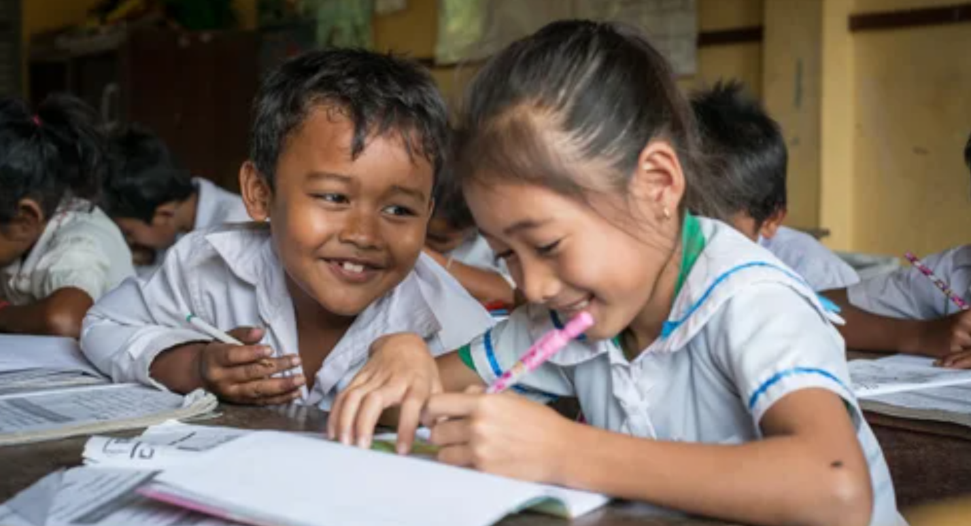
“Children have the right to say what they think should happen when adults are making decisions that affect them and to have their opinions taken into account.”
(United Nations Conventions on the Rights of the Child, Article 12)
Notes:
United Nations. (1990). United Nations Convention on the Rights of the Child. Retrieved from https://www.unicef.org.au/united-nations-convention-on-the-rights-of-the-child

Slide 20
If a parent asked you why student voice is important, what would you say?

Slide 21
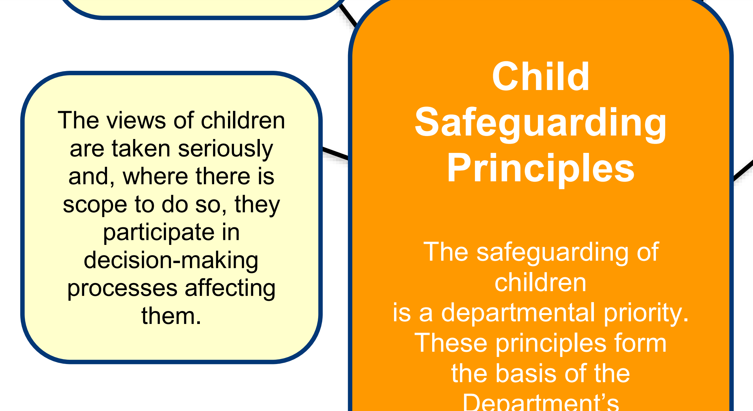
Notes:
Department of Social Services, Commonwealth of Australia. (2021). Safe and supported: The national framework for protecting Australia’s children. Retrieved from https://www.homeaffairs.gov.au/reports-and-pubs/files/child-safeguarding-framework.pdf

Slide 22
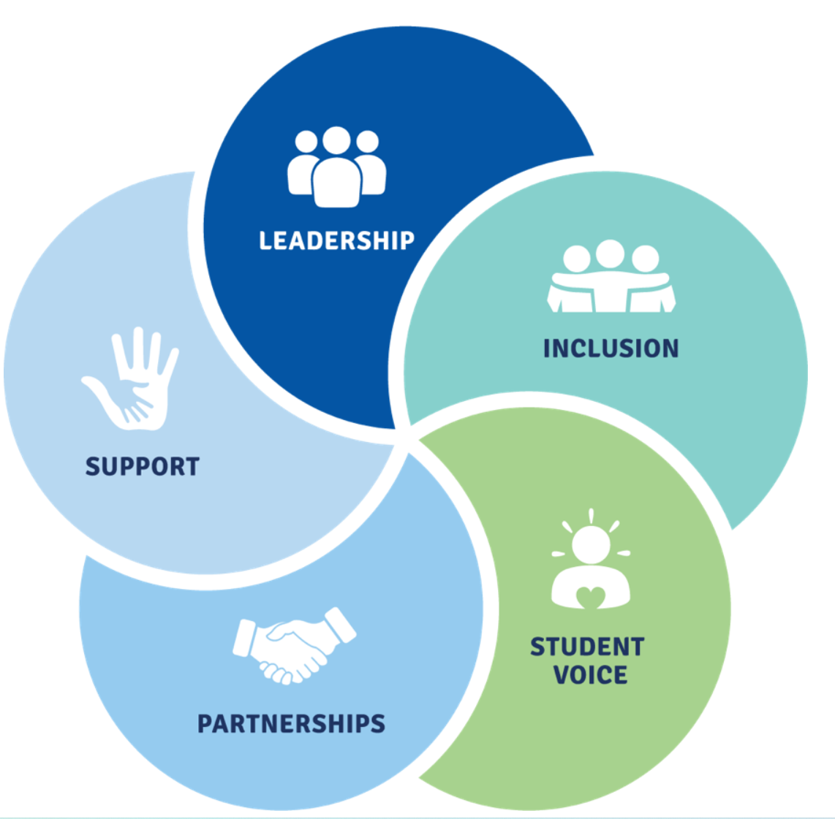
Notes:
Department of Education, Australian Government. (2020). Australian Student Wellbeing Framework. Retrieved from https://studentwellbeinghub.edu.au/educators/framework/

Slide 23

Notes:
2 mins video
Hattie, J. (2012). John Hattie’s summary: Know thy impact [video]. Retrieved from https://vimeo.com/41737863

Slide 24
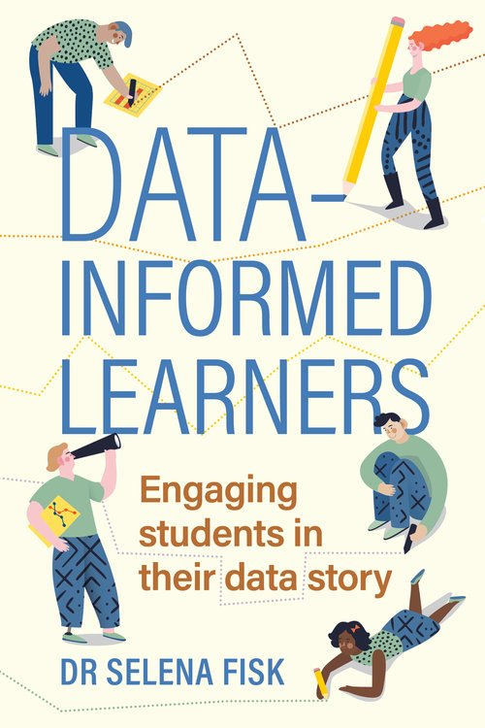
“When students become data-informed learners, they have a better understanding of their ability as a learner, are more readily able to identify opportunities for growth, and are able to have more specific and targeted conversations about what they need to do to improve.”
(Fisk, 2023)
Notes:
Fisk, S. (2023). Data-informed learners: Involving students in their data story. Amba Press.

Slide 25
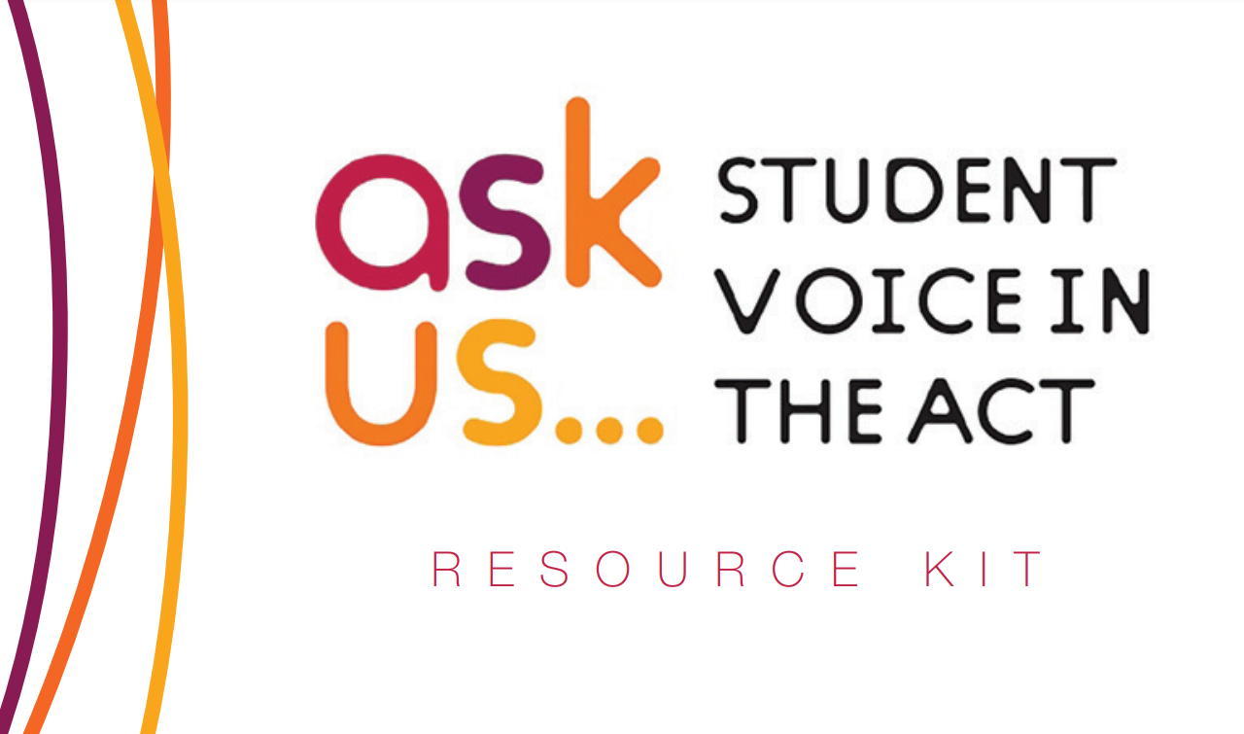
Notes:
Youth Coalition of the Australian Capital Territory (2023). Ask us: Student voice in the ACT. Retrieved from https://www.education.act.gov.au/__data/assets/pdf_file/0009/1251981/Student-Voice-Resource-Kit-Web.pdf

Slide 26
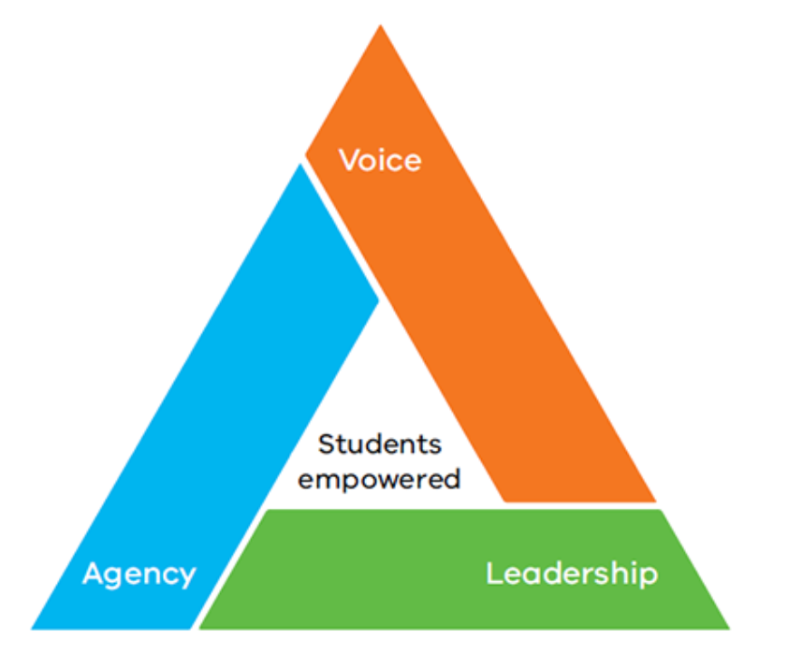
Notes:
Department of Education and Training, Victoria. (2019a). Amplify: Empowering students through voice, agency, and leadership. Retrieved from https://www.education.vic.gov.au/Documents/school/teachers/teachingresources/practice/Amplify.pdf

Slide 27
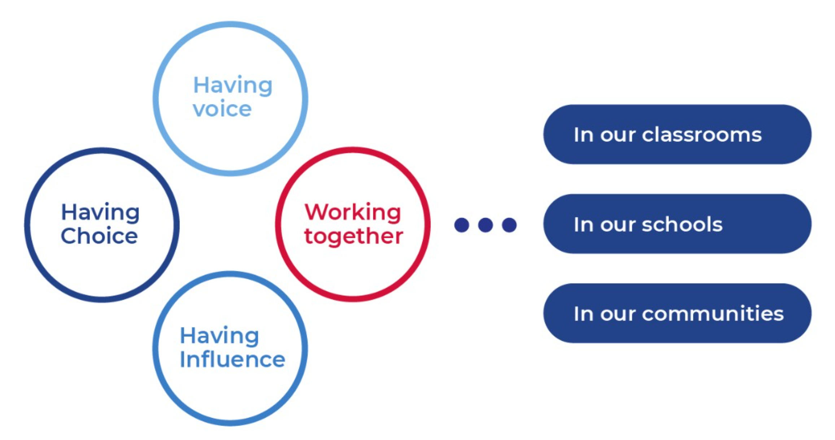
Notes:
NSW Government. (2023). Student wellbeing: Why student voice matters. Retrieved from https://education.nsw.gov.au/student-wellbeing/student-voices/student-voice-and-leadership/why-student-voice-matters

Slide 28
“You do not rise to the level of your goals. You fall to the level of your systems.”
Clear (2018, p. 31)
Notes:
Clear, J. (2018). Atomic Habits: An Easy & Proven Way to Build Good Habits & Break Bad Ones. Avery.

Slide 29
How are ‘student voice’ practices embedded within the systems of your school?

Slide 30
A student is vulnerable when they are not understood.

Slide 31
Personalisation: Exceptional students
Differentiation:
Some students
Universal design for learning:
All students

Slide 32
How do we embed student voice at the individual student level?

Slide 33
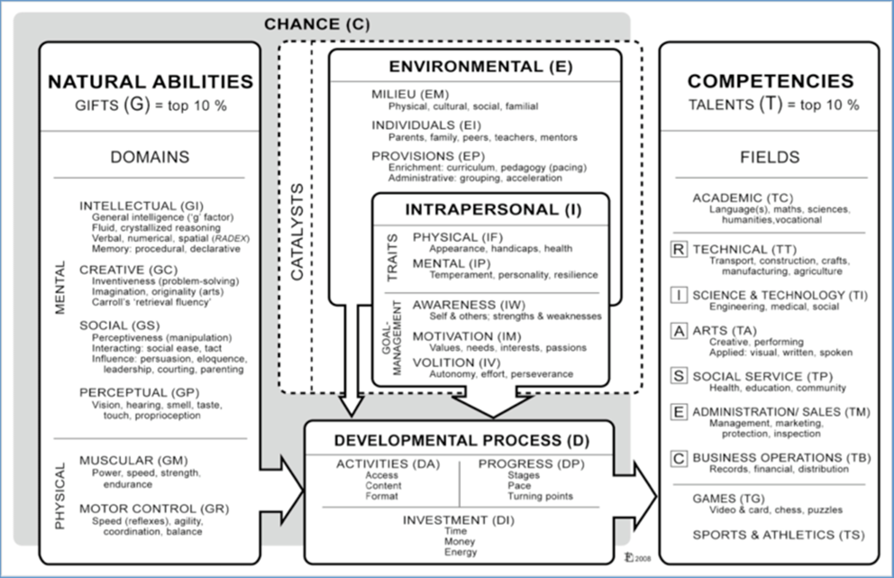
Notes:
Gagne, F. (2014). Building gifts into talents: Brief overview of the DMGT 2.0. Retrieved from https://australiangiftedsupport.com/ccmword/wp-content/uploads/2014/12/Gagne_DMGT_Model.pdf

Slide 34
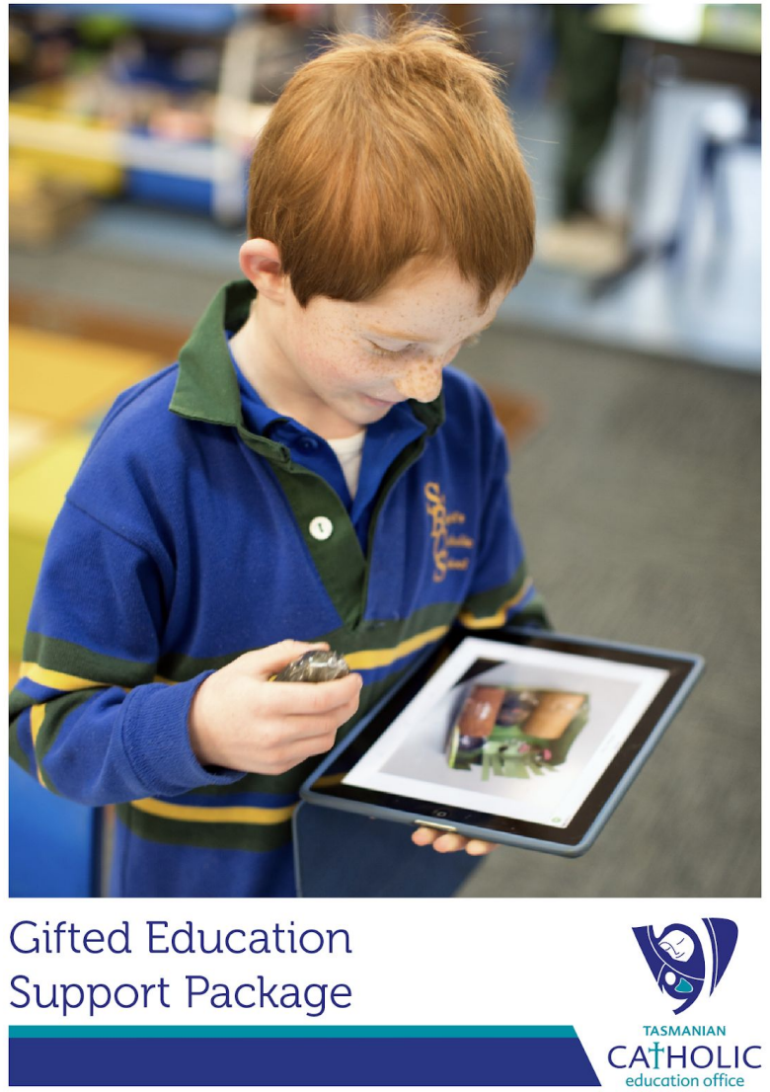
Notes:
Tasmanian Catholic Education Office. (2018). Gifted education support package. Retrieved from https://www.tasgifted.com/wp-content/uploads/2018/09/Gifted-education-Support-Package-final.pdf

Slide 35
Questions in Tasmanian ILP (Independent) template:
• What do I love to do?
• How do I learn best?
• What helps my learning?
• What helps me to attend school regularly?
• What have I achieved? (At school and/or outside school) (NB. This is an ongoing learning and reflective activity.)
• Something I feel proud of in the month/term?
• Why are the goals in my learning plan (below) important to me? How do they link to ‘real life’ or future goals or things I would like to do.
Notes:
Independent Schools Tasmania. (2023). Inclusive Education Resources: IST Individual Adjustments and Learning Plan Template. Retrieved from https://independentschools.tas.edu.au/members-hub/resources/inclusive-education-resources. Available on request.

Slide 36
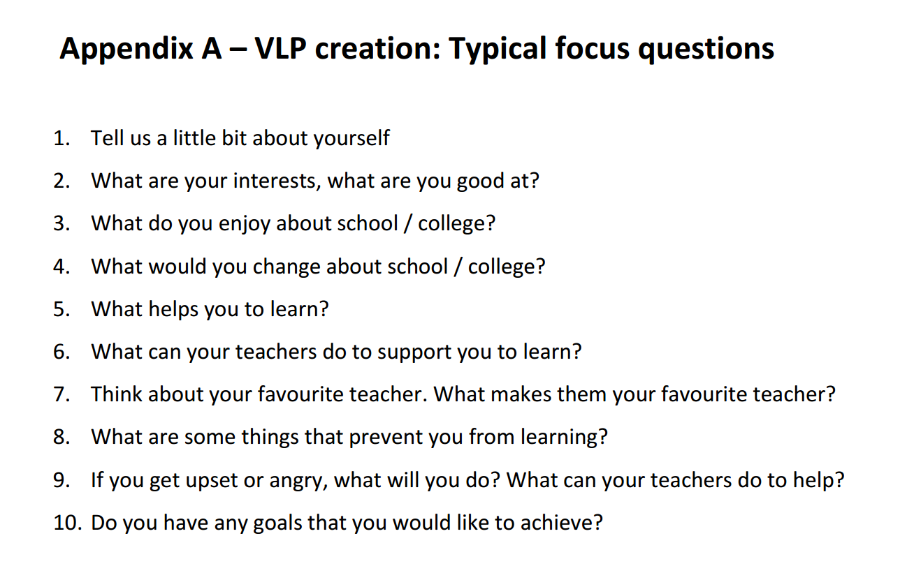
Notes:
Rayner, C. (2017). Video Learning Profiles (VLPs): Pilot study report. Tasmanian Department of Education, Professional Learning Institute. Electronic copies available on request.

Slide 37
A major issue and priority for students with disability is self-determination.

Slide 38
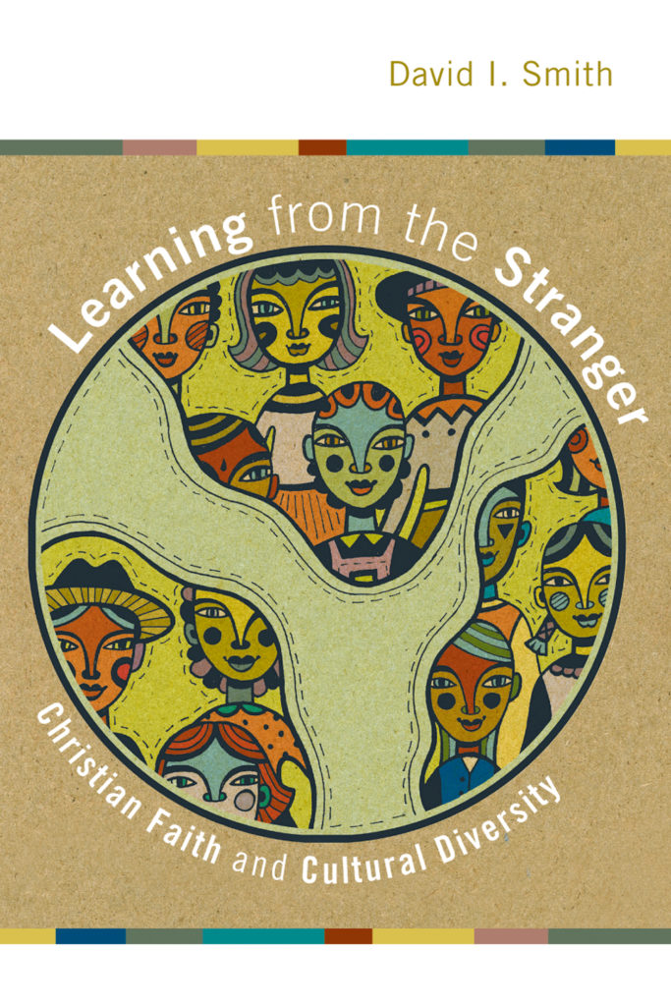
“Continuing the trajectory set at Pentecost, the miracle is not that all are given the same language, but that they become able to hear one another...Revelation offers us a final vision of people of every cultural origin drawn together through shared love of God and love of each other as themselves. To be Christian is to hope for this, and to actively seek the realization of that hope. Such seeking cannot take place without learning from the stranger.”
(Smith, 2009, p. 147)
Notes:
Smith, D. I. (2009). Learning from the stranger: Christian faith and cultural diversity. Eerdmans.

Slide 39
How might we embed student voice in the classroom?

Slide 40
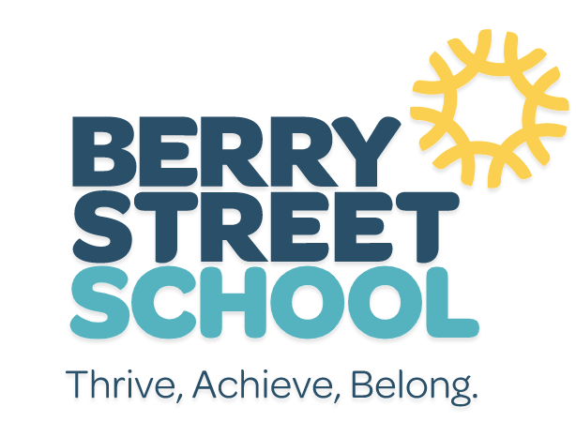
At the start of the day
At the start of the day, all students gather for a Morning Circle. The circle is a great time to welcome students, frame the learning for the day, and help everyone in the community be ready to learn.
Students also show where they are on the 'Ready to Learn' scale - starting at 1 being 'No way am I ready to learn', up to 5 'I am pumped to learn'. This helps staff find out how students are feeling and what support they need that day. We help take care of their wellbeing, so they feel safe and ready to learn.
Notes:
Berry Street School. (2023). A day in the life of a student. Retrieved from https://www.berrystreetschool.vic.edu.au/student-life/life-of-a-student/student

Slide 41
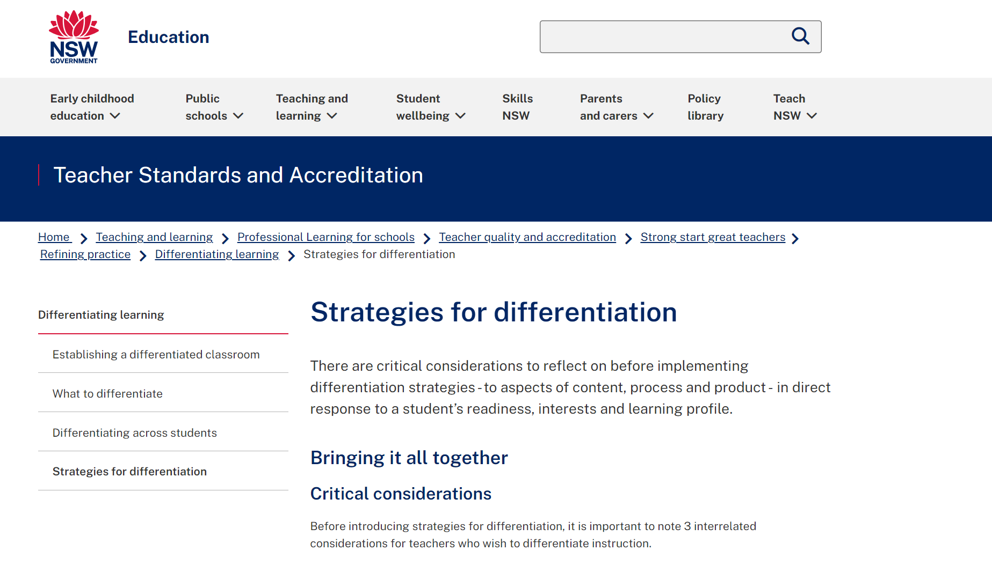
Notes:
NSW Government. (2023). Strategies for differentiation. Retrieved from https://education.nsw.gov.au/teaching-and-learning/professional-learning/teacher-quality-and-accreditation/strong-start-great-teachers/refining-practice/differentiating-learning/strategies-for-differentiation

Slide 42
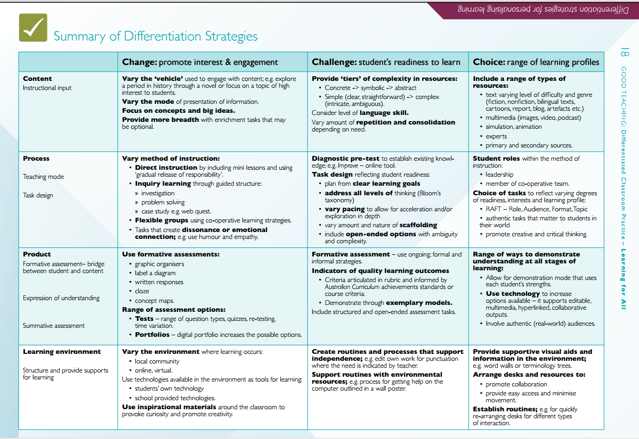
#8
Notes:
Tasmanian Department of Education. (2016). Good teaching: Differentiated classroom practice. Retrieved from https://publicdocumentcentre.education.tas.gov.au/library/Shared%20Documents/Good-Teaching-Differentiated-Classroom-Practice-Learning-for-All.pdf

Slide 43
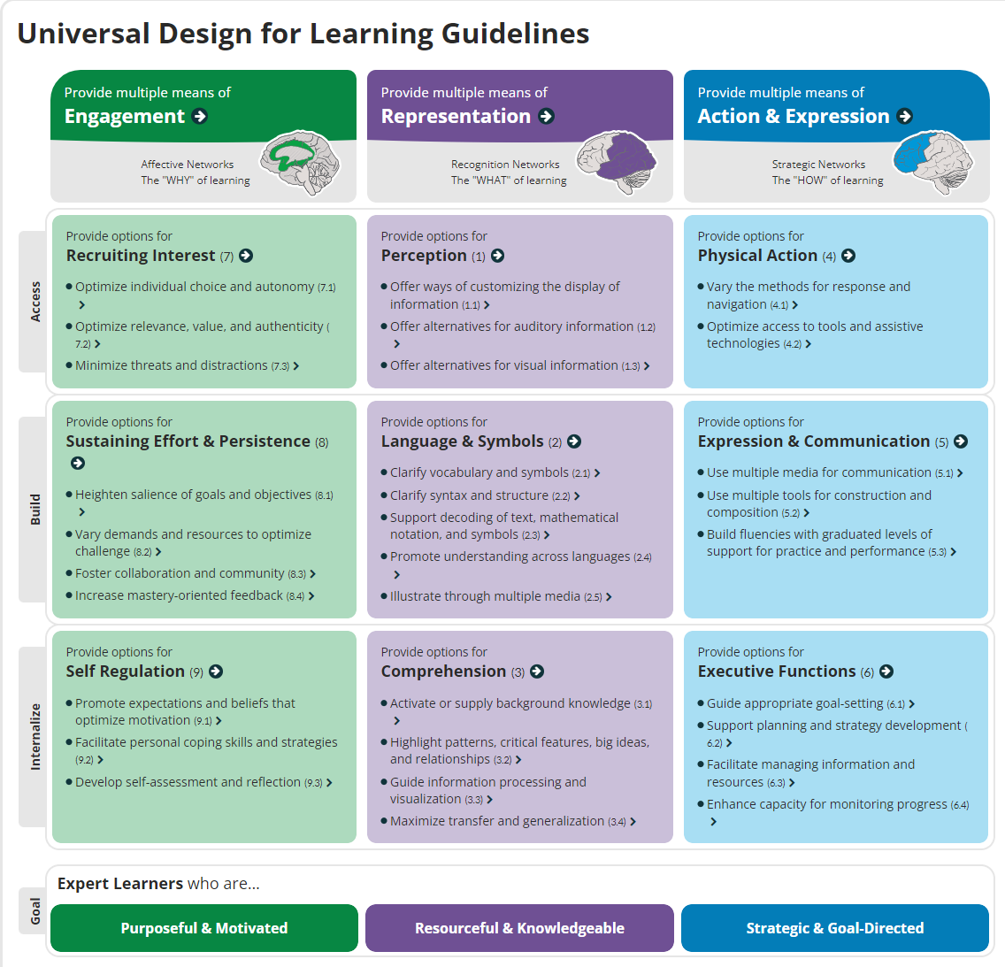
Notes:
CAST (2018). Universal Design for Learning Guidelines version 2.2. Retrieved from http://udlguidelines.cast.org

Slide 44
Personalisation: Creating a unique pathway
Differentiation:
Negotiating the level of challenge
Universal design for learning:
Creating options

Slide 45
Whose ‘voice’ might you and your school need to hear?

Slide 46
References
Australian Curriculum, Assessment and Reporting Authority [ACARA]. (2018). Australian Curriculum: Personal and social capability. Retrieved from https://www.australiancurriculum.edu.au/f-10-curriculum/general-capabilities/personal-and-social-capability/
Berry Street School. (2023). A day in the life of a student. Retrieved from https://www.berrystreetschool.vic.edu.au/student-life/life-of-a-student/student
CAST (2018). Universal Design for Learning Guidelines version 2.2. Retrieved from http://udlguidelines.cast.org
Clear, J. (2018). Atomic Habits: An Easy & Proven Way to Build Good Habits & Break Bad Ones. Avery.
Department of Education, Australian Government. (2020). Australian Student Wellbeing Framework. Retrieved from https://studentwellbeinghub.edu.au/educators/framework/
Department of Education and Training, Victoria. (2019a). Amplify: Empowering students through voice, agency, and leadership. Retrieved from https://www.education.vic.gov.au/Documents/school/teachers/teachingresources/practice/Amplify.pdf
Department of Social Services, Commonwealth of Australia. (2021). Safe and supported: The national framework for protecting Australia’s children. Retrieved from https://www.homeaffairs.gov.au/reports-and-pubs/files/child-safeguarding-framework.pdf
Fisk, S. (2023). Data-informed learners: Involving students in their data story. Amba Press.
Gagne, F. (2014). Building gifts into talents: Brief overview of the DMGT 2.0. Retrieved from https://australiangiftedsupport.com/ccmword/wp-content/uploads/2014/12/Gagne_DMGT_Model.pdf
Graham, D. (2003). Teaching redemptively: Bringing grace and truth into your classroom. Purposeful Design Publications.
Graham, D. (2023). Teaching redemptively: Bringing grace and truth into your classroom (3rd edition). Purposeful Design Publications.
Graham, D. (2022). The evolution of teaching redemptively. Christian Teachers Journal, 30(3), 14-16.
Greyling, C. (2019). Convention on the Rights of the Child? It’s Biblical! Retrieved from https://www.wvi.org/stories/faith-and-development/convention-rights-child-its-biblical-1
Hattie, J. (2012). John Hattie’s summary: Know thy impact [video]. Retrieved from https://vimeo.com/41737863
Imes, C. (2023). Being God’s image: Why creation still matters. InterVarsity press.
Independent Schools Tasmania. (2023). Inclusive Education Resources: IST Individual Adjustments and Learning Plan Template. Retrieved from https://independentschools.tas.edu.au/members-hub/resources/inclusive-education-resources. Available on request.

Slide 47
References (continued)
Menzies Foundation. (2023). Menzies Emerging Leaders Program. Retrieved from https://www.menziesfoundation.org.au/2023melpvoice/
Middleton, R. (2005). The liberating image: The Imago Dei in Genesis 1. Brazos Press.
NSW Government. (2023). Strategies for differentiation. Retrieved from https://education.nsw.gov.au/teaching-and-learning/professional-learning/teacher-quality-and-accreditation/strong-start-great-teachers/refining-practice/differentiating-learning/strategies-for-differentiation
NSW Government. (2023). Student wellbeing: Why student voice matters. Retrieved from https://education.nsw.gov.au/student-wellbeing/student-voices/student-voice-and-leadership/why-student-voice-matters
Rayner, C. (2017). Video Learning Profiles (VLPs): Pilot study report. Tasmanian Department of Education, Professional Learning Institute. Electronic copies available on request.
Smith, D. I. (2009). Learning from the stranger: Christian faith and cultural diversity. Eerdmans.
Tasmanian Catholic Education Office. (2018). Gifted education support package. Retrieved from https://www.tasgifted.com/wp-content/uploads/2018/09/Gifted-education-Support-Package-final.pdf
Tasmanian Department of Education. (2016). Good teaching: Differentiated classroom practice. Retrieved from https://publicdocumentcentre.education.tas.gov.au/library/Shared%20Documents/Good-Teaching-Differentiated-Classroom-Practice-Learning-for-All.pdf
United Nations. (1990). United Nations Convention on the Rights of the Child. Retrieved from https://www.unicef.org.au/united-nations-convention-on-the-rights-of-the-child
Wright, N. T. (2008). Surprised by hope: Rethinking heaven, the resurrection, and the mission of the church. HarperOne.
Wright, N. T. (2015). Excursus on Paul’s use of Adam. In J.H. Walton, The lost world of Adam and Eve: Genesis 2-3 and the human origins debate. IVP Academic. Retrieved from https://zoboko.com/text/9o0ejlnq/the-lost-world-of-adam-and-eve-genesis-2-3-and-the-human-origins-debate/55
Youth Coalition of the Australian Capital Territory (2023). Ask us: Student voice in the ACT. Retrieved from https://www.education.act.gov.au/__data/assets/pdf_file/0009/1251981/Student-Voice-Resource-Kit-Web.pdf

