Slide 1

If you want to improve Wellbeing, fix your culture first.

Slide 2

Richard Chapman
Principal of Star of the Sea Catholic College
George Town

Slide 3
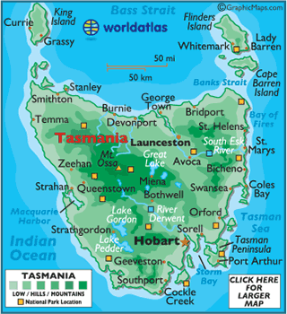

Slide 4
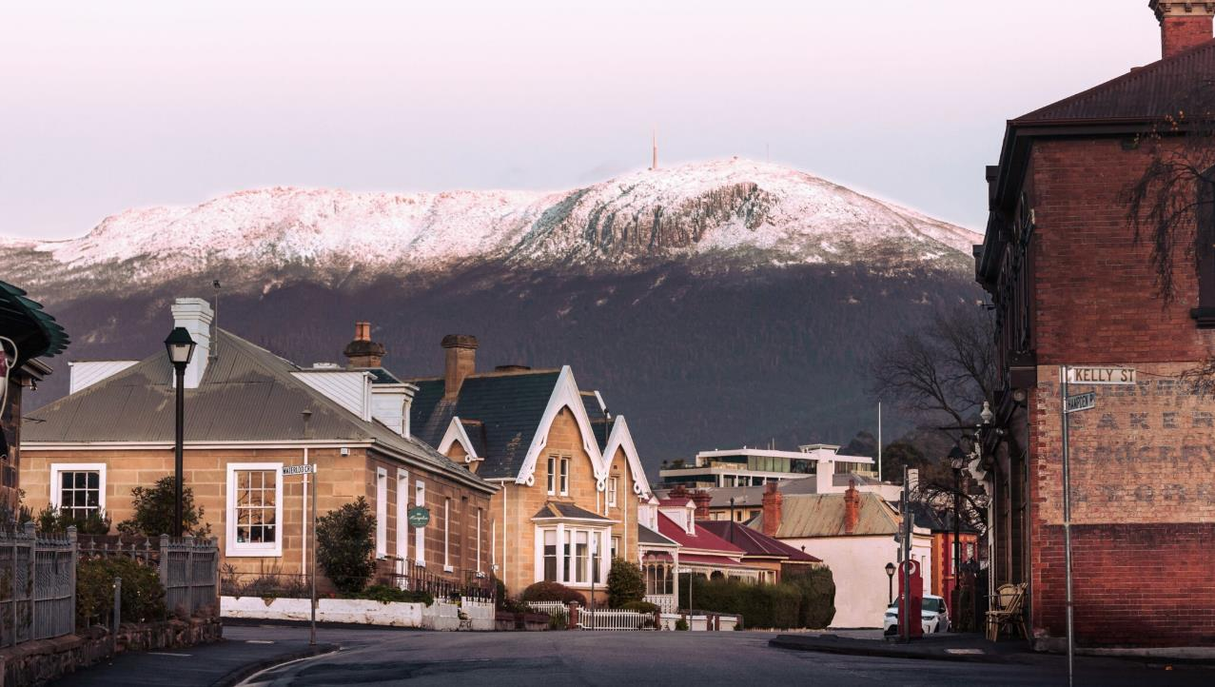

Slide 5
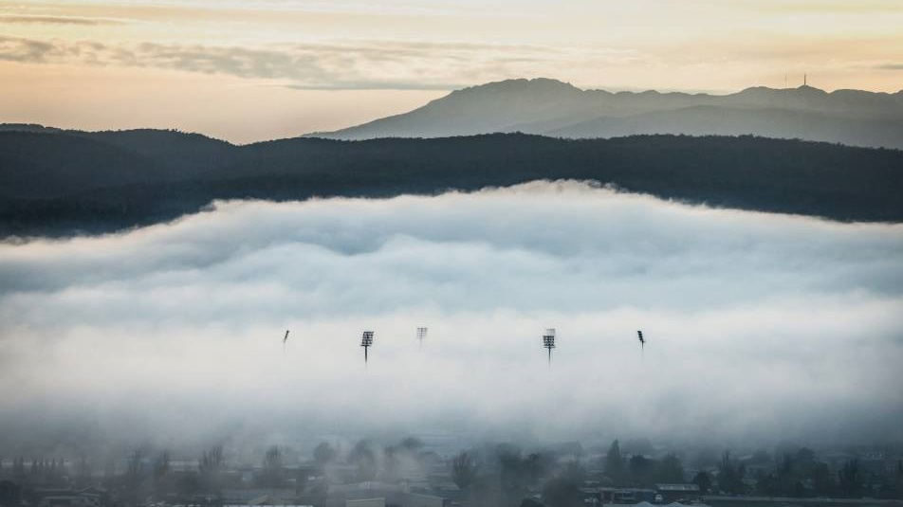

Slide 6
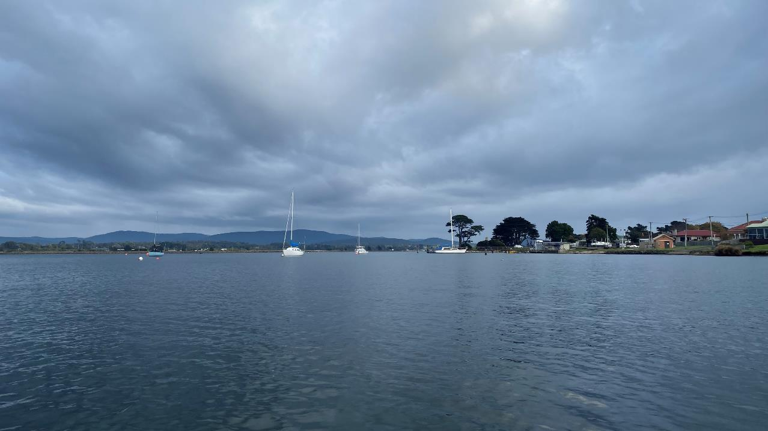

Slide 7
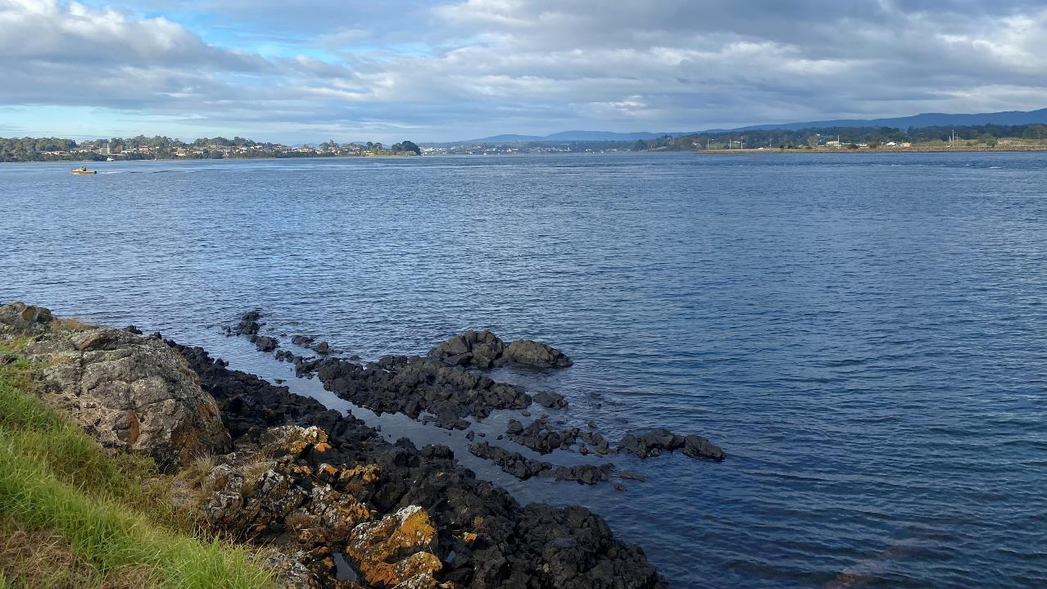

Slide 8
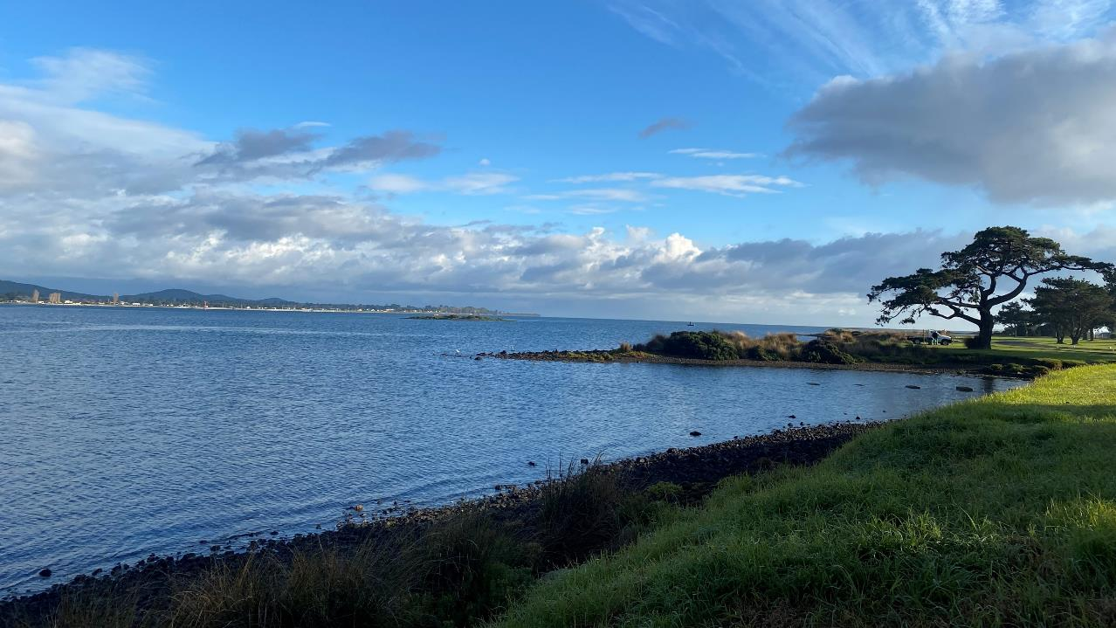

Slide 9
The Grand Chancellor is located on the traditional lands of the Muwinina people of the South East Nation who lived with and cared for this land for many generations, and who are no longer here due to the impact of colonisation and invasion.
We acknowledge and respect the Palawa people, and the deep connection that Tasmanian Aboriginal people have to Country and Culture. We acknowledge and respect the Tasmanian Aboriginal Community and pay our respect to Elders past and present.
We are committed to learning as a part of this community, and to supporting the continued sharing of knowledge and Culture.

Slide 10

What are we doing today?
We will:
Talk about the positives and negatives of wellbeing programs
Talk about how our school culture can have positive and negative effects on individual wellbeing
Talk about what Nano Nagle tells us about wellbeing

Slide 11
I’m not here to tell people that what they are doing is wrong. I’m here to invite you to reflect.

Slide 12
You don’t have to agree with anything that I say.

Slide 13
Find someone who you have never met before and sit next to them.

Slide 14
Introduce yourself.
What school are you from?
How long did it take to get here?
Where were you born?
Where do you come in your family?
If you gave a TED talk, what would it be about?

Slide 15
What do you, or what would your school, say WELLBEING means?

Slide 16
Wellbeing encompasses quality of life and the ability of people and societies to contribute to the world with a sense of meaning and purpose.
- World Health Organisation

Slide 17
Does your school have any wellbeing programs?
What are they?

Slide 18
Star of the Sea Catholic College

Slide 19
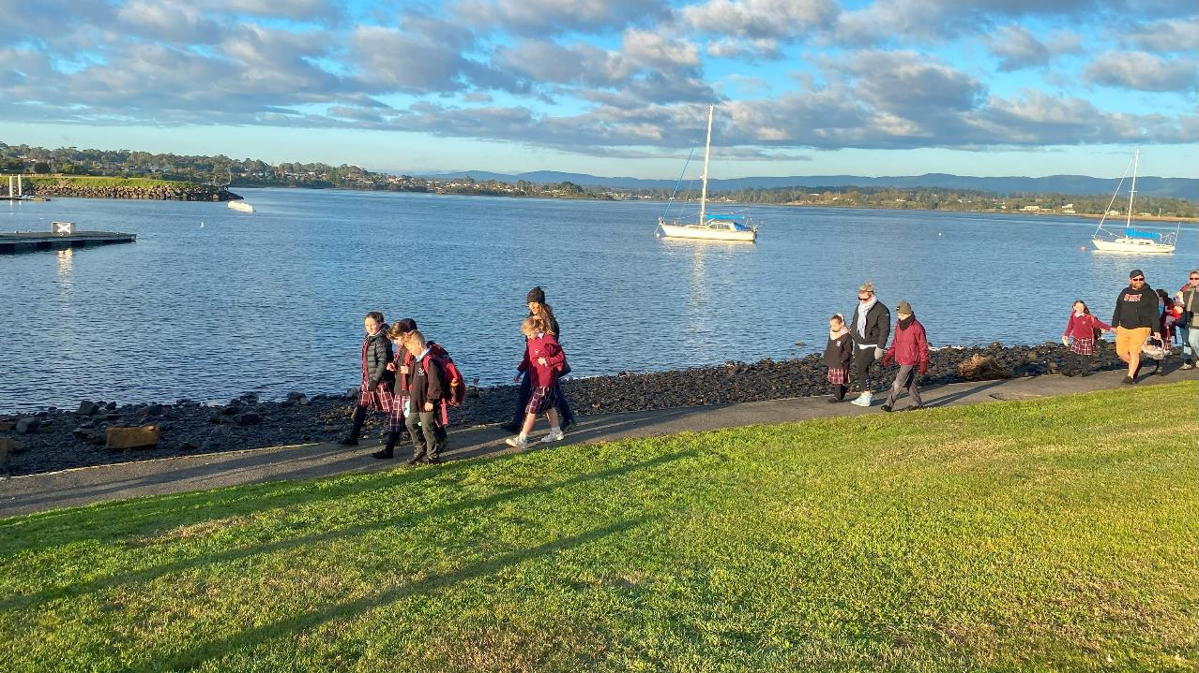

Slide 20
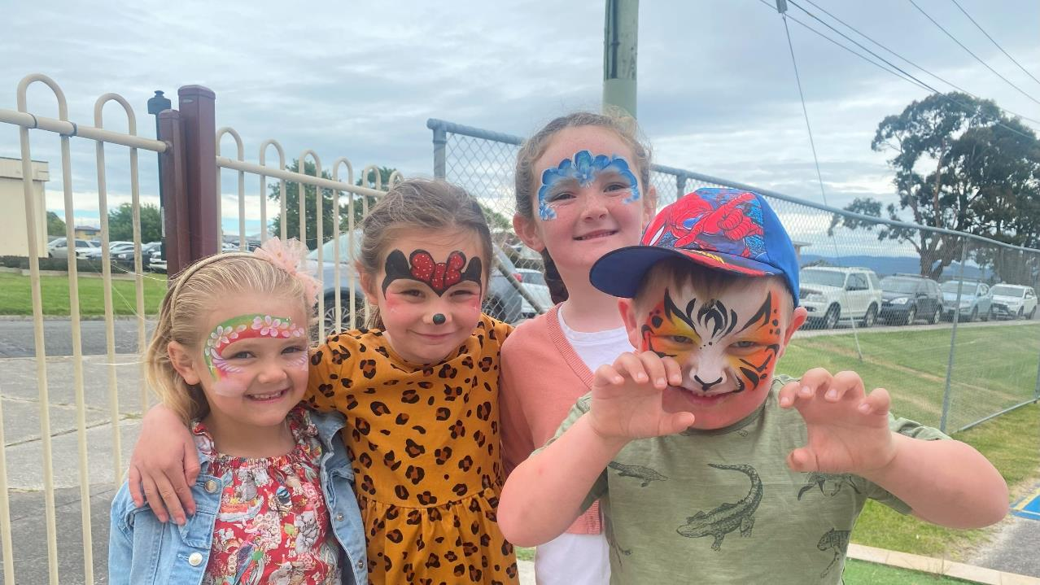

Slide 21
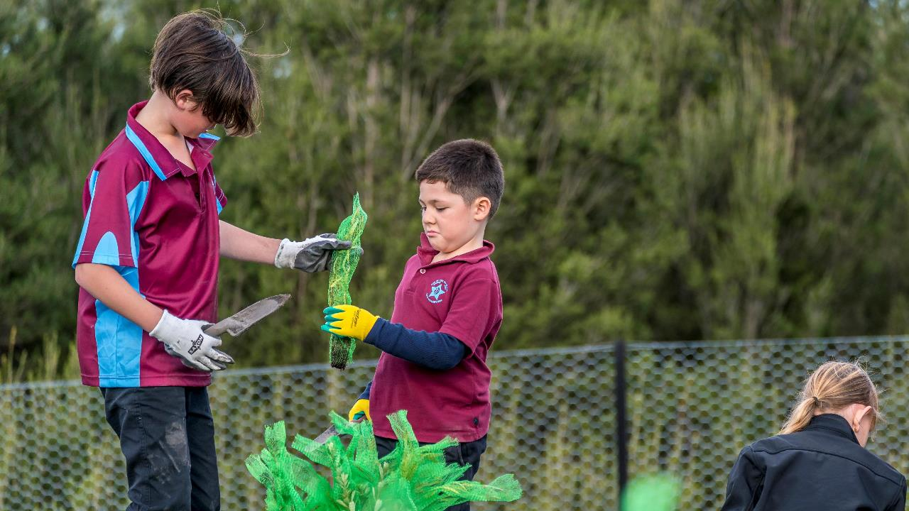

Slide 22
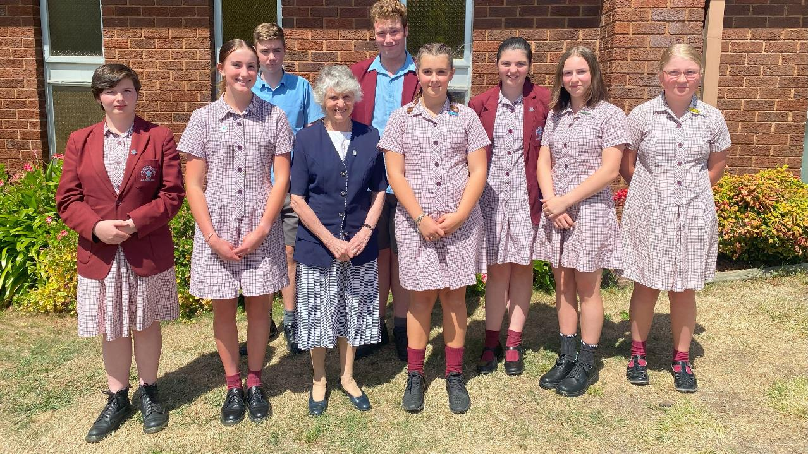

Slide 23

Index of Community Socio-Educational Advantage (ICSEA)
Average score is 1000

Slide 24
1012
1125
1052
951
1137
1146
1063

Slide 25
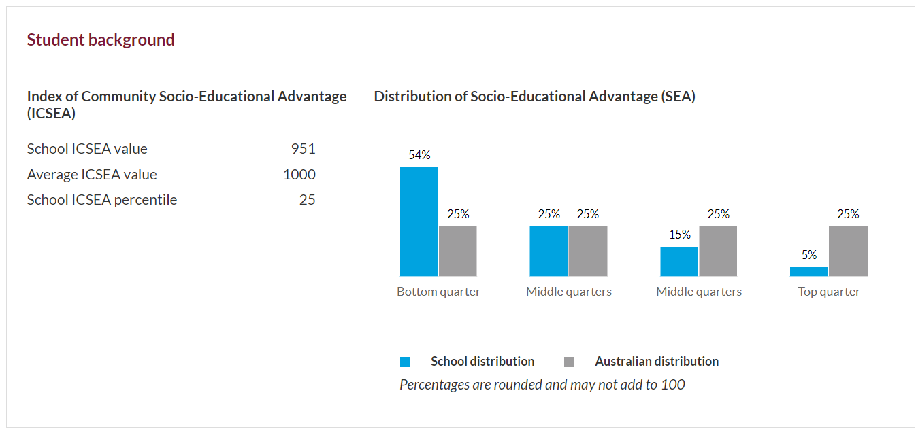

Slide 26
We are there to serve George Town.

Slide 27
Our Wellbeing Programs

Slide 29
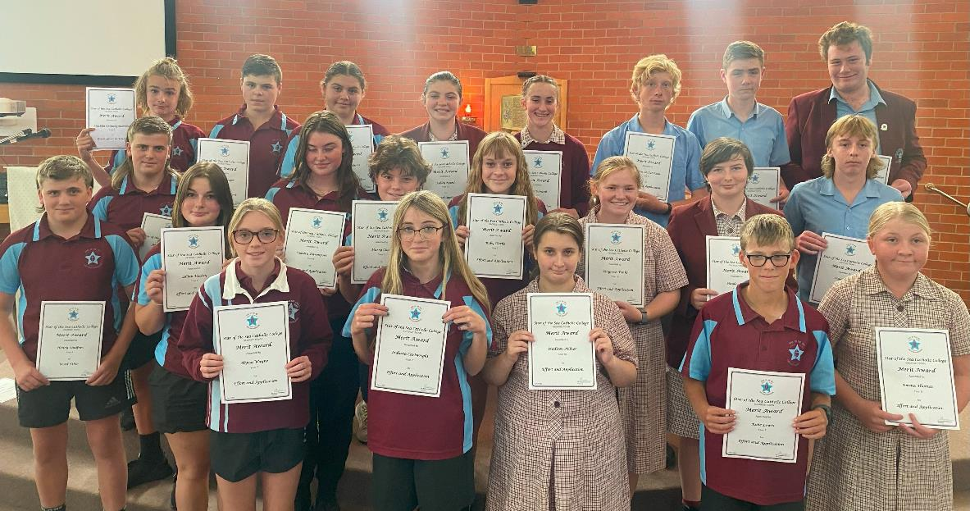

Slide 30
Helping (judging people as having lesser strength) vs
Fixing (judging people as broken) vs
Serving (seeing people as whole)

Slide 31
The difficulties with wellbeing programs.

Slide 32
Not everyone is a wellbeing teacher…and not every teacher has great wellbeing.
Teacher turnover disrupts consistent messaging.
Quality of programs varies, as does how they treat the students.
Programs can be focused on the intellect.
Measuring their effectiveness can be a minefield.

Slide 33
Does running a Breakfast Club at school change students’ wellbeing in any way? And how would you know?
Does running a 10-week program focused on strategies to improve mental health actually improve mental health of the students? Or do those who already have strong mental health benefit the most – i.e., the rich get richer, and the poor get poorer?
Can you really teach someone to have gratitude? Or does it come with life experience?

Slide 34

Talk with your partner.
Are your wellbeing programs actually effective? How do you know?

Slide 35
School Culture and Wellbeing

Slide 36
Is the culture we promote in our school helping or harming wellbeing?

Slide 37
Fr Richard Rohr, OFM
Non-duality

Slide 38


Slide 39


Slide 40
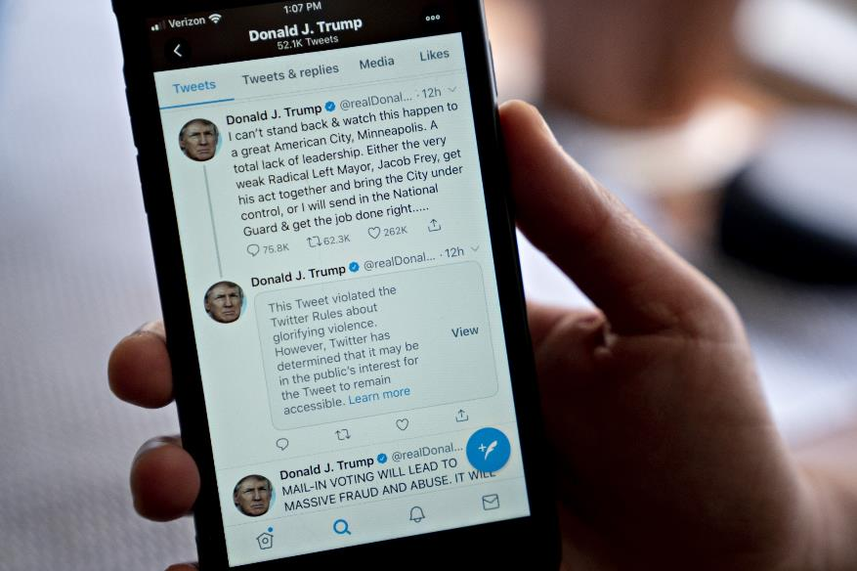

Slide 41


Slide 42
Is the culture we promote in our school helping or harming wellbeing?

Slide 43
Can each of your students answer yes to these questions:
Do I belong here?
Am I known here?
Can I be successful here?

Slide 44
Can we think about the following in a non-dualistic way?
Can we sit with the tension?

Slide 45

School Uniforms
…can provide a great sense of belonging
…but not when the emphasis is on the image of the school rather than being part of something bigger

Slide 46

School Sport
…can provide a great sense of belonging as well as a chance for physical activity
…but not when the emphasis is on winning so the school looks good

Slide 47

Student Leadership Positions
…can provide a great sense of meaning and purpose and a chance to make a difference
…but not when the role is mainly about wearing a badge, doing what teachers tell you and giving a nice speech here and there

Slide 48
Extra-curricular activities
…can provide a great sense of belonging when forming a group with like-minded students
…but not when the emphasis is on performance rather than enjoyment

Slide 49
Power with students
…can provide a great sense of purpose and belonging as well as students knowing that they are heard
Power over students
…gives the students a sense that they have no voice, and the school is only there for the image of the school, and not for the students

Slide 51
Does my school have the balance right?
What are the messages (either explicit or subtly) that we give to our students?

Slide 52
Can each of your students answer yes to these questions:
Do I belong here?
Am I known here?
Can I be successful here?

Slide 53
Schools can create environments which are harmful to student wellbeing.
The schools recognise students have poor wellbeing, so put in wellbeing programs with the idea of fixing it.
But the wellbeing program becomes just another thing we have to do, increasing the workload and messages of staff and students, which is not good for their wellbeing.
So we put in another wellbeing program to fix this…

Slide 54
Instead of automatically looking for a wellbeing program as our first step, maybe we need to ask if our current school climate and culture is helping or harming the wellbeing of students and staff.

Slide 55
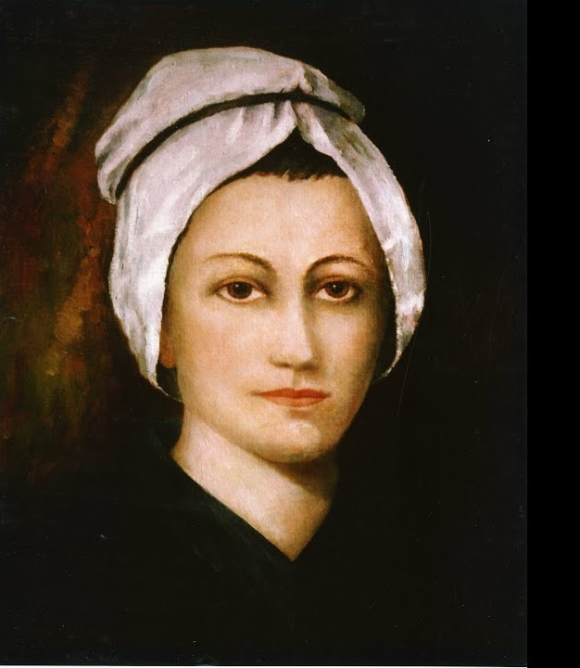
Nano Nagle and Wellbeing

Slide 56
If Nano Nagle was your school’s Head of Wellbeing, what would she put into place?

Slide 57

We wouldn’t ask her to lead by example!

Slide 58
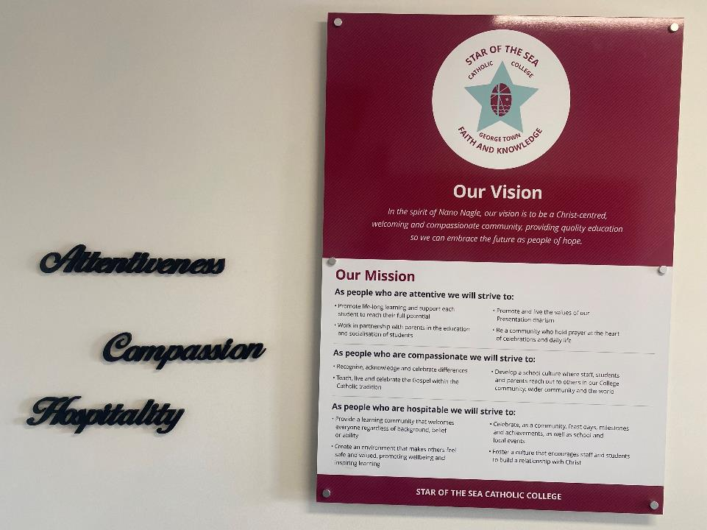

Slide 59
Attentiveness
Hospitality
Compassion

Slide 60
Attentive
to God
to ourselves
to the needs of others

Slide 61
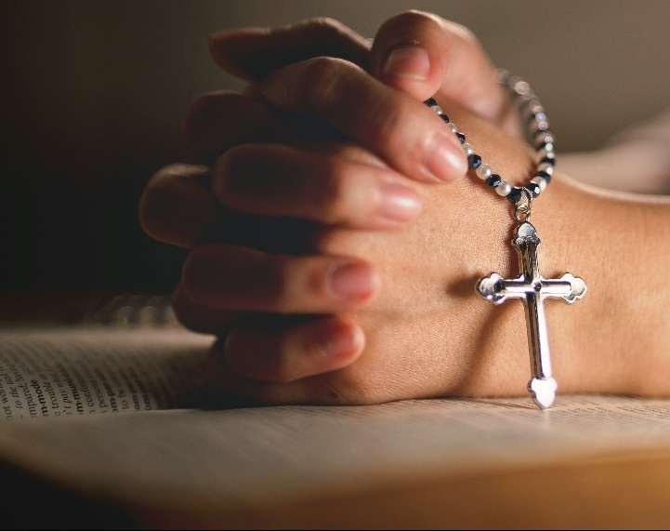
Am I Attentive to God?
Praying the Hail Mary
5.5 seconds in, 5.5 seconds out.
James Nestor, Breath.

Slide 62
Am I Attentive to Myself?

Slide 63
Unhealthy attachments
What time do I leave school…and why?
What notifications do I have on my phone…and why?
How involved do I get with my students…and why?
Do you identify yourself with your job, or with how God identifies you?
Do I trust in God enough to get on board for the journey, or am I trying to control the journey?

Slide 64
Am I attentive to the needs of others?

Slide 65
Hospitable
- towards all who seek shelter

Slide 66
Compassionate
share in the suffering of others
be with them on the journey

Slide 67
The Story of Laila

Slide 68
Do you need to “fix” your culture?

Slide 69
What did you get out of today?

Slide 70
A Blessing for Each Other

Slide 71
May you have warm words on a cold evening,
A full moon on a dark night,
And the road downhill all the way to your door.

Slide 72
May every hair on your head turn into a candle
To light your way to heaven.
And may God and his Holy Mother
Take the harm of the years away from you.

Slide 73
And…may you have no frost on your spuds,
No worms on your cabbage,
May your goat give plenty of milk,
And if you should buy a donkey,
Please, God, she be pregnant.

Slide 74
Comments.

Slide 75
Thank you.
And try not to read the words on this slide.

