Slide 1

Nagle Education Alliance of Australia (NEAA)
Annual General Meeting – Wednesday 3 March 2021

Slide 2
Prayer NEAA - AGM
Dear God I come to you for strength—strength of body, strength of mind and strength of soul. I feel the infilling of your Spirit. I feel the assurance of your upholding presence.
All: Thank you, God, for strength.
Dear God I come to you for wisdom—wisdom to know what I should do, wisdom to choose the course that means growth and understanding.
All: Thank you, God, for wisdom.
Dear God I come to you for courage—courage to face every experience, courage to stand strong and firm in the midst of situations that require much of me.
All: Thank you, God, for courage.
Dear God I come to you for serenity—serenity of heart and spirit. Bless me with your untroubled Spirit of peace. I feel your calming touch upon my heart. I feel your love enfolding me.
All: Thank You, God, for serenity.

Slide 3
AGM - AGENDA
Welcome and Prayer – Dale Morrow
Apologies –
Minutes of AGM Saturday 14 March 2020 (sent previously)
Annual Report –Executive Officer: Louise Gunther and Dale Morrow – President
Financial Report
Election of Committee
Annual Subscription
Virtual Staff Conference May 7, 2021
AOB – new website

Slide 4
Nagle Education Alliance of Australia (NEAA)
2020 a Year in Review

Slide 5

NEAA - 2020
The Nagle Education Alliance of Australia (NEAA) is an organisation of schools committed to the Presentation charism and the legacy of Nano Nagle. It developed from an earlier, smaller grouping of schools and, with expanded membership, was launched and incorporated in 2014.
The NEAA believes that the Presentation charism has lasting value. The continued relevance of the Nano Nagle story is an inspiration for Presentation People to make a difference in their world and in the way we live the Gospel.

Slide 6
NEAA 2020
Vision
• The Nagle Education Alliance of Australia is committed to perpetuating the legacy of Nano Nagle in Australian education. The NEAA provides leadership to school communities across Australia in their endeavour to identify with, express and live out the Presentation charism and mission by sharing resources and experiences.
Mission
• Bringing Australian Presentation People together through education and social justice. • The NEAA works in collaboration with the Society of Australian Congregation of the Presentation of the Blessed Virgin Mary and the Presentation Sisters who form the Society's membership.

Slide 7
Executive Committee 2020
Dale Morrow – President
Delma Horan
Catherine Dunbar
Valerie Thomas
Vivienne Awad
Susan Miller
Filina Virgato
Brigid Knight
Ray Rose
Executive Officer – Louise Gunther

Slide 8
Executive Officer / President Report
• As a member-based organisation, our members (schools and Presentation communities) remain our core focus. Since the decision by the National Presentation Principals Group (NPPG) to dissolve and form the new entity the Nagle Education Alliance of Australia (NEAA), the direction and growth of the NEAA has continued in a positive manner.

Slide 9
Executive Officer / President Report (Cont.)
2020 was a year unlike any other experienced in recent history
As a member-based not-for-profit organisation, we faced a set of highly unique circumstances in 2020 as a result of the COVID-19 pandemic.
Specifically, we were forced to postpone both our pilgrimage to Ireland and our student conference that was to be hosted by Mater Dei, Wagga Wagga as well as some professional development for staff in schools
Like everyone we made some adjustments and set about connecting via Zoom

Slide 10
Executive Officer / President Report (Cont.)
Events of 2020 -
Prior to the lockdown we held a Spirituality Leadership Forum in Perth on 13 & 14 March. Our two speakers: Professor Anne Tuohy and Dr Michelle Jones spoke on Presentation Charism and the Simplicity of Nano Nagle. We were grateful to BBI (The Australian Institute of Theological Education) for their support of our speakers.
Principal’s Zoom meeting
Senior student leader’s forum
Term newsletters and other relevant news and updates share via email or social media

Slide 11
Executive Officer / President Report (Cont.)
We wish to thank the following executive committee members who have finished their time on the executive committee:
Catherine Dunbar – St Ursula’s College, Yeppoon, QLD
Vivienne Awad – Domremy College, Five Dock, NSW
Filina Virgato – Presentation College Windsor, VIC

Slide 12
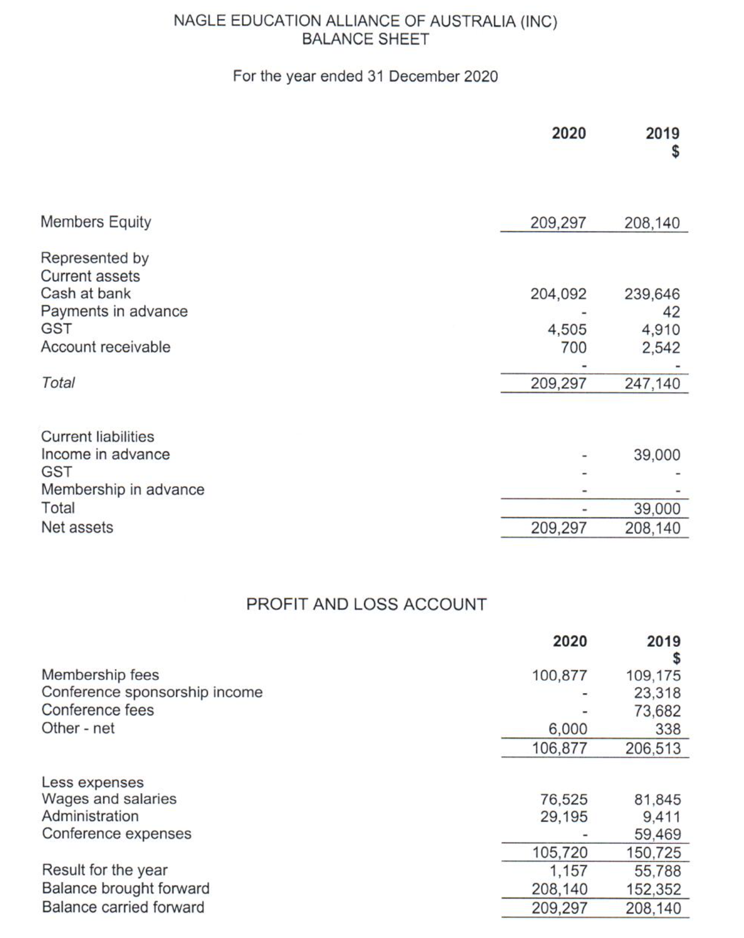

Slide 13
Election of Committee members
Continuing executive committee members:
* Dale Morrow, Delma Horan, Valerie Thomas, Susan Miller, Ray Rose, Des Fox
* Helen Spencer will be replacing Brigid Knight for 2021 and we welcome Deborah Ryan – St Ursula's College, Yeppoon, QLD
* Dale Morrow will be stepping down as President and we would like to thank her for her leadership over the past four years.
* Delma Horan will take on the role as President

Slide 14
Annual subscription / Membership fee
The annual subscription / membership fee has remained unchanged for the past five years. Fees are based on student enrolment numbers.
Primary fees - $3.00 + GST per student
Secondary fees - $4.50 + GST - per student (capped at $4500)
Motion: That the annual subscription fees remain at $3.00 (primary) and $4.50 (secondary) for 2022.

Slide 15
Upcoming events:
Wednesday 10 March – Sharing our Stories, hear from a range of staff in our primary and secondary NEAA schools
4:00pm - 5:00pm (VIC, NSW, TAS) 3:00pm - 4:00pm (QLD) 1:00pm - 2:00pm (WA)
Friday 7 May 2021 – Staff Virtual Conference, all day event with keynote speakers and breakout sessions (flyer)
Please support these events and encourage your staff to attend
New NEAA website – please look out notifications

