Slide 1
I thank God, our creator, for the Tasmanian Aboriginal people as the traditional custodians of this land.
I acknowledge and value their rich culture, history and strength. I pay respect to Elders – past, present and future.

Slide 2

crayner@cst.tas.edu.au

Slide 3
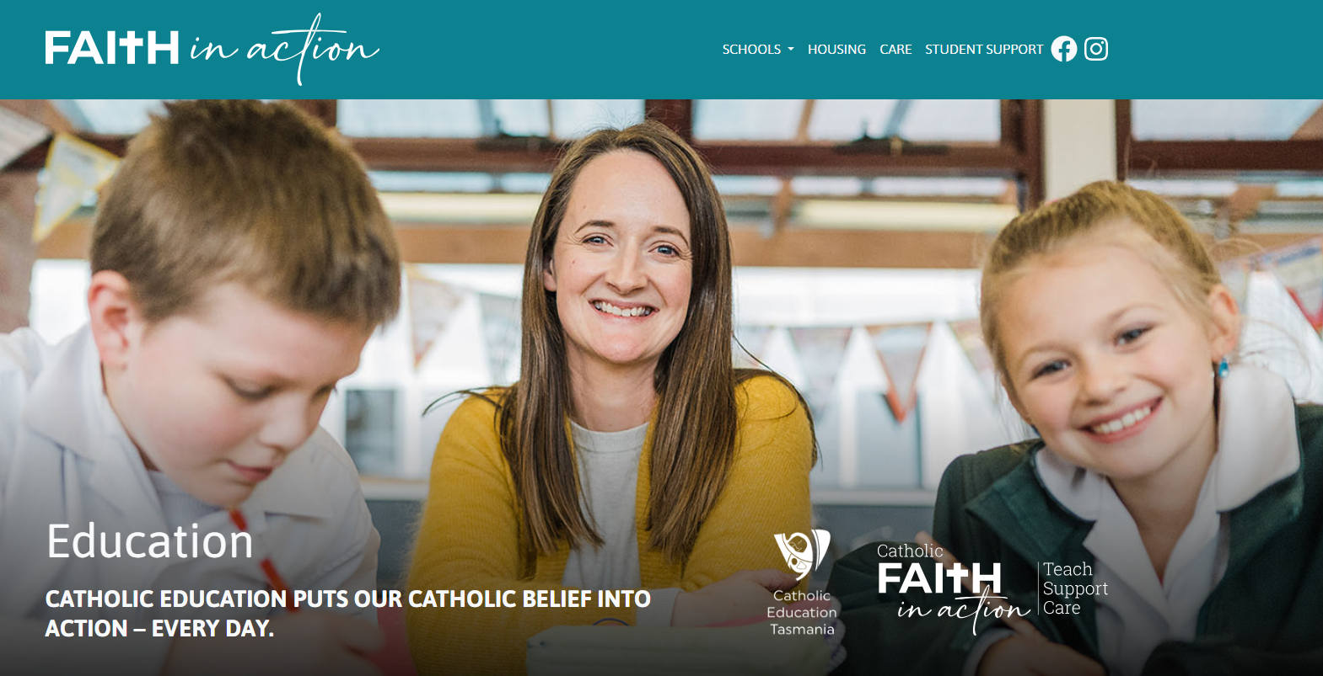

Slide 4
“…I will show you my faith by my works.”
James 2:18b, NKJV

Slide 5

‘The story I’m
telling myself is…’
Brené Brown (2018)
Notes:
Brown, B. (2018). Dare to lead. Penguin Random House.

Slide 6
Identity = ‘storied self’
Tosca Nathan (2022)

Slide 7
Worldview ‘story’ questions
Who am I?
What is my purpose?
What is the problem?
What is the solution?

Slide 8
Exploring the possibilities
What story is our curriculum telling students?
What story is our pedagogy telling students?
What story is the life of the teacher telling students?

Slide 9
What story is the curriculum telling our students?

Slide 10
What story is the curriculum telling our students?

Slide 11
He is the image of the invisible God, the firstborn of all creation: for by Him all things were created, both in the heavens and on earth, visible and invisible, whether thrones, or dominions, or rulers, or authorities—all things have been created through Him and for Him. He is before all things, and in Him all things hold together. He is also the head of the body, the church; and He is the beginning, the firstborn from the dead, so that He Himself will come to have first place in everything. For it was the Father’s good pleasure for all the fullness to dwell in Him, and through Him to reconcile all things to Himself, whether things on earth or things in heaven, having made peace through the blood of His cross.
Colossians 1:15-20

Slide 12


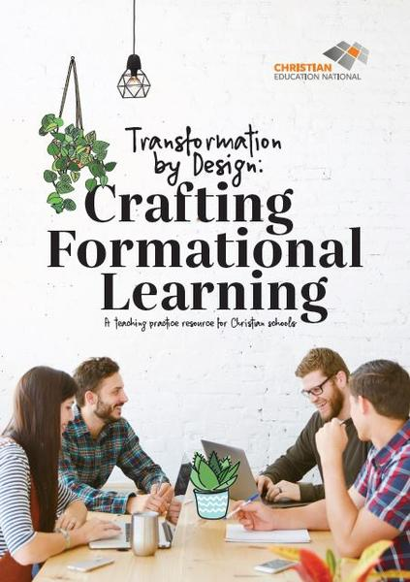

Slide 13

Overview
A TRACK TO FOLLOW
Overall task and purpose of Christian education
A BIG PICTURE MODEL
A model for developing a biblical perspective
A BIBLICAL PERSPECTIVE
Descriptions, tools, schemas to assist Christian educators
A SELECTION OF THREADS
Exploring faithful response to the biblical worldview
Notes:
Make it clear here that you are unfolding the structure of the book.
Note the sub headings in the slide as descriptions of each of the components.
TRACK Section to be sent as PDF before the visit with the expectation of student engagement
We suggest that the TRACK section is dealt with by the school as a Staff Meeting exercise in preparation for the CCE Design workshop. Laying down foundational understandings are important but we don’t wish to give it too much time within the workshop so that time is maximised around ‘using the model’.

Slide 14

TRACK summary
Transforming vision
Responsive discipleship
All things in Christ
Crafted teaching
Kingdom building
Notes:
Mention that the TRACK summary is also a summary or revision of the foundation laid out in Certificate of Christian Education

Slide 15









Notes:
This resource provides a framework for how to work with any prescribed curriculum. We are not taking curriculum and trying to make it sacred or tack on a Biblical perspective or Christianise it. Instead we shape and design the material, teaching and outcomes with the ‘Biblical threads and Biblical perspectives’ as the key shapers and drivers.

Slide 16
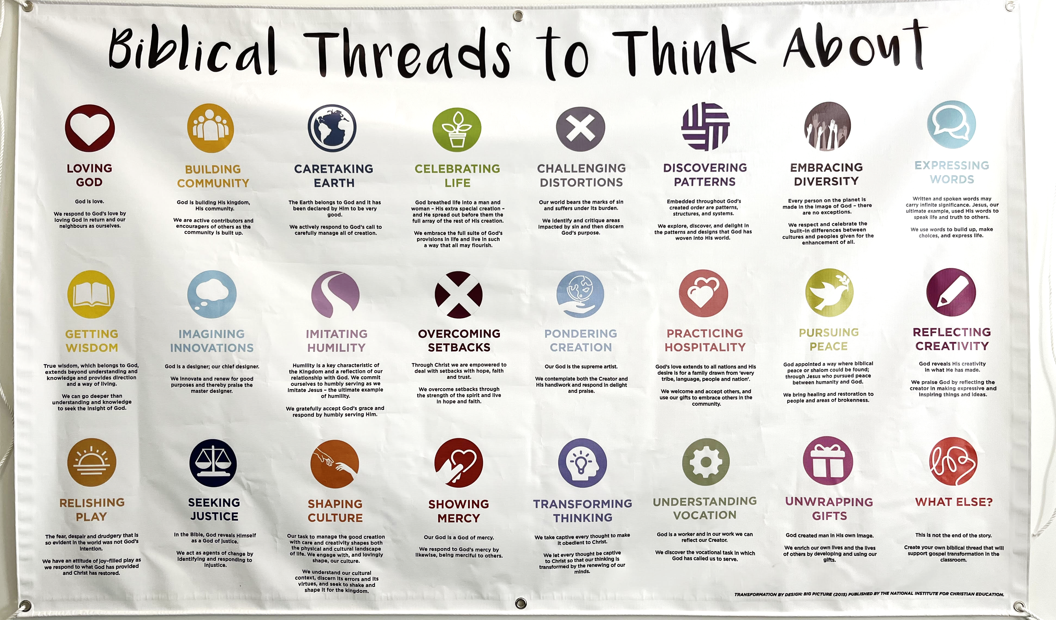

Slide 17



Slide 18

Notes:
https://whatiflearning.com/examples/

Slide 19
What story is the pedagogy telling our students?

Slide 20
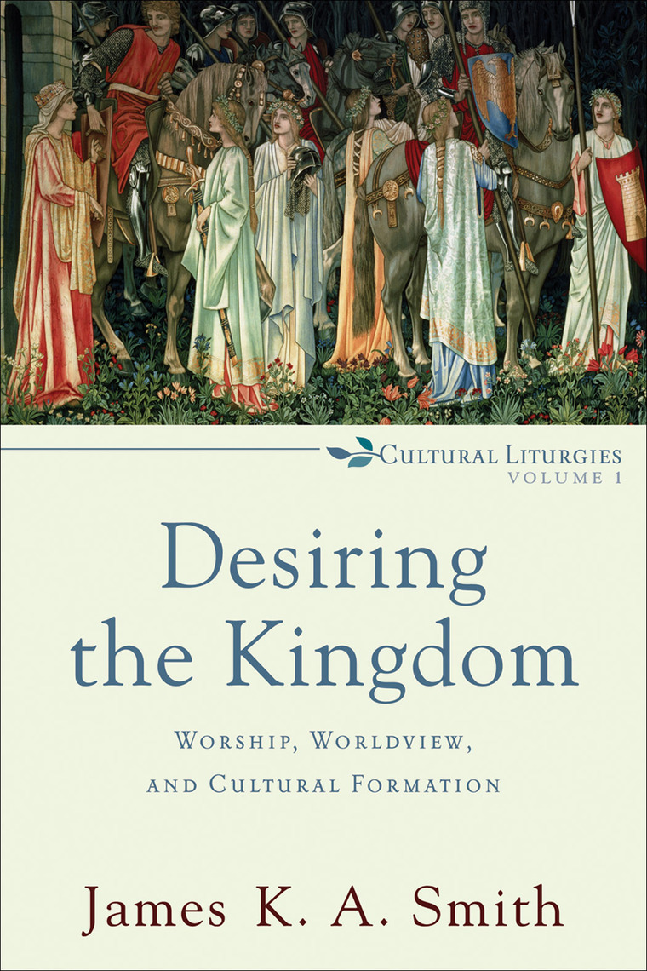
‘‘…how we think about a distinctly Christian education would not be primarily a matter of sorting out which Christian ideas to drop into eager and willing mind-receptacles; rather, it would become a matter of thinking about how a Christian education shapes us, forms us, molds us to be a certain kind of people whose hearts and passions and desires are aimed at the kingdom of God.’
Smith (2009, p. 18)

Slide 21

‘‘When we teach, when we design learning, we offer a temporary home in which students will live for a while, and we shape the patterns of life together within which they will grow. A pedagogy is a home in which teachers and students can live together for a while, a place to which students are welcomed as guests and in which they grow. Like any home, it involves resources for and patterns of interaction, both intended and unintended, that shape how those within it grow and imagine the world.’
David Smith (2018, p. 12)

Slide 22

‘‘Viewing them as image bearers forces teachers to remember that they must treat the students as the free, responsible, creative, rational, moral co-rulers of the creation that God made them to be. It also forces them to realise that apart from the intervention of God through His Word, His Spirit, and His representatives of Christ, those students will inevitably live out that image in ways that do not honour God and that often hurt others. Therefore, as teachers who represent Christ, they enter the students’ lives as incarnations of the truth, not to control students but to nurture, love, and discipline students in their fallenness.’
Donovan Graham (2023, p. 214)

Slide 23
What story is the teacher’s life telling students?

Slide 24
Supervising Teacher of the Year
2018: Tammi Crosswell
(St Fin Barr’s Catholic Primary School)
2019: Therese McDevitt (Dominic College)
2020: Shelley Macleod (St Mary’s College)
& Lynelle Joy Davis (Star of the Sea College)

Slide 25
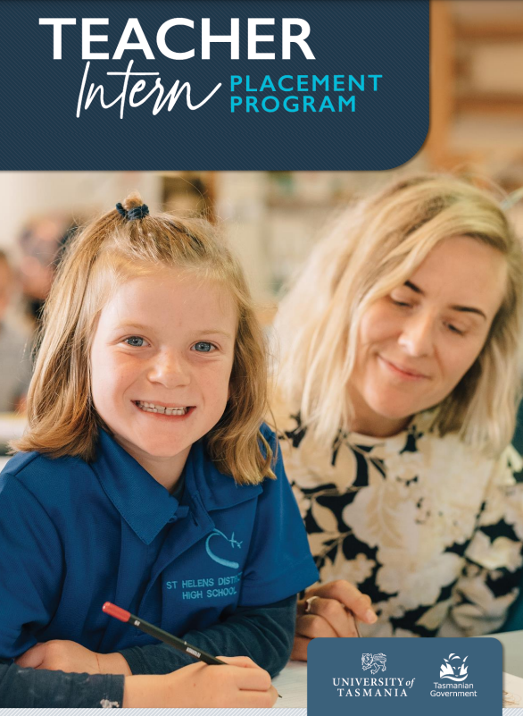
Notes:
https://pli.education.tas.gov.au/wp-content/uploads/2021/08/TIPP-Student-Brochure-PDF-Version.pdf

Slide 26
Discipleship: a ‘system’ for making us like Jesus
Christian teacher as a disciple
Christian teaching as discipleship
Julia Verdouw (2023)
Notes:
Verdouw, J. (2023).

Slide 27

Notes:
https://www.cst.tas.edu.au/teaching-hub

Slide 28
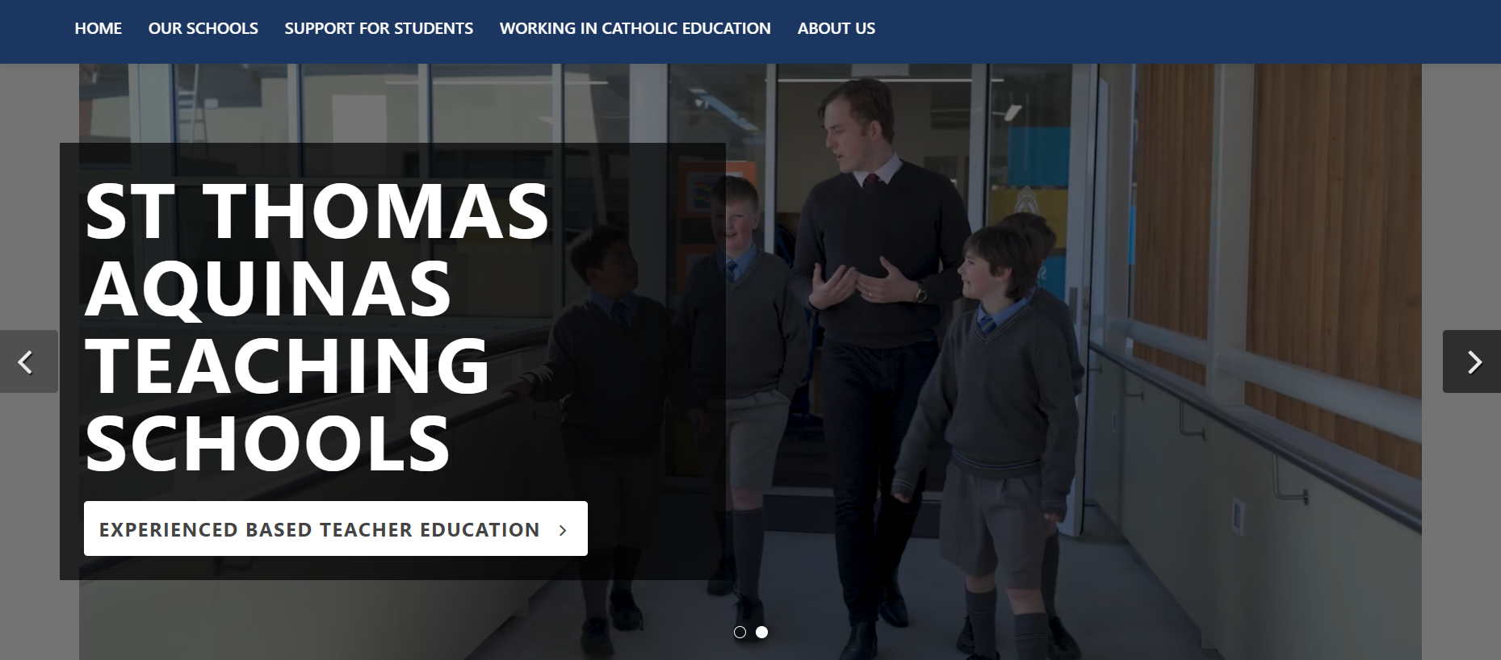
Notes:
https://catholic.tas.edu.au/teaching-schools

Slide 29

Notes:
https://catholic.tas.edu.au/teaching-schools

Slide 30
What (Whose) story will your school tell?
What actions will give expression to your faith?

Slide 31
References
Brown, B. (2018). Dare to lead. Penguin Random House.
Clear, J. (2018). Atomic Habits: An Easy & Proven Way to Build Good Habits & Break Bad Ones. Avery.
Graham, D. (2023). Teaching redemptively: Bringing grace and truth into your classroom (3rd edition). Purposeful Design Publications.
Hanscamp, M., Clarke, D., Mustin, A., & Parker, C. (2019). Transformation by Design: Crafting transformational learning. Christian Education National.
Nathan, T. (August 2022). Identity and Grace. Workshop at the Christian Education National (CEN) Developing Leaders and Learning and Teaching Conference, Gold Coast, Australia.
Smith, D. (2018). On Christian teaching: Practicing faith in the classroom. Eerdmans Publishing.
Smith, J. K. A. (2009). Desiring the kingdom: Worship, worldview, and cultural formation. Grand Rapids, MI. Baker Academic.
Stapleford Centre. (2023). What if learning. Retrieved from https://whatiflearning.com/
Verdouw, J. (July 2023). Transformation by Design Research: Implications for Teachers and Professional Learning in Christian Schools. Tasmanian CEN Conference, Hobart.

