Slide 1

How St Rita’s articulates its pillars
We embed the pillars into both ‘action and words’, so that these values are foundational to our wholistic education to nurture women who make a difference in the world

Slide 2
6 pillars – uphold our decisions and actions
Hospitality
Compassion
Simplicity
Courage
Justice
Hope

Slide 3
An understanding/definition of the pillars is provided in the student planner.

Slide 4
Theme for each pillar
Hospitality People of welcoming heart
Compassion Begin with the heart
Simplicity Travelling lightly
Courage Leading with courage
Justice Living justly
Hope A light to our path

Slide 5
Captains lead student understanding
Terms’ overview & focus
Initiatives = wristbands, rummage, song/dance
Artwork, videos, instagram

Slide 6
Language
Pillars included in the language of restorative justice
Pillars direct ‘Action’ as per our motto
Pillars are foundational to our retreats’ foci & House activities

Slide 7
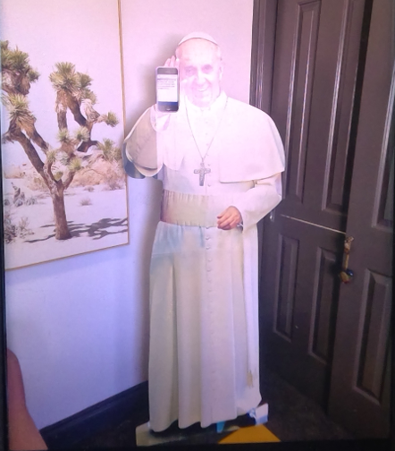
Pope Francis lends support

Slide 8
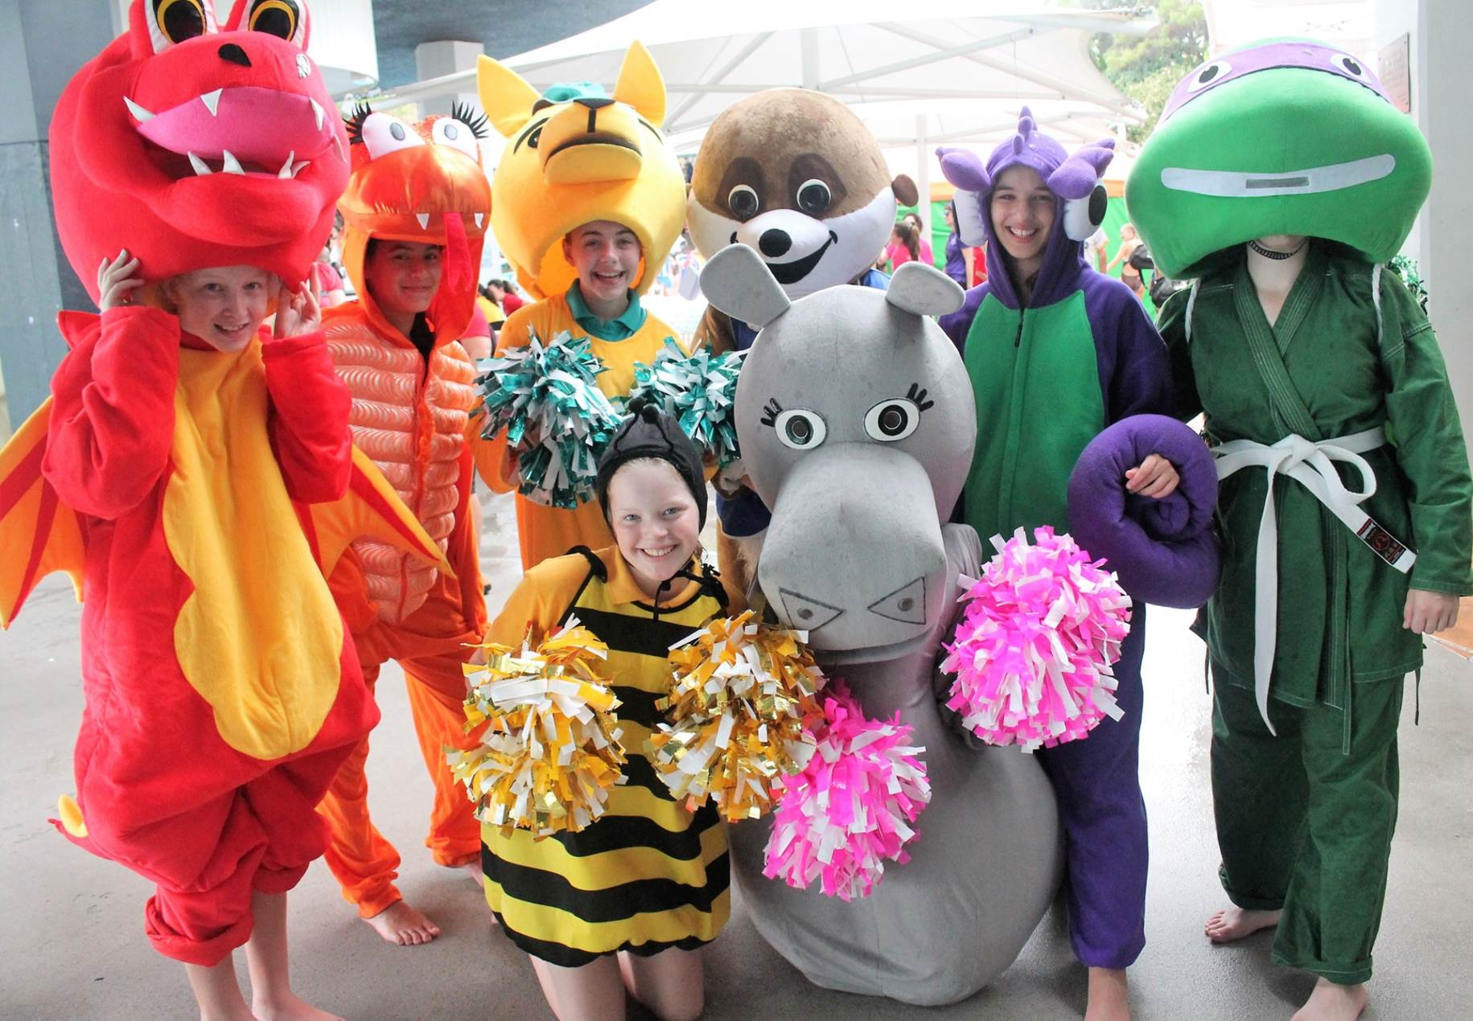
Mascots lend support

