Slide 1
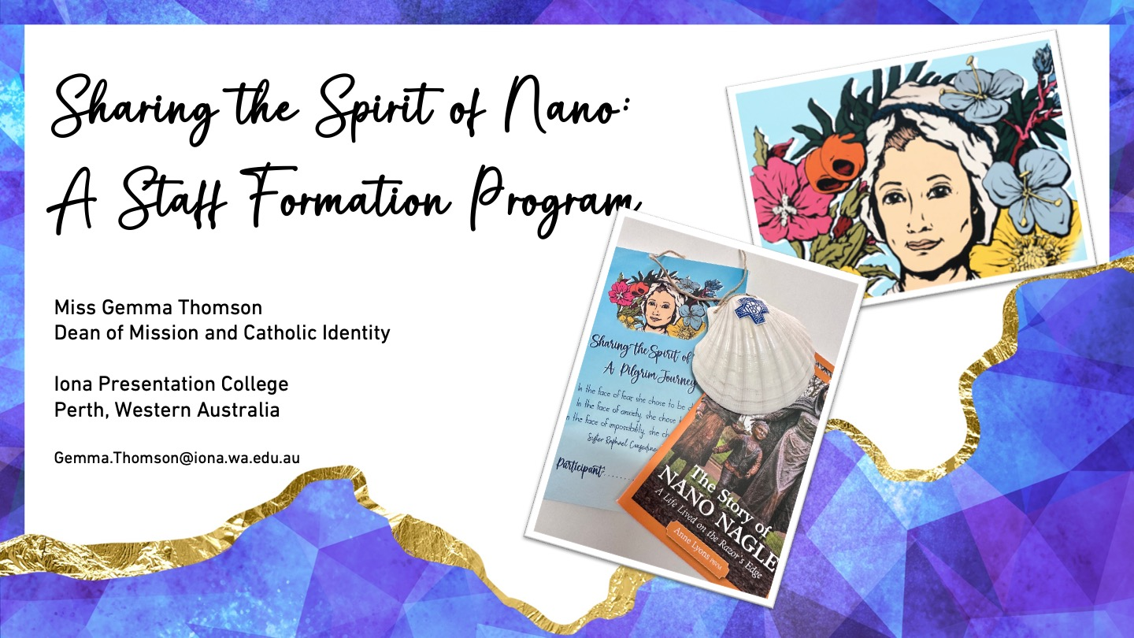

Slide 2


Slide 3
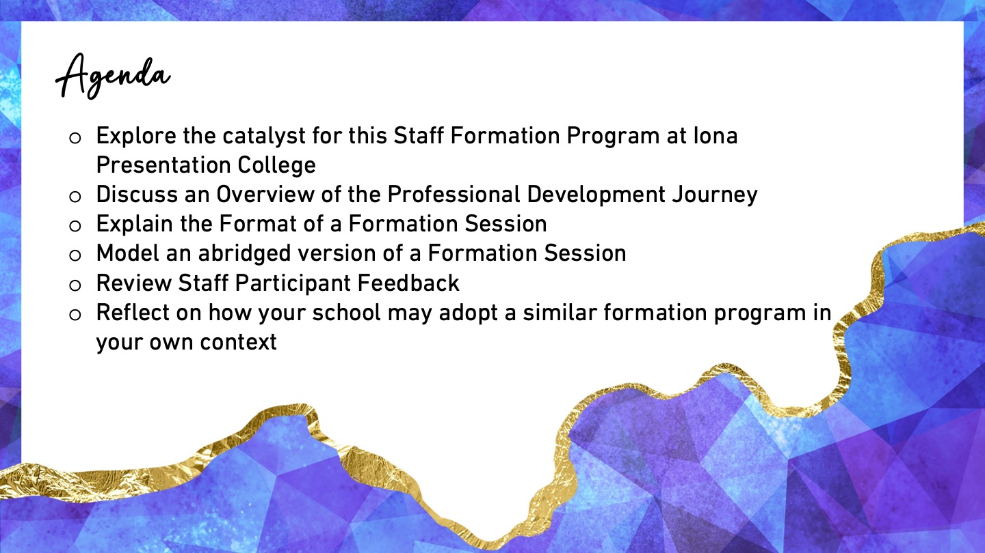

Slide 4
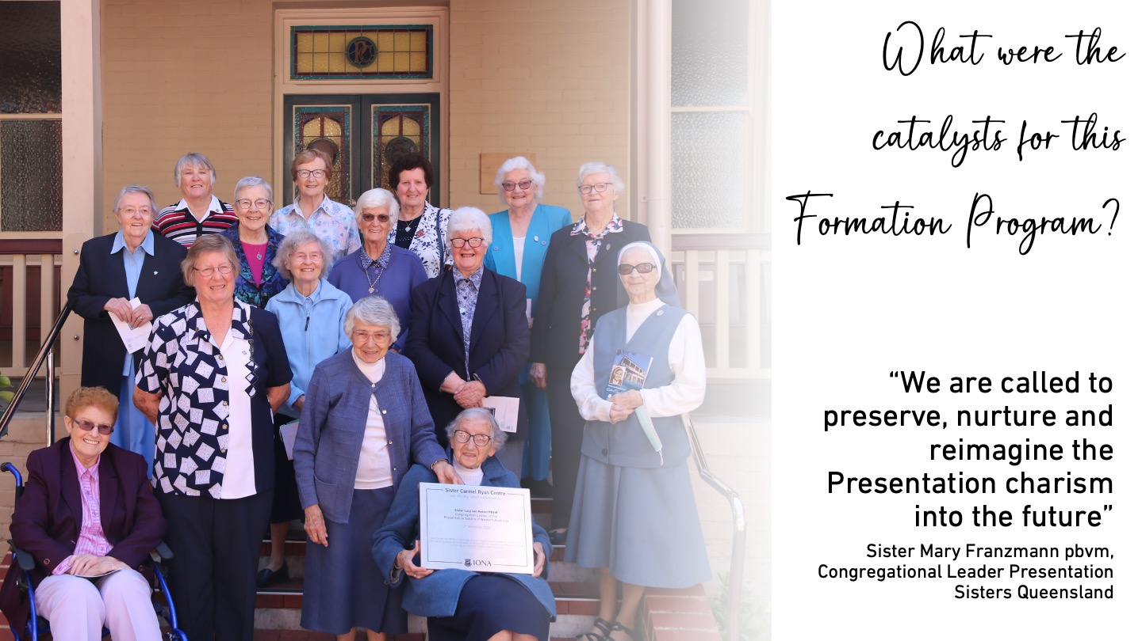

Slide 5
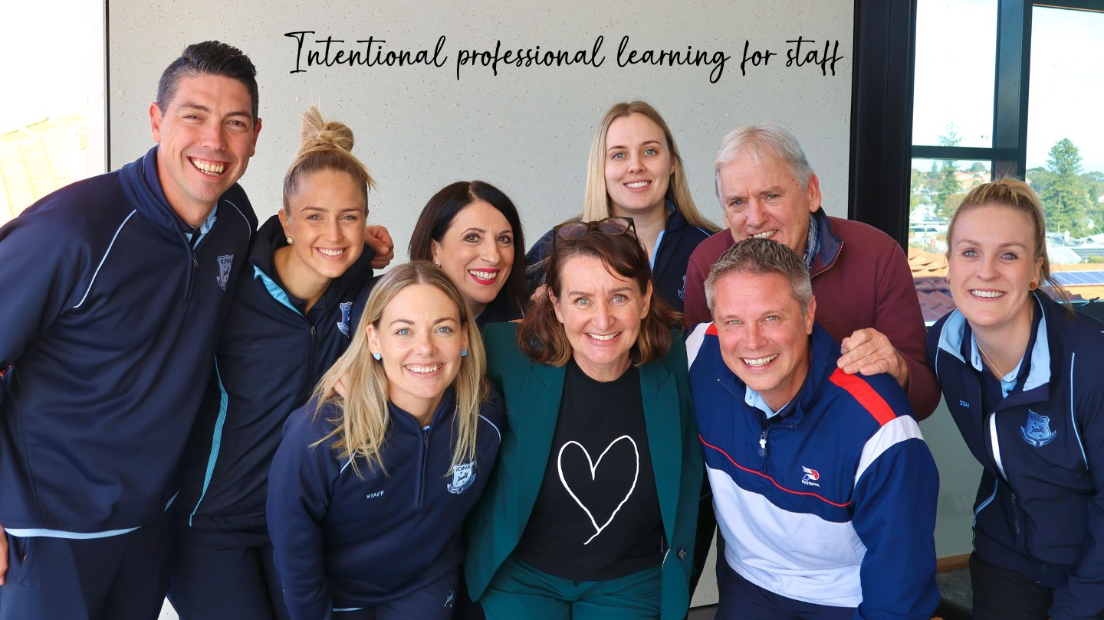

Slide 6
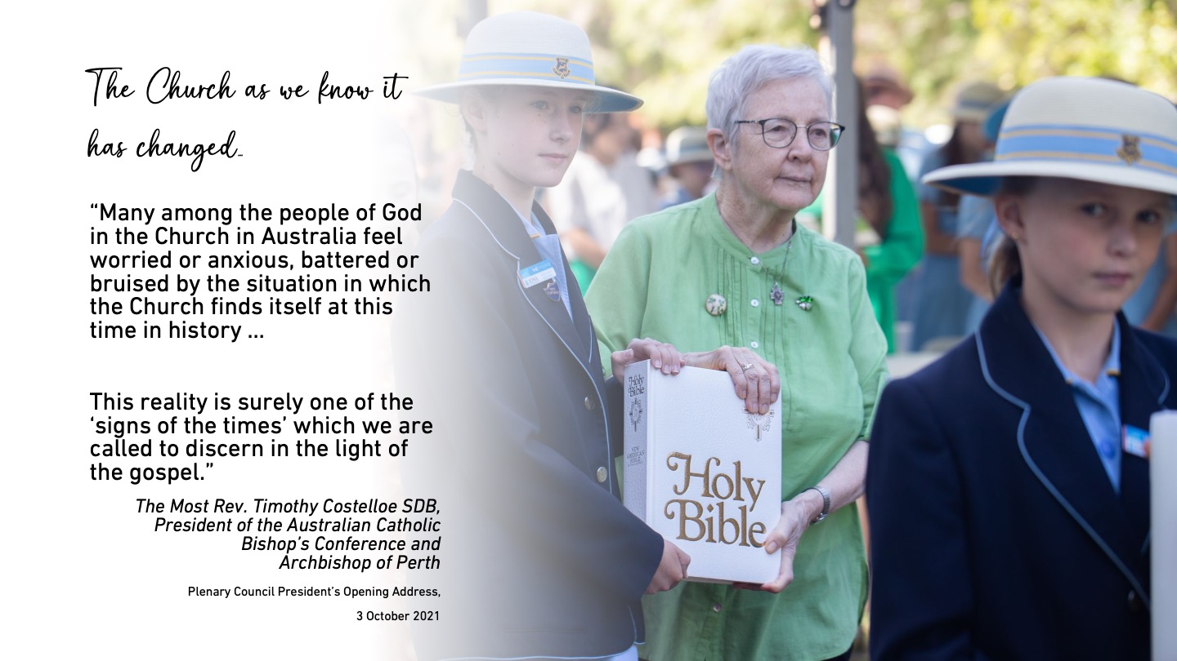

Slide 7

Session 6:
Continuing the Pilgrim Journey |
Presentation People of the Lantern
Session 5:
Continuing the Pilgrim Journey |
Presentation People of Justice
Session 4:
Continuing the Pilgrim Journey |
Presentation People of Compassion
Session 3:
Continuing the Pilgrim Journey |
Presentation People of Vision
Session 2:
Continuing the Pilgrim Journey |
Presentation People of Faith
Session 1:
Commencing the Pilgrim Journey |
The Venerable Nano Nagle Narrative

Slide 8

Will they go “One Step Beyond”? …
Session 11:
Continuing the Pilgrim Journey |
Presentation People of Leadership
Session 10:
Continuing the Pilgrim Journey |
Presentation People of Presence
Session 9:
Continuing the Pilgrim Journey |
Presentation People of Community
Session 8:
Continuing the Pilgrim Journey |
Presentation People of Contemplation
Session 7:
Continuing the Pilgrim Journey |
Fostering a Presentation Culture

Slide 9
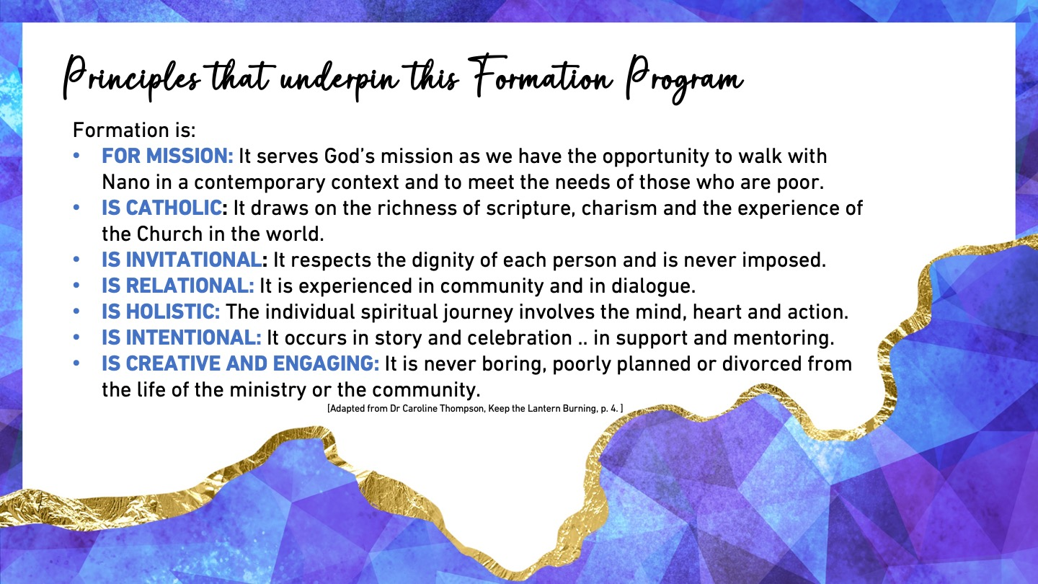

Slide 10
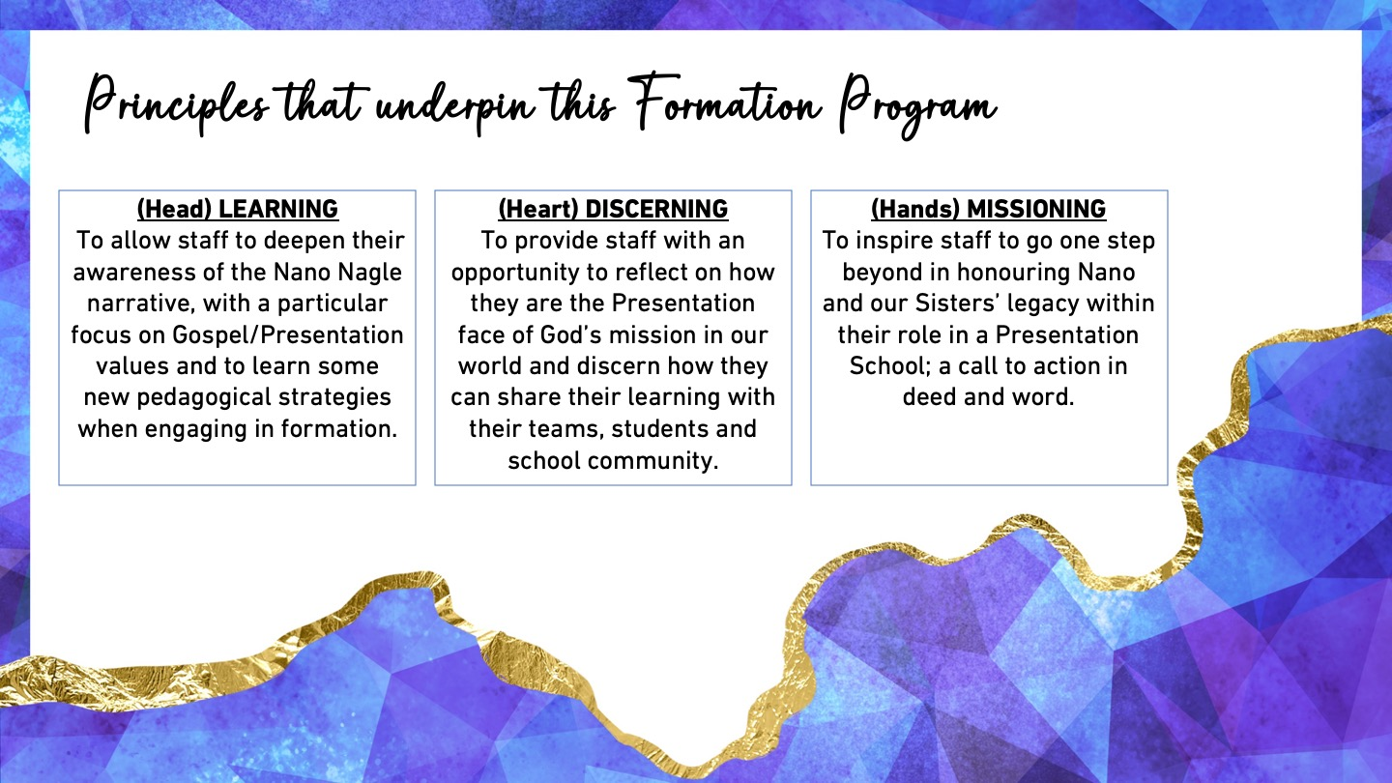

Slide 11
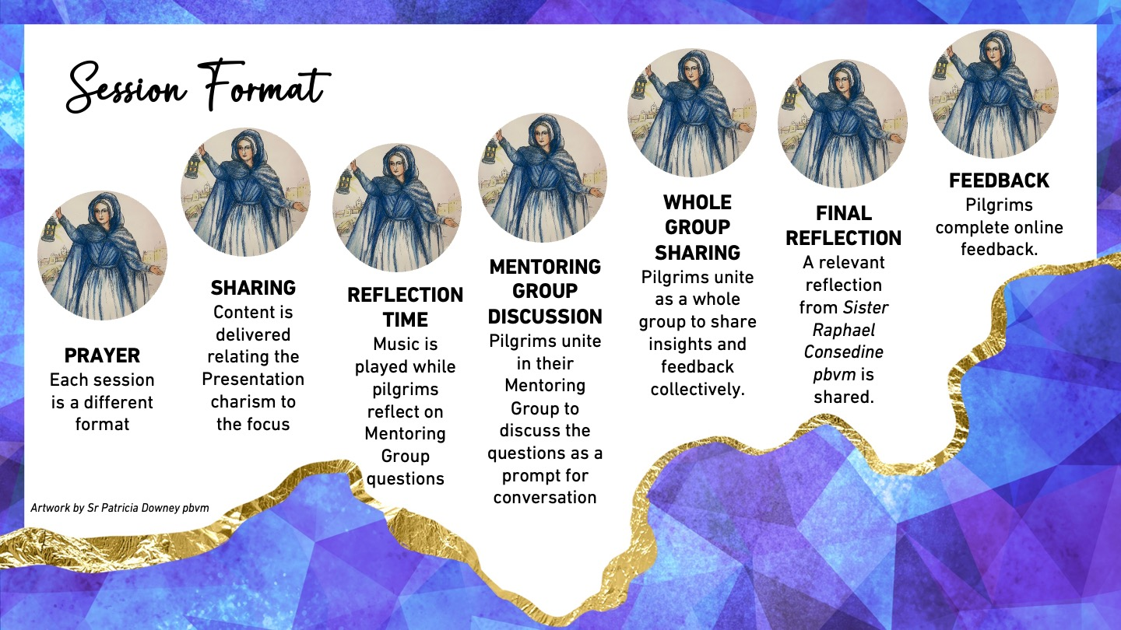

Slide 12
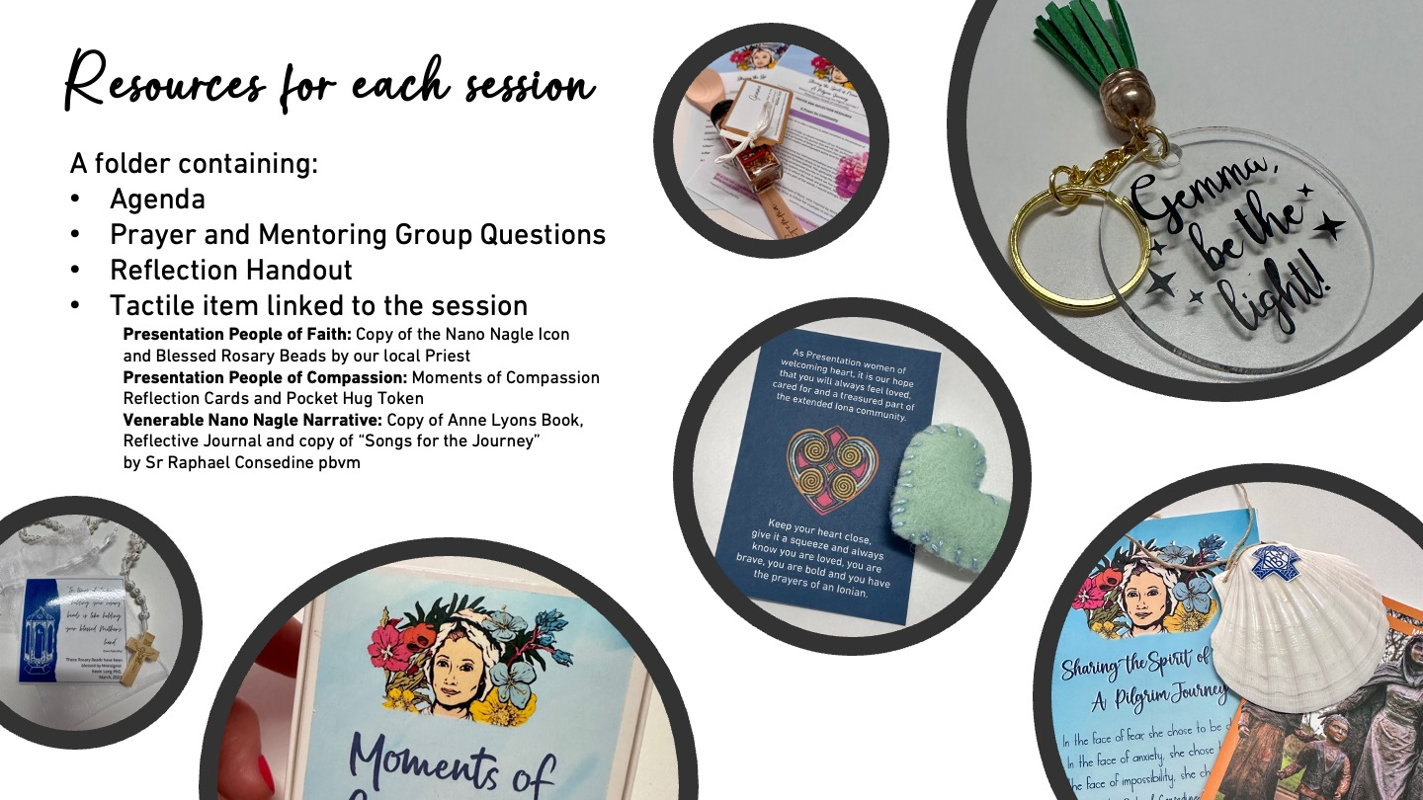

Slide 13


Slide 14
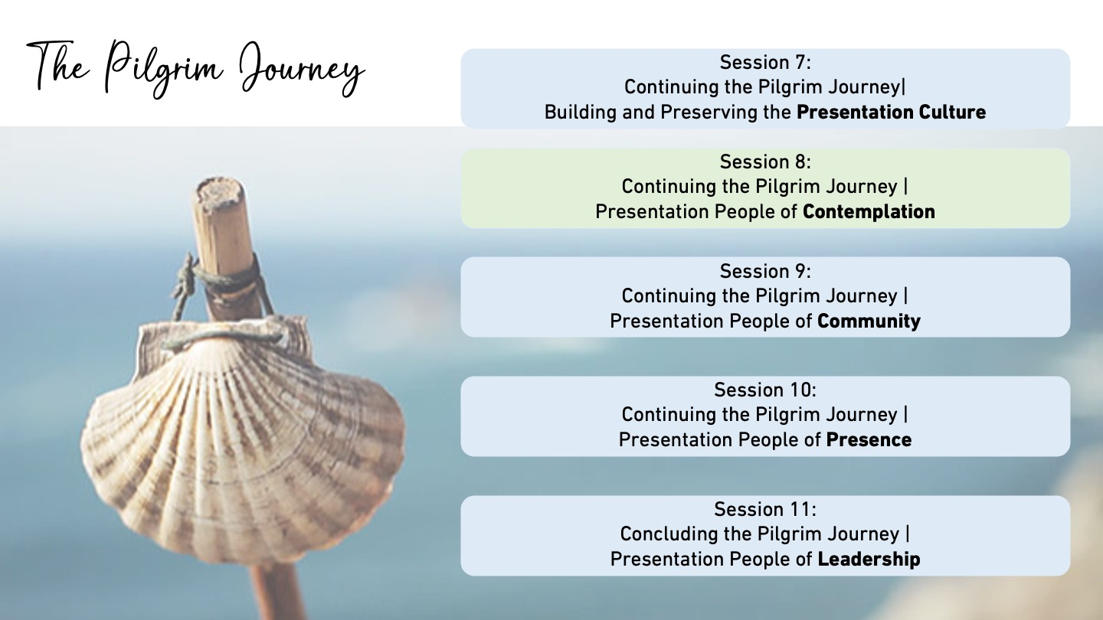

Slide 15
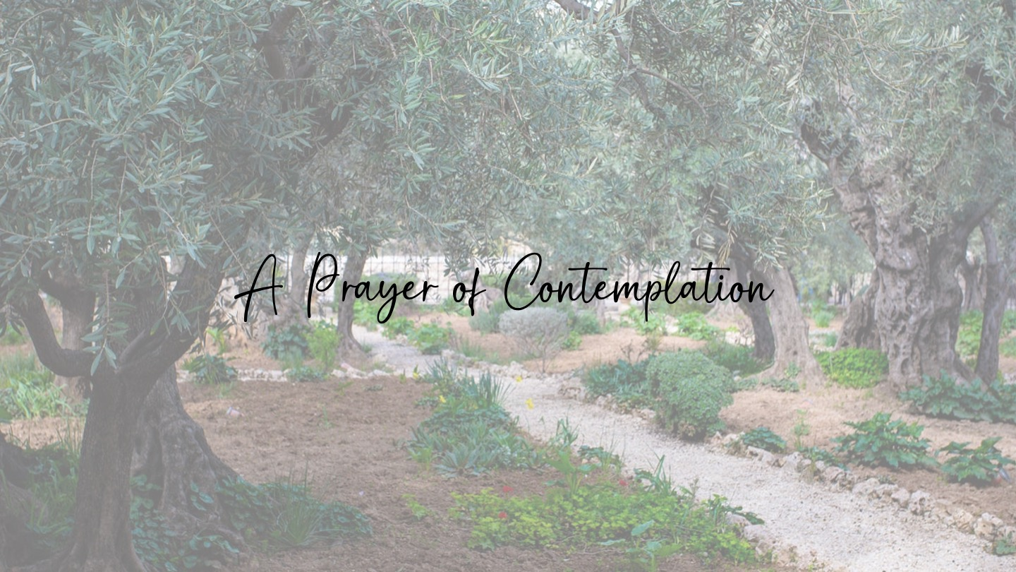

Slide 16



Slide 17


Slide 18


Slide 19


Slide 20
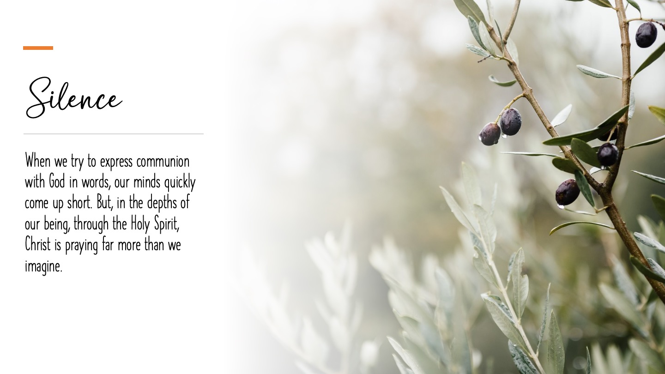

Slide 21


Slide 22
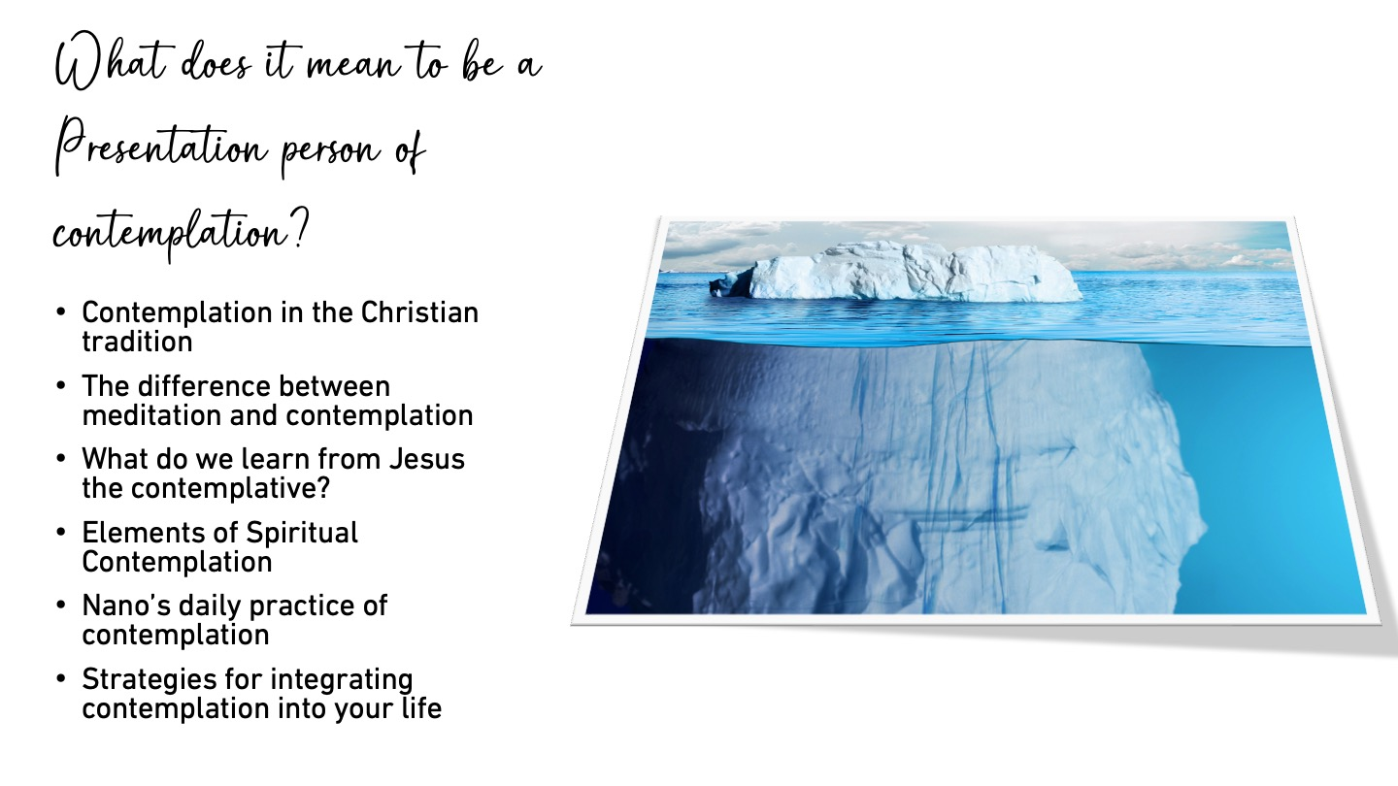

Slide 23
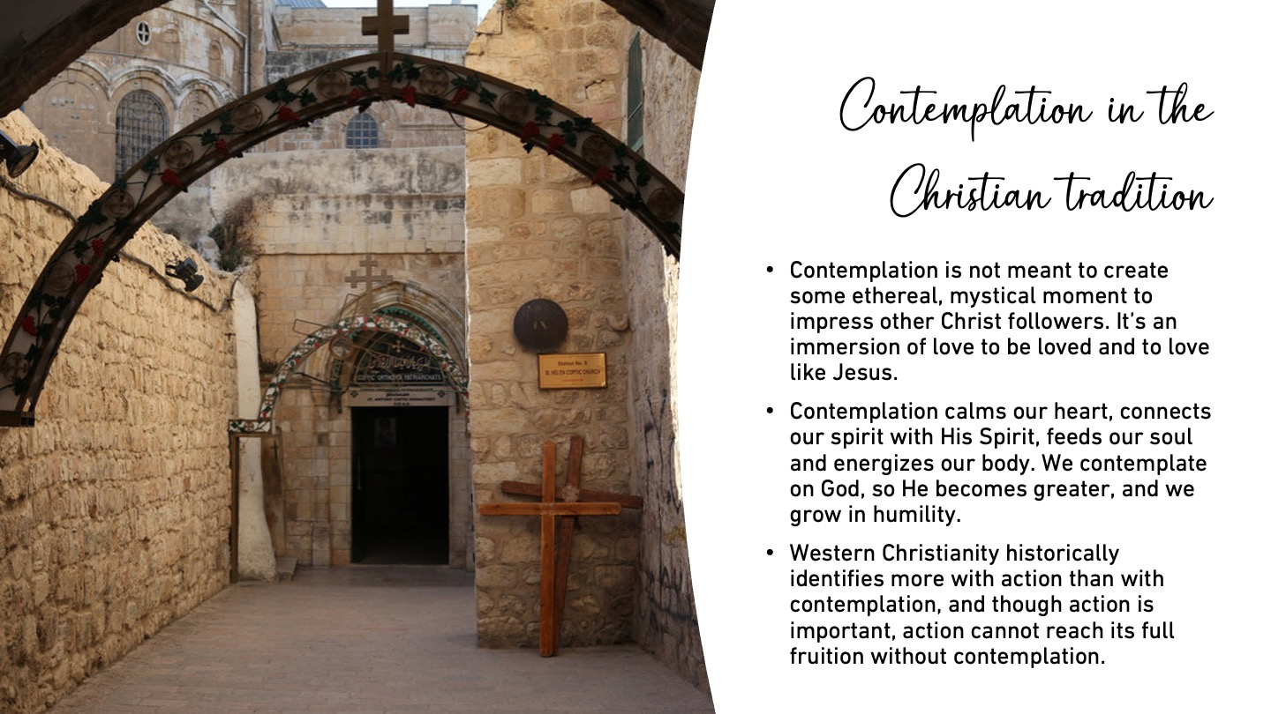

Slide 24
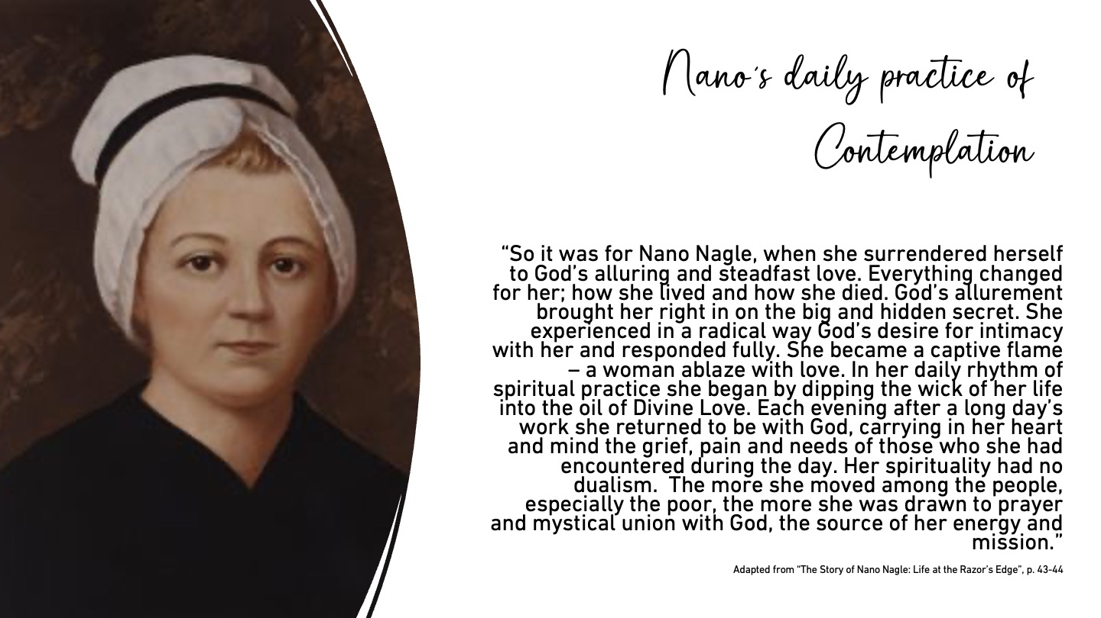

Slide 25
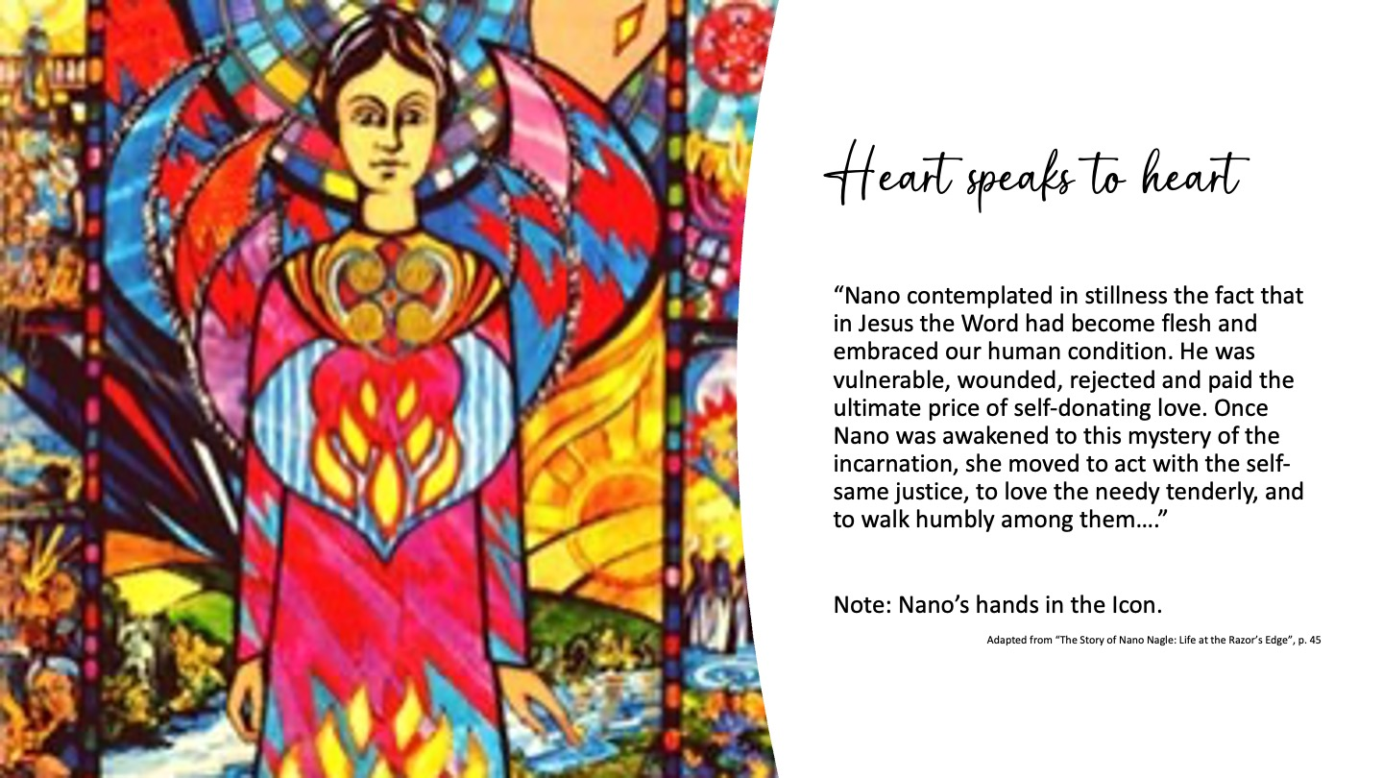

Slide 26
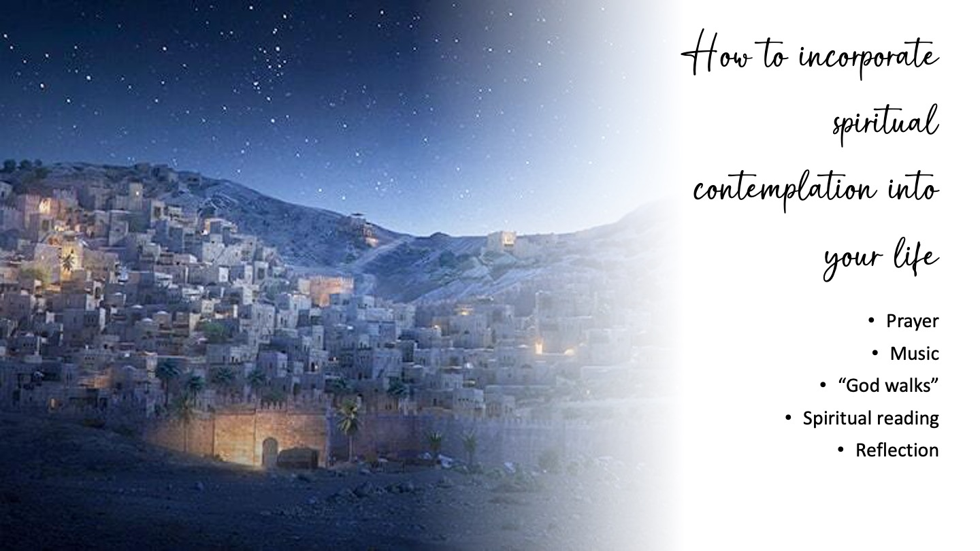

Slide 27


Slide 28
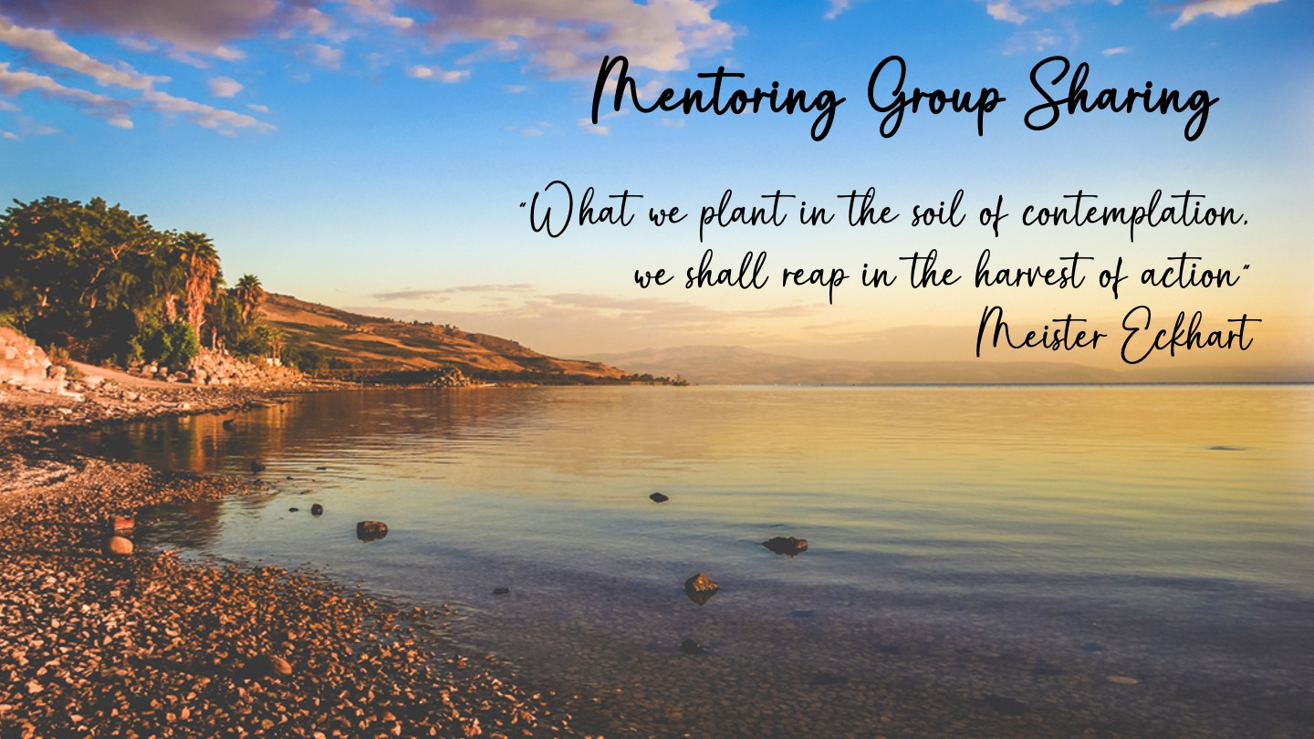

Slide 29
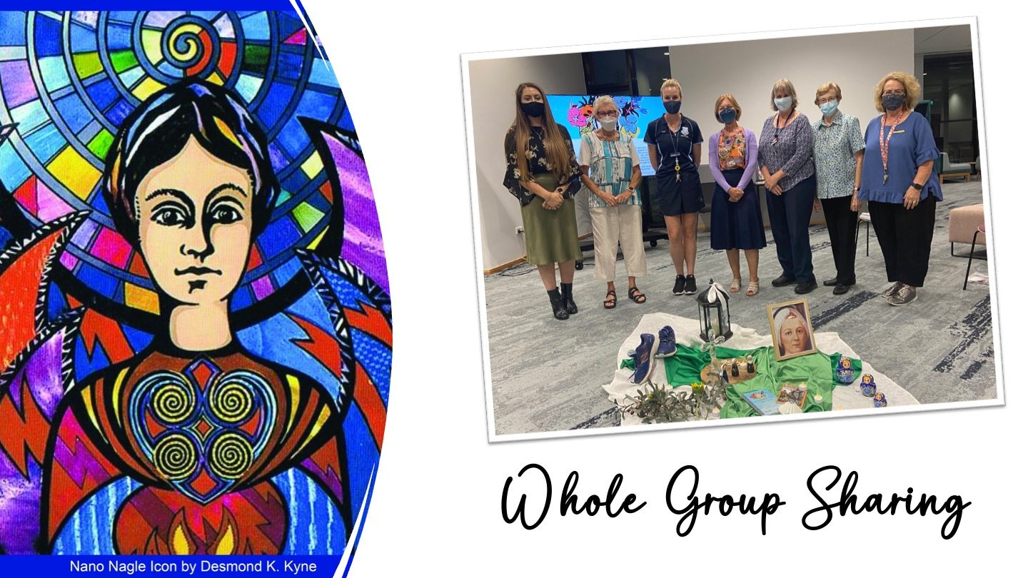

Slide 30


Slide 31
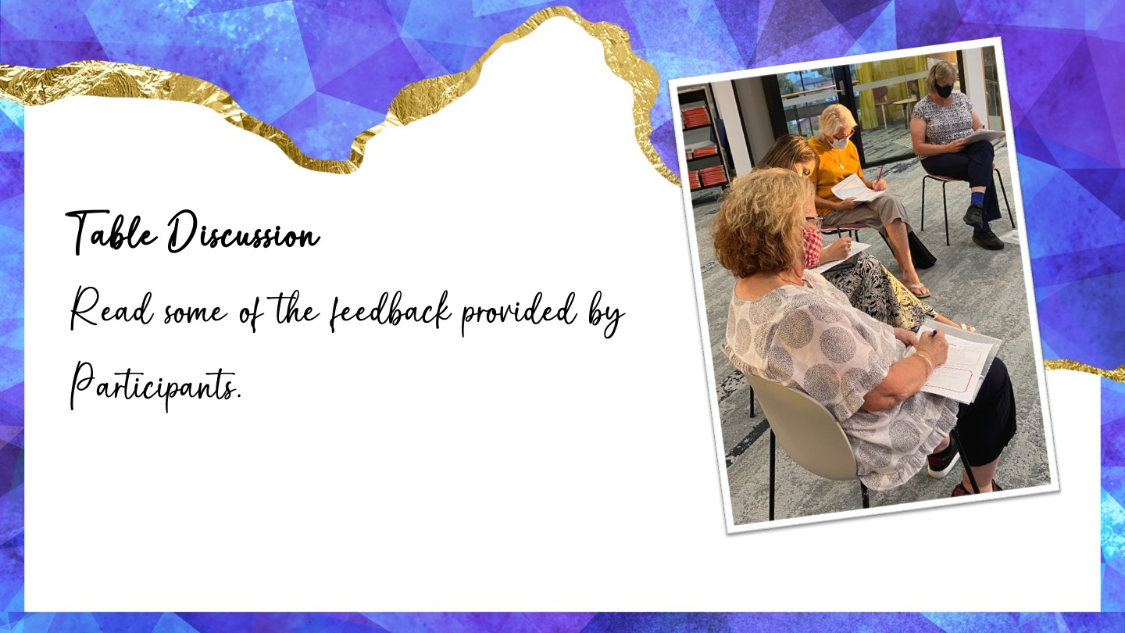

Slide 32
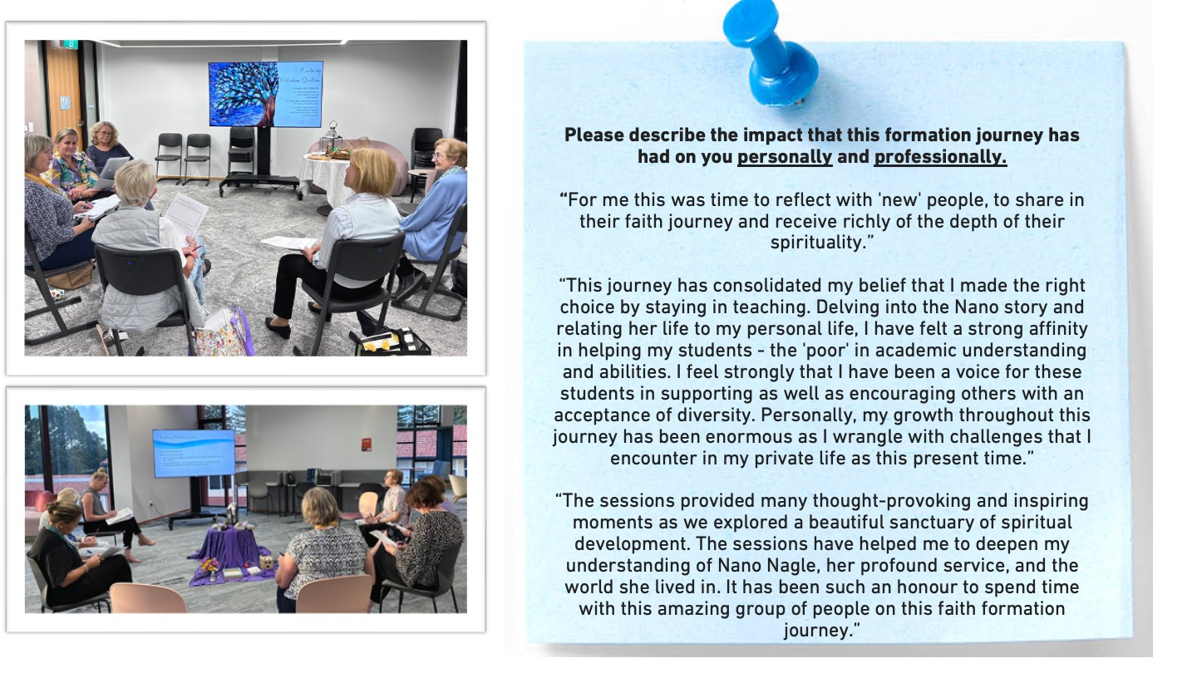

Slide 33
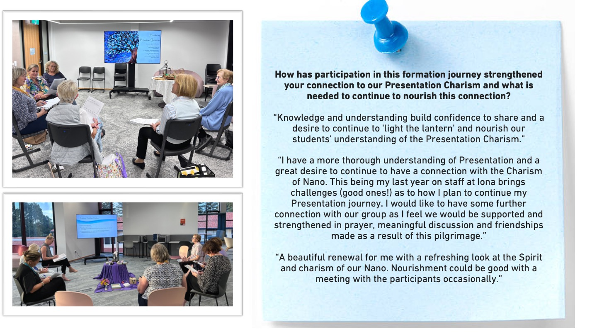

Slide 34
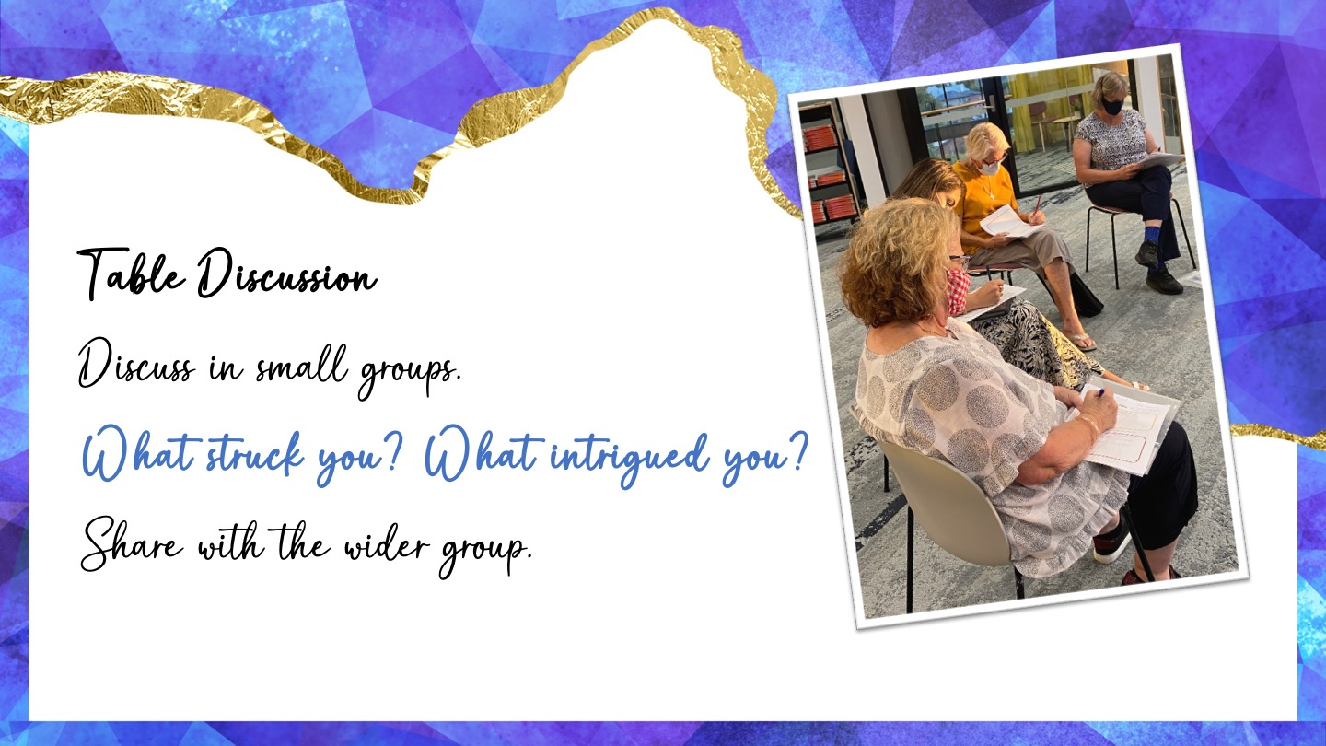

Slide 35
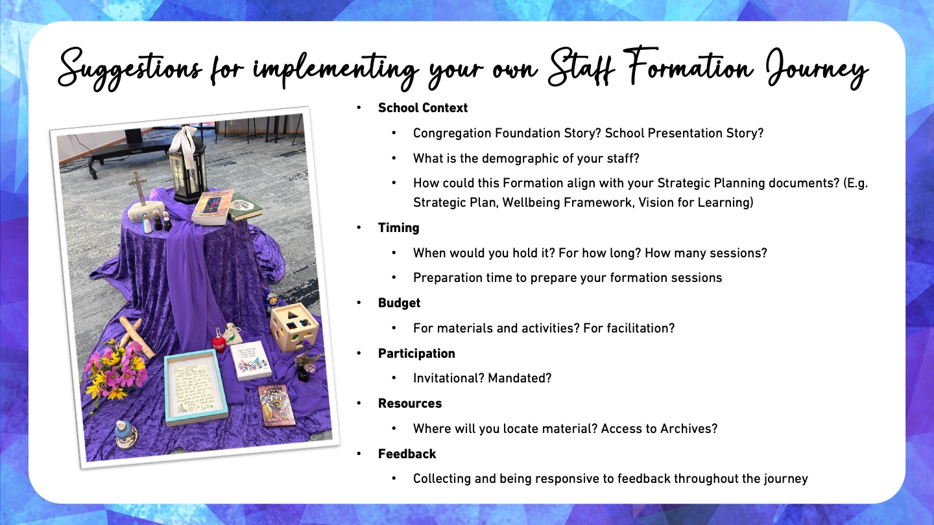

Slide 36
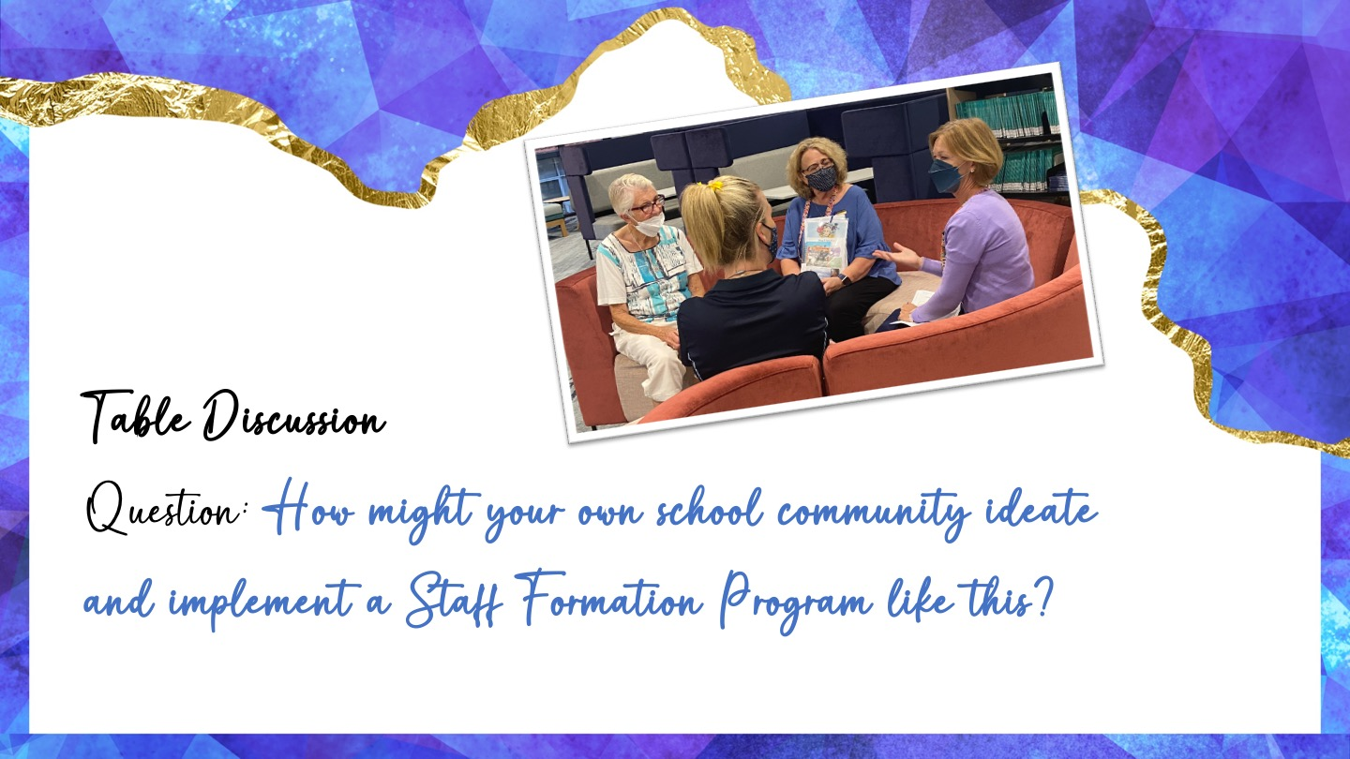

Slide 37
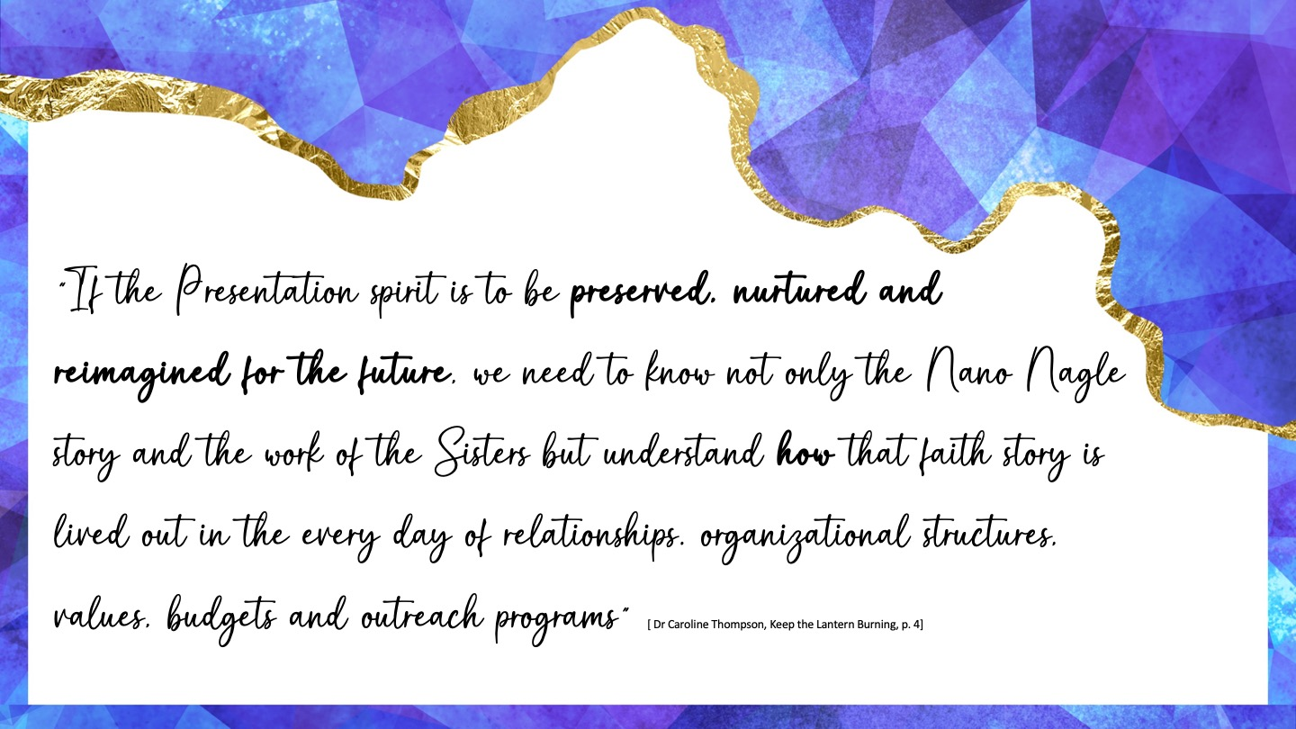

Slide 38
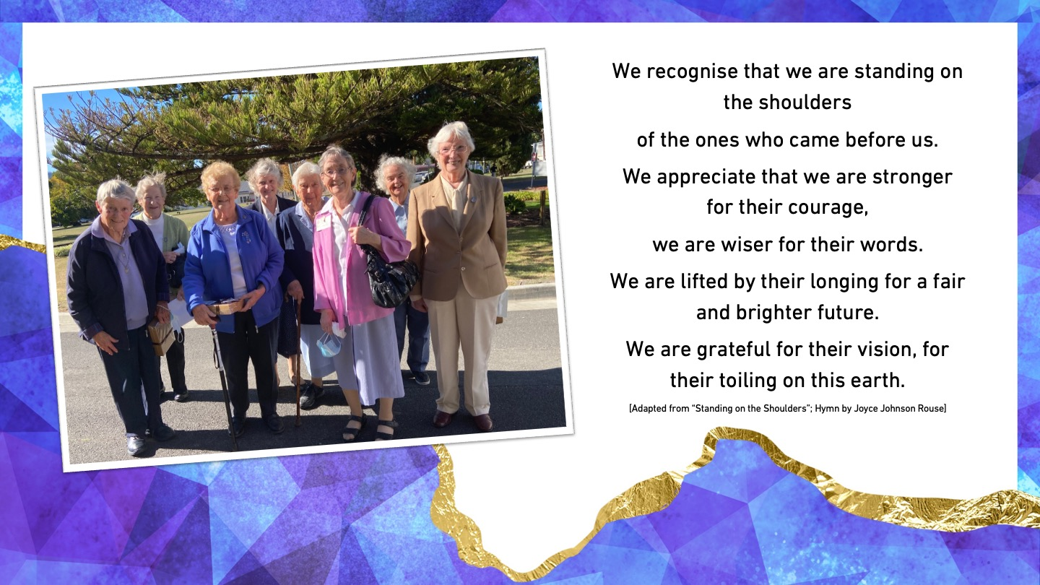

Slide 39
