Slide 1

Acknowledgement of
Country
We acknowledge the traditional custodians of the land, the Wangal people of the Eora nation, and call on the Spirit Ancestors to walk with us today as we share and learn together.

Slide 2
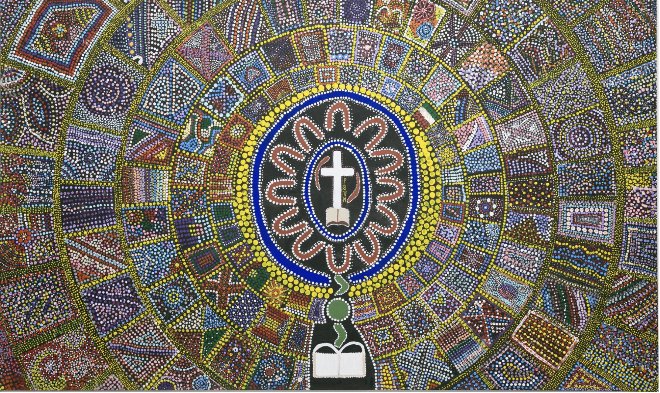

Slide 3
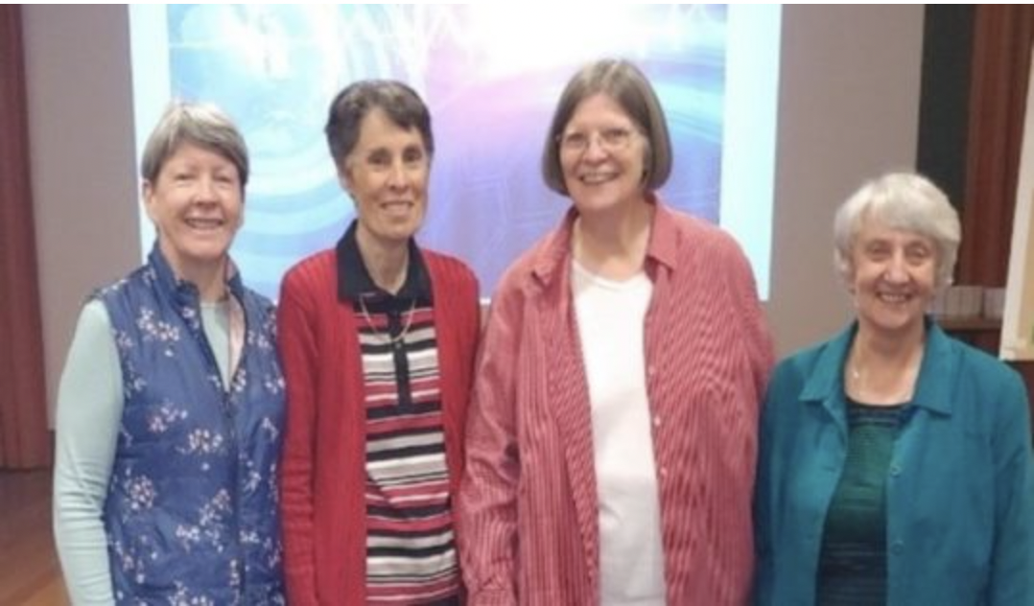
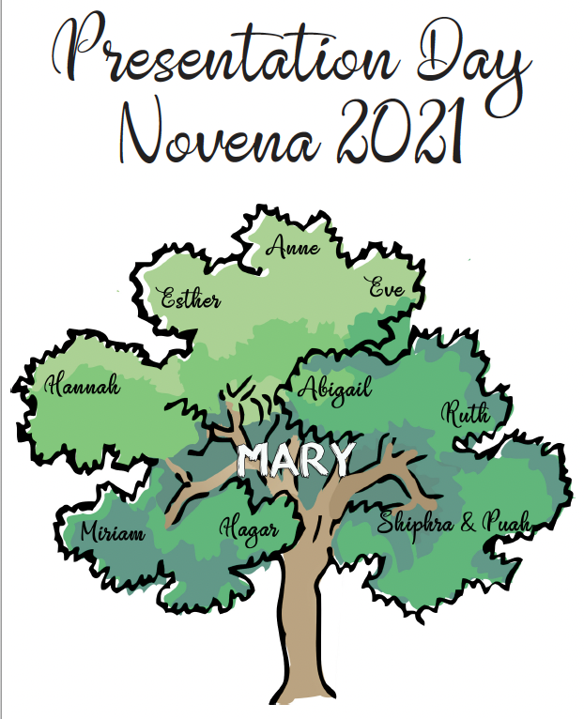
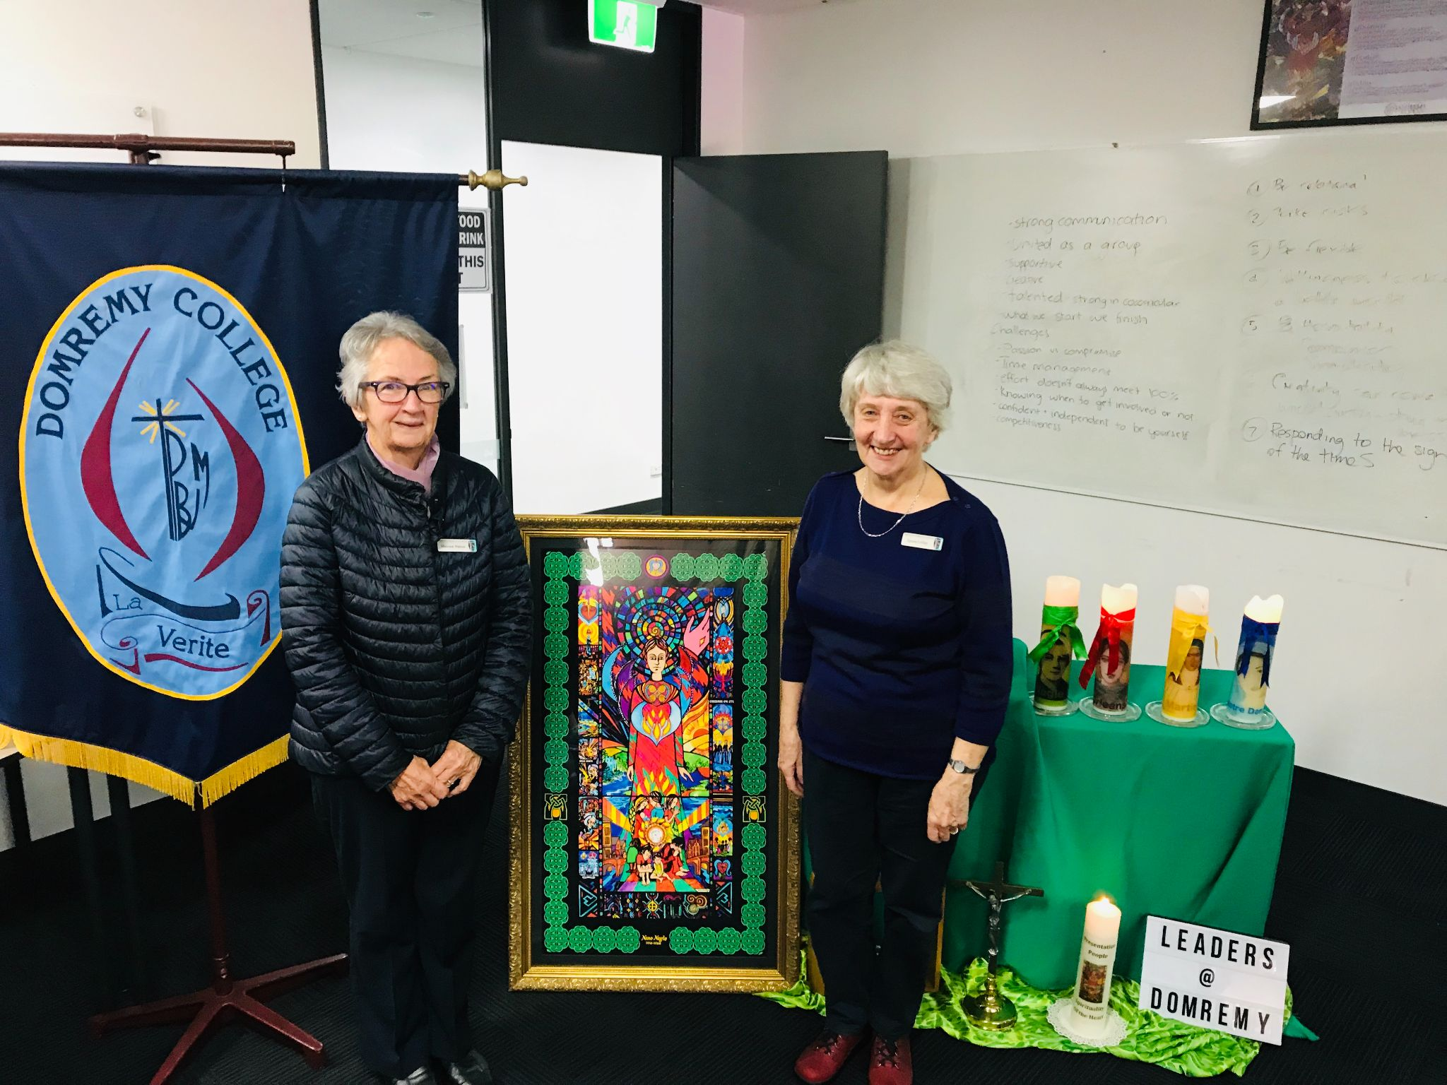
Feast of the Presentation of the Blessed Virgin Mary

Slide 4
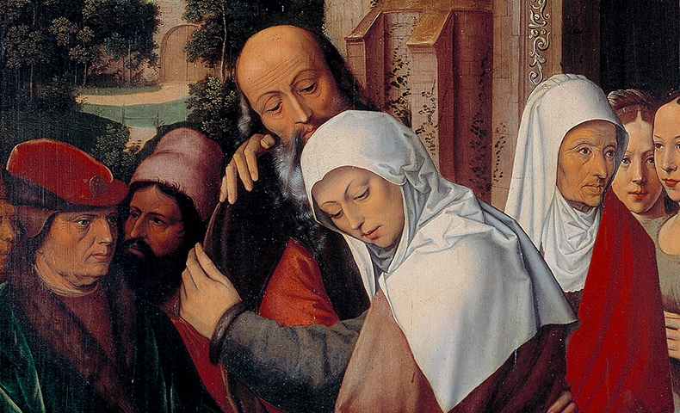
Mary’s Parents
St Anne and
St Joachim

Slide 5
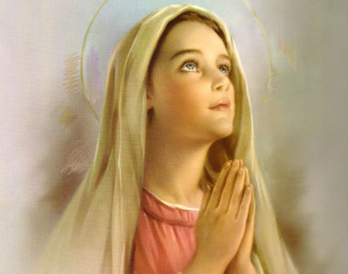
A Jewish girl who followed Jewish ritual and tradition.

Slide 6
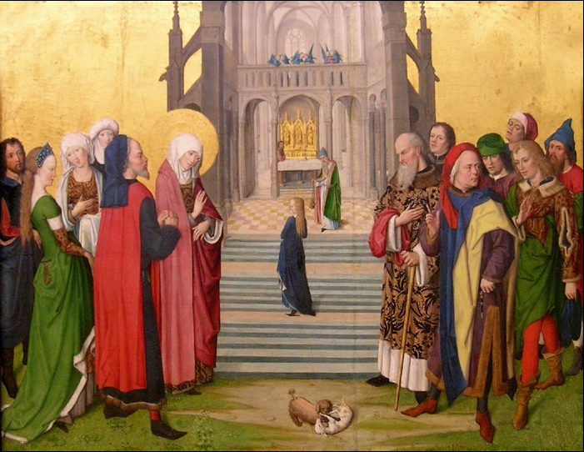
Temple life

Slide 7
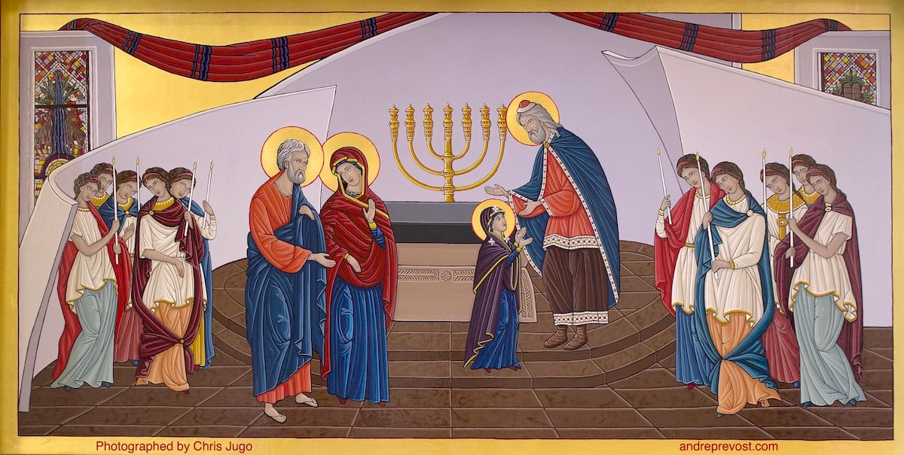

Slide 8
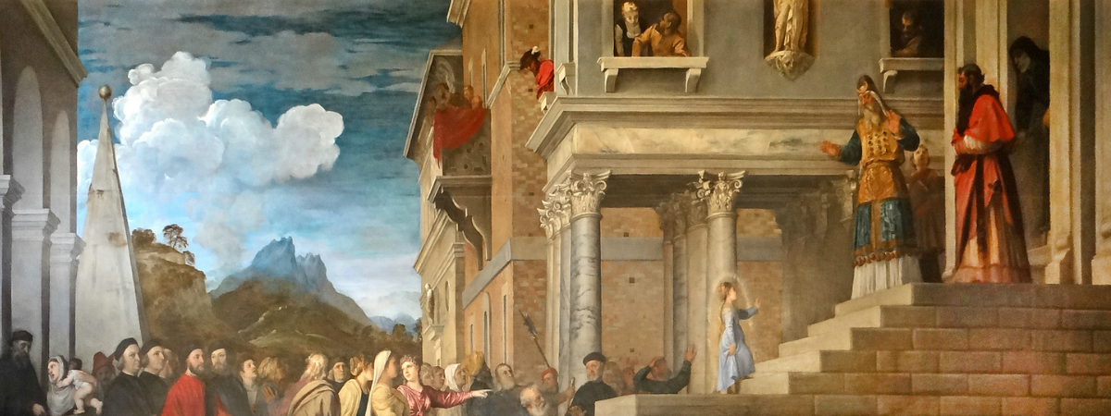
Foreign ideas to us in a modern world, but a custom of the Jews in ancient times...

Slide 9
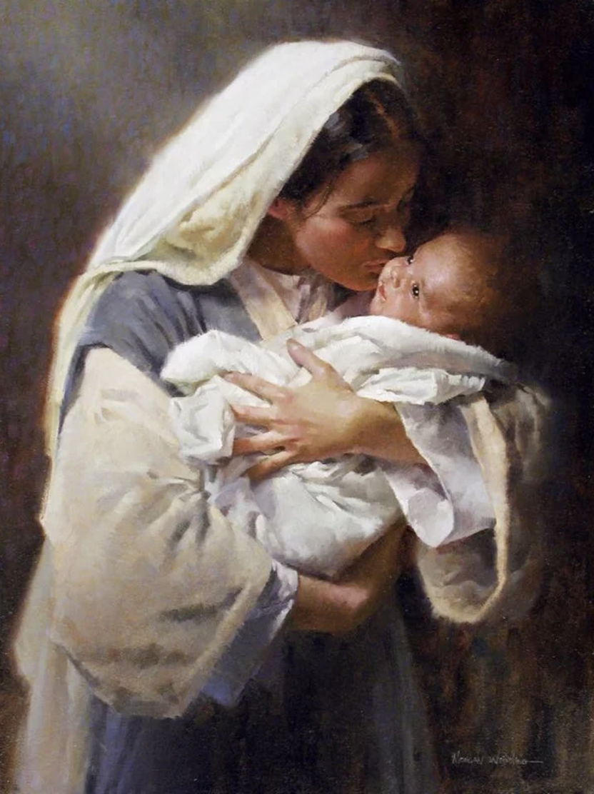
This was to prepare Mary for the discerning
“YES” to be the Mother of God
Notes:
https://www.youtube.com/watch?v=EXM_M4fEmak&list=RDGMEMpBTPDS4vUcNkxDpMWGK7rw&index=7

Slide 10
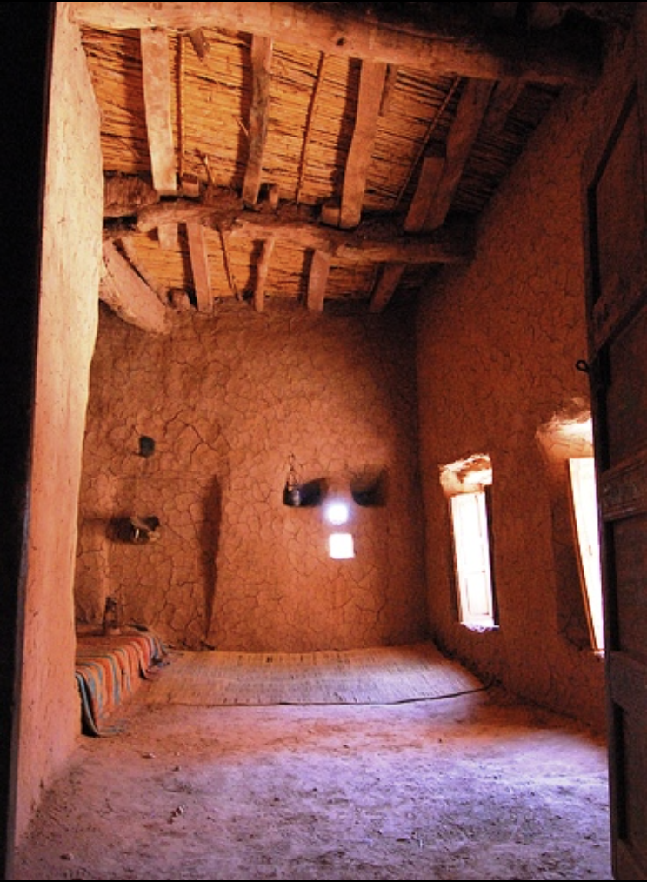
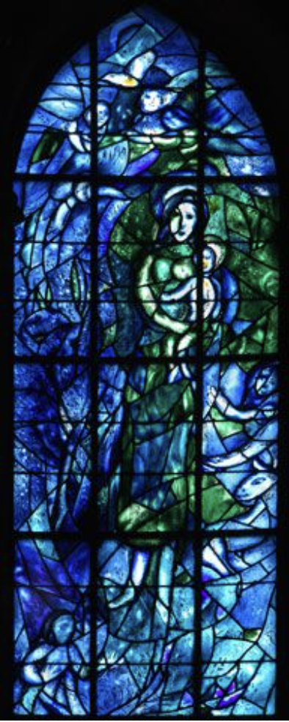
Notes:
https://www.youtube.com/watch?v=EXM_M4fEmak&list=RDGMEMpBTPDS4vUcNkxDpMWGK7rw&index=7

Slide 11
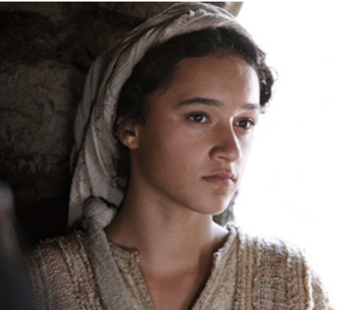
Mary, close to the age that you are now.
Lk 1:30-35

Slide 12
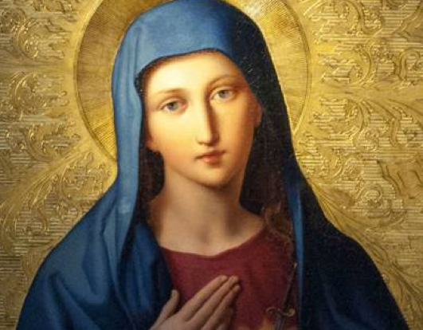
God Planted the seed of life in the womb of Mary with her YES at the Annunciation,
Notre Dame House Students to read:

Slide 13
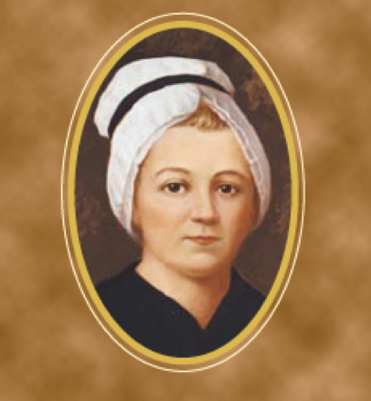
Nagle House Students to read:
God Planted the seed in the heart of Nano with her YES in responding to the needs of the poor in her native Ireland,

Slide 14
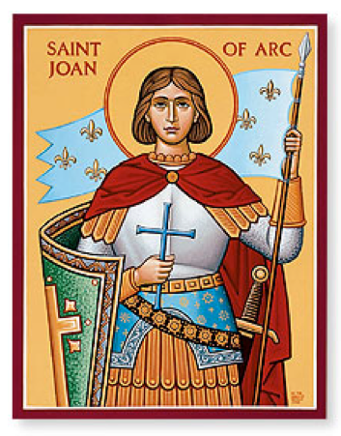
Orleans House Students to read:
And God called the young women as Presentation Sisters to establish Domremy College in the Five Dock area, in the early 20th Century,

Slide 15
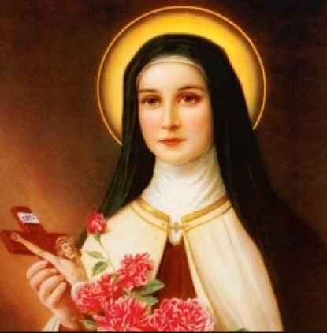
We are called today to celebrate the Feast of the Presentation of the Blessed Virgin Mary in the Temple, gathered together as a community joined in spirit.
Martina House Students to read:

Slide 16

Silence….Deep Listening….Heartfelt Response…Awareness…..
Hospitality and Welcome….Courage…Trust…..Communion….
Journeying together as Presentation People…..
May God’s blessing be among us as we
respond to these calls.
Mary of the Presentation, ALL:Pray for us.
Venerable Nano Nagle, ALL: Pray for us

Slide 17
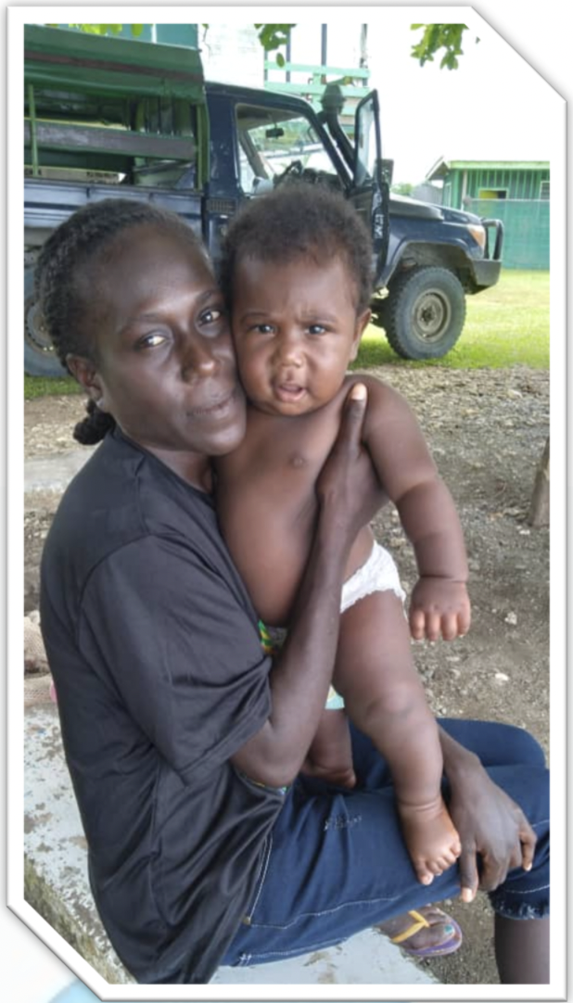
Gender-based
violence in
Papua New Guinea
Her name is Raylinda. She is 23 years old, and she is from Papua New Guinea.

Slide 18
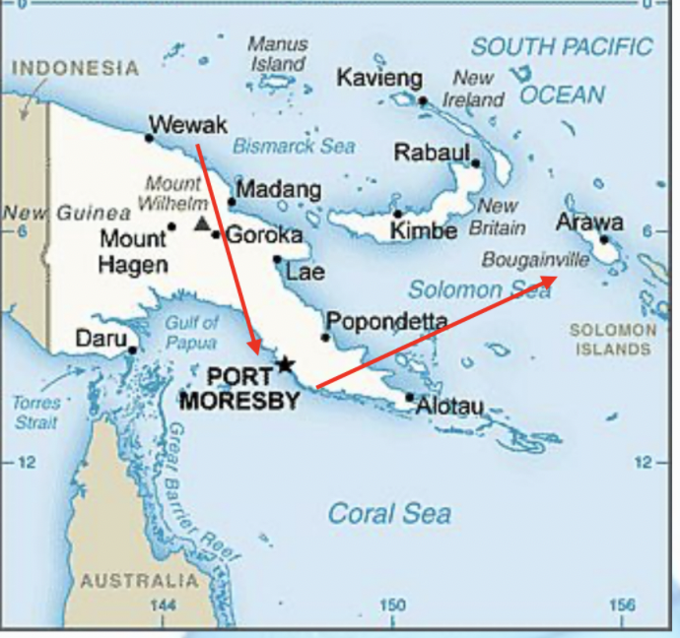
Presentation Society is seeking your assistance to fund the cost of two airfares for Raylinda and her child to return to her parents to live in safety away from the child’s father who is a violent and an abusive alcoholic.
He threatens them constantly and has burnt all of their clothes in a drunken rage. The Presentation Sisters that Raylinda is currently living in hiding with need to provide clothing and food to Raylinda and her baby.
The plan is for her to travel secretly on a truck to take her to the airport in safety.
Raylinda and her child will need to fly from Wewak to Port Moresby and travel onward from there to Bougainville. Mrs Sullivan has come up with a plan!
HOW CAN YOU HELP?

Slide 19
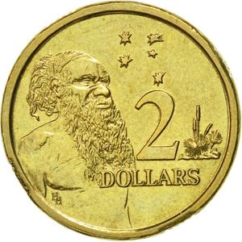
Friday MUFTI DAY
GOLD COIN DONATION IN HOMEROOM

Slide 20
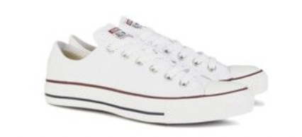
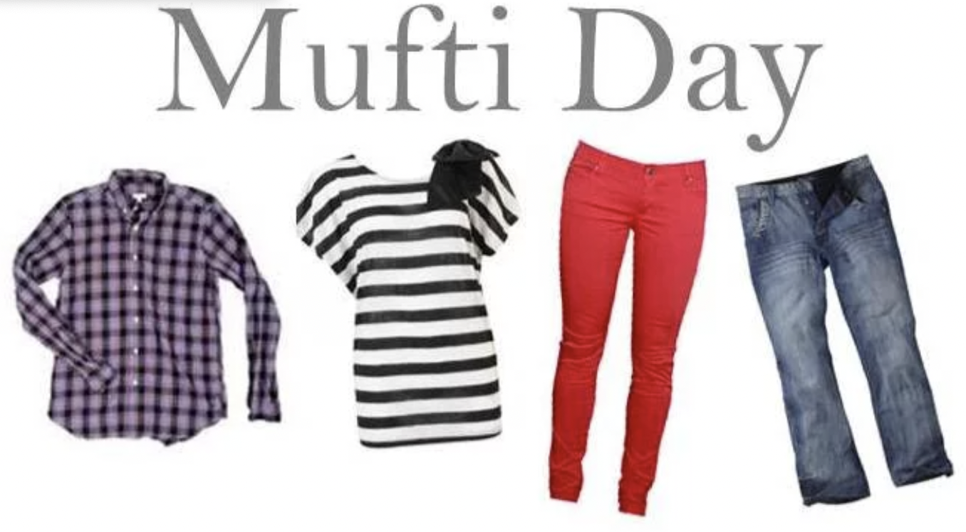
MUFTI DAY RULES
All required equipment, books and stationery must be brought, as it is a normal school day. This includes equipment and clothing for all specialist subjects such as TAS, PDHPE and Science.
College rules still apply regarding hair, chewing gum, make-up and jewellery.
Closed shoes
(No thongs and sandals)
No revealing tops
No midriff tops
No narrow strapped singlet tops
No short skirts
No short shorts
No clothing with inappropriate pictures or messages
Students who do not comply with these rules may be withdrawn from classes and parents contacted to bring appropriate clothing.

