Slide 1

Prophetic like nano
Cristina lledo-Gomez
BBI-THE AUSTRALIAN INSTITUTE OF THEOLOGICAL EDUCATION

Slide 2
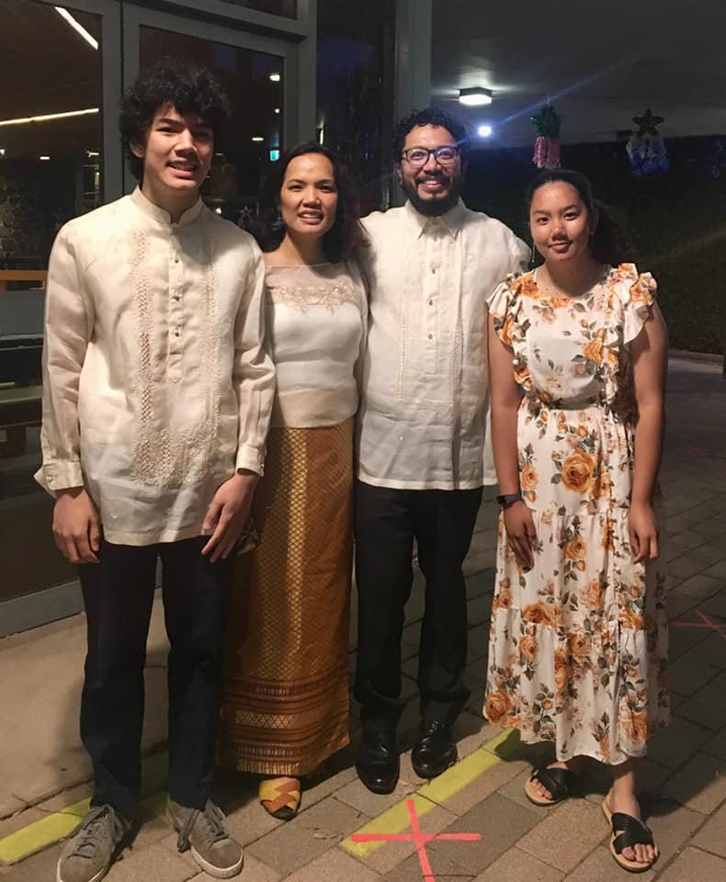
My context
Mum of 14yr old girl and 16yr old boy
Aware of some of their challenges
As a Christian and a Theologian how do
I help them or equip them for this world?

Slide 3
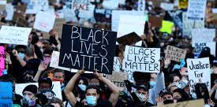

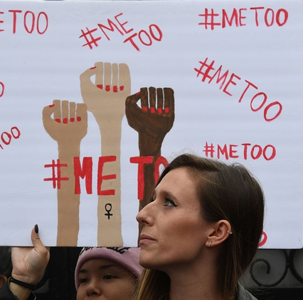
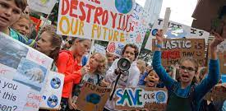
Contemporary Issues in need of prophets
Covid – social distancing, isolation, mental and health
Race – Black Lives Matter, racism
Gender – #MeToo, gender diversity
Ecology – SchoolStrike4Climate
How do we respond to these prophetically?

Slide 4
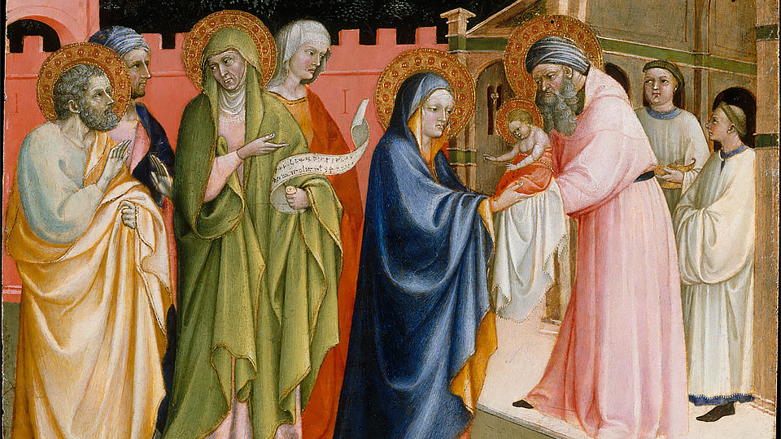
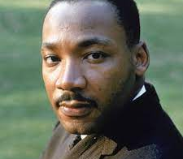
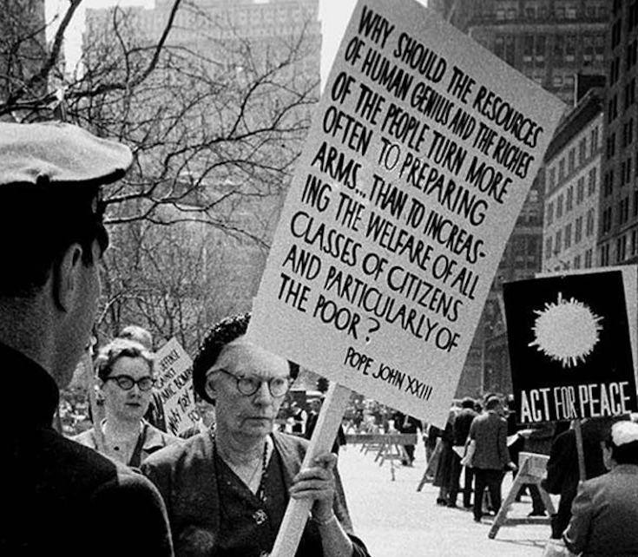
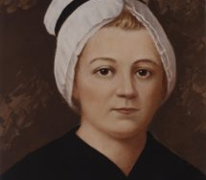
Prophets in the Jewish & Christian traditions
Role of the Prophets
Nano Nagle as a prophet
Responding prophetically today

Slide 5
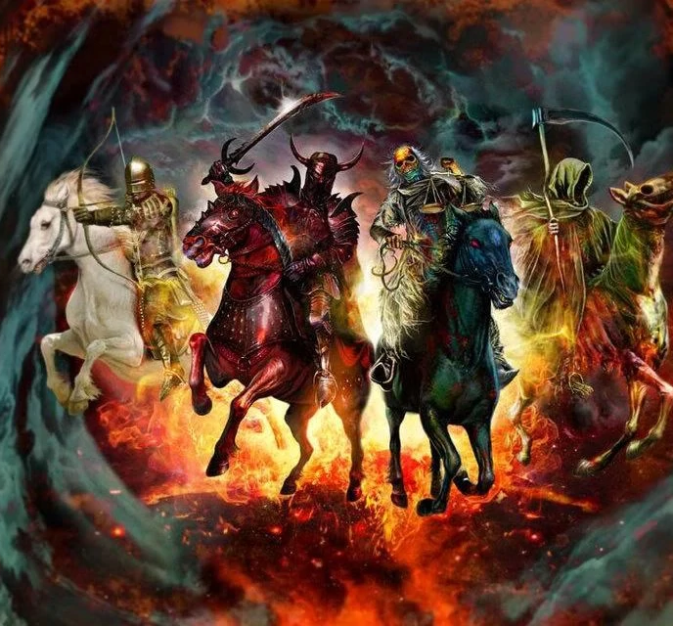
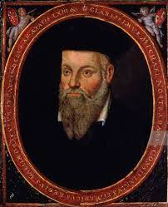
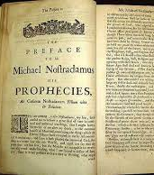

Is this prophecy?

Slide 6
1.&2. Prophets in the jewish-christian traditions & their roles

Slide 7
IN the jewish &
In the Vatican II documents on the Church
In the Christian and Jewish Scriptures
Old Testament prophets – eg. Isaiah, Hosea, Jeremiah, Micah, Miriam, Deborah, Hulday
New Testament prophets – Zechariah, Elisabeth, Anna the Prophetess, Simeon, Barnabas, Silas, John the Baptist, Jesus
Pope Francis often spoke on the Christian call to be prophetic

Slide 8
Vatican II Lumen Gentium – constitution on the church
LG 12. The holy people of God shares also in Christ's prophetic office; it spreads abroad a living witness to Him, especially by means of a life of faith and charity and by offering to God a sacrifice of praise, the tribute of lips which give praise to His name.
LG 31. The term laity is here understood to mean all the faithful except those in holy orders and those in the state of religious life specially approved by the Church. These faithful are by baptism made one body with Christ and are constituted among the People of God; they are in their own way made sharers in the priestly, prophetical, and kingly functions of Christ; and they carry out for their own part the mission of the whole Christian people in the Church and in the world.
Sce: https://www.vatican.va/archive/hist_councils/ii_vatican_council/documents/vat-ii_const_19641121_lumen-gentium_en.html

Slide 9
Prophets in the scriptures
OT Scriptures – Tanak
The Pentateuch (Torah), the Prophets (Nebi’im), and the Writings (Ketubim)
The Prophets – Former (Joshua, Judges, 1-2 Samuel, 1-2 Kings) + Latter (Isaiah, Jeremiah, Ezekiel, and the Book of Twelve, i.e. 12 minor prophets)

Slide 10
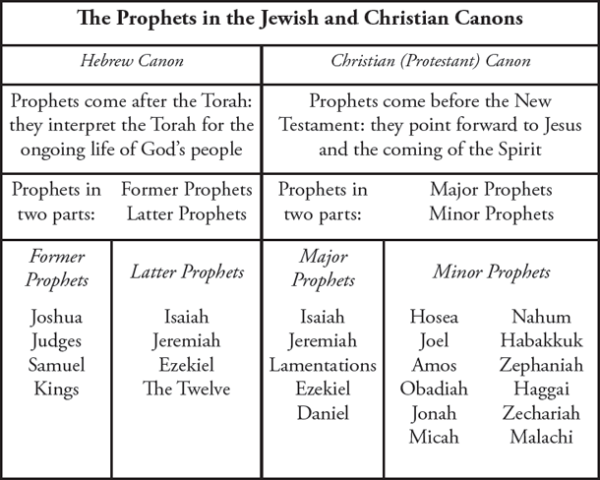

Slide 11
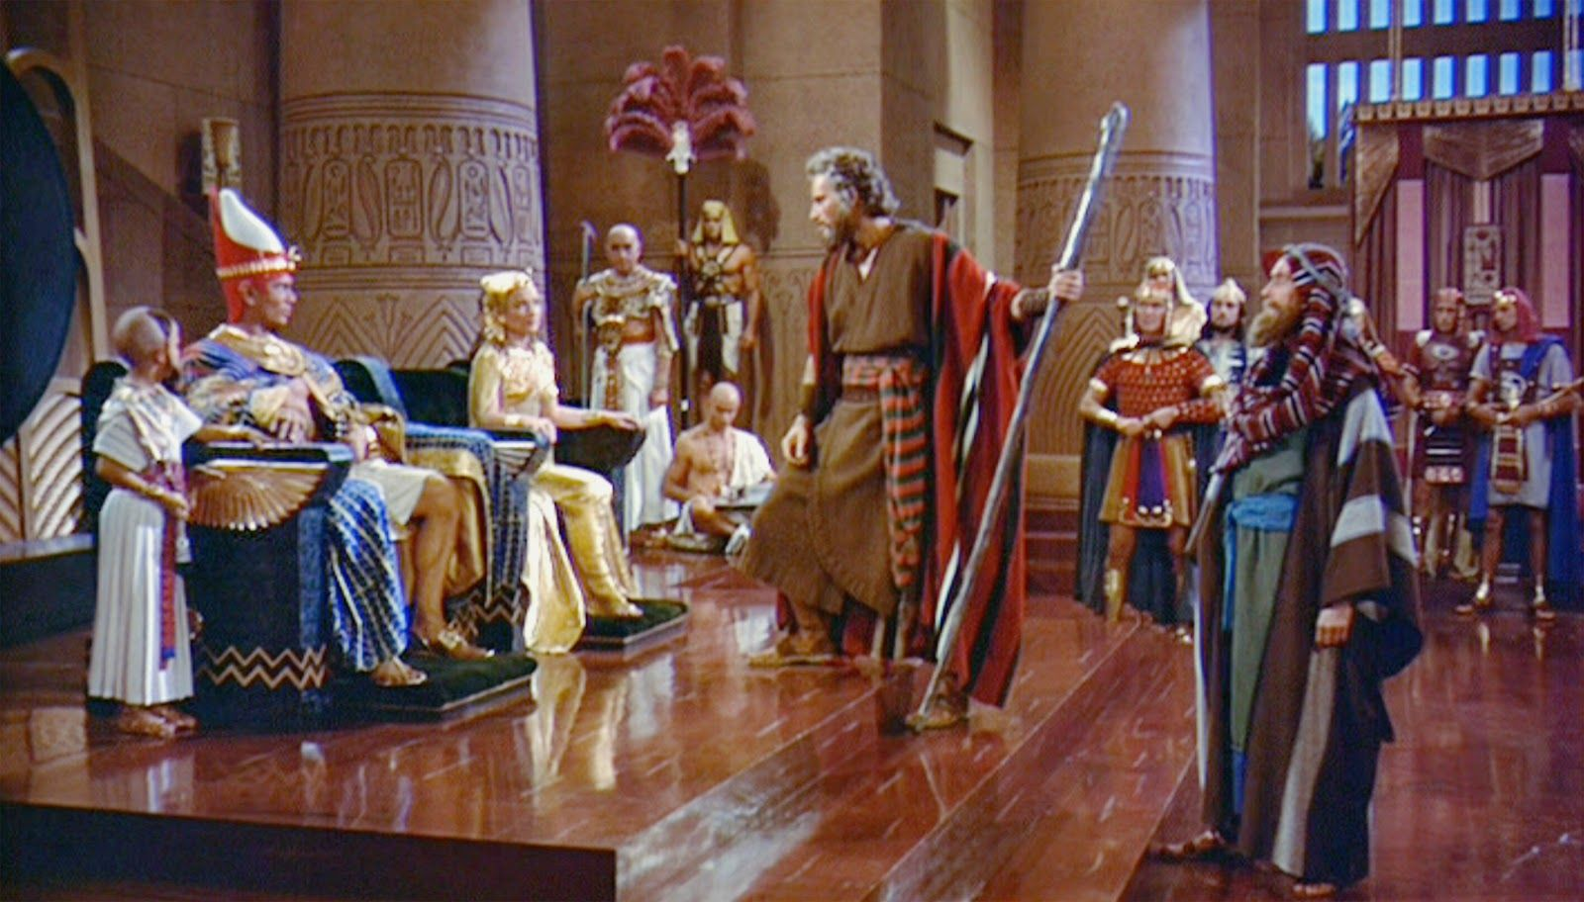
prophets in the ot
Prophets play a critical role in understanding God’s redemptive plan
Scathing of social injustice and sin, they reveal hard truths
Eg. Moses (Exodus 7:1, Deuteronomy 18:14-22)
Source: https://www.pinterest.com.au/pin/389209592789523835/?autologin=true
from “The Ten Commandments (1956)”
https://www.youtube.com/watch?v=ahkwQhQZWG8

Slide 12
Covenant between God and the Israelites
Garden of Eden (Bk of Genesis) as a pattern of human sin (breaking relationship w/ God-others-self)
Redemption and salvation as God’s plan
I will be your God,
You will be my people,
I will dwell in your midst
You will have land, descendants, and blessings upon them

Slide 13
Key messages of OT prophets
1. ﻿You (Israel/Judah) have broken the covenant; repent and return to worship to the one God!
2. No repentance? Then judgment! Judgment will also come on the nations.
3. Yet there is hope beyond the judgment for a glorious future restoration both for Israel/Judah and for the nations.
Idolatry, social injustice, and reliance on religious ritualism
Source: Hays, J. Daniel. The Message of the Prophets (p. 63). Zondervan Academic. Kindle Edition.

Slide 14
https://www.youtube.com/watch?v=edcqUu_BtN0

Slide 15
The christian scriptures / new Testament (nt)
Centred on Jesus and New Covenant made through him
Basis is the paschal mystery – life, cross, death, and resurrection
New Covenant – forgiveness/reconciliation & restoration of relationships through belief in Jesus
Belief in Jesus
Incorporates Old Covenant

Slide 16
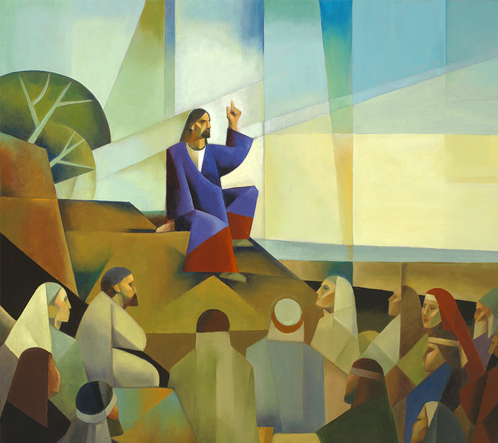
jesus as prophet in the NT
Proclaimed God’s Good News
Like OT prophets - Scathing of social injustice and sin, revealed hard truths
Call to metanoia
Not welcomed everywhere (Lk 9:51-56)
Ultimate price = death
Image sce: https://discoveryseries.org/courses/sermon-on-the-mount/

Slide 17
Key messages of jesus’ prophetic acts
1. Good News of God’s Reign (basileia tou theou)
³⁴ Then the king will say to those at his right hand, ‘Come, you that are blessed by my Father, inherit the kingdom prepared for you from the foundation of the world; ³⁵ for I was hungry and you gave me food, I was thirsty and you gave me something to drink, I was a stranger and you welcomed me, ³⁶ I was naked and you gave me clothing, I was sick and you took care of me, I was in prison and you visited me.’ (Matthew 25:31-46)

Slide 18
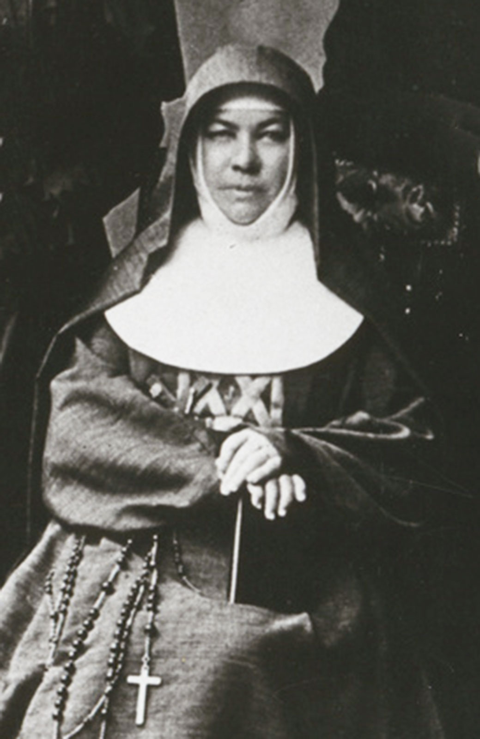
2. Through Word (through parables and sayings) and deed (healings, miracles).
3. Church called to continue Jesus’ mission including being prophetic
Notes:
Dorothy Day movie – Entertaining Angels (1996) – Moira Kelly, Heather Graham and Charlie Sheen

Slide 19
Is there anything new in what you’ve heard so far?
Do any points resonate with or interest you?
Are you making any connections with Nano as part of a line of prophets?

Slide 20
3. Nano nagle as prophetic

Slide 21
Nano’s epiphany – version 1
“In the small, early hours of a spring morning of the year 1750, a heavy lumbering carriage rolled over the woven pavement of the quartier Saint Germain of the French capital, awakening the echoes of the sleeping city. The beams of the rising sun had not yet struggled over the horizon to light up the spires and towers and lofty housetops, but the cold, gray dawn was far advanced. The occupants of the carriage were an Irish young lady of two-and-twenty, and her chaperon, a French lady, both fatigued and listlessly reclining in their respective corners. They had lately formed part of a gay and glittering a crowd in one of the most fashionable Parisian salons. As they moved onward, each communing with her own thoughts, in all probability reverting to the brilliant scene they had just left, and anticipating the recurrence of many more such , the young lady’s attention was suddenly attracted by a crowd of poor people standing at the yet unopened door of a parish church. They were work-people, waiting for admission by the porter, in order to hear Mass before they entered on their day’s work.

Slide 22
“The young lady was forcibly struck. She reflected on the hard lot of those children of toil, their meagre fare, their wretched dwellings, their scanty clothing, their constant struggle to preserve themselves and their families even in this humble position – a struggle in many a case unavailing; for sickness, or interruption of employment, or one of the many other casualties incidental to their state, might any day sink them still deeper in penury. She reflected seriously on all this; and then she dwelt on their simple faith, their humble piety, their thus ‘preventing the day to worship God’. She contrasted their lives with those of the gay votaries of fashion and pleasure, of whom she was one. She felt dissatisfied with herself, and asked her own heart, Might she not be more profitably employed? Her thoughts next naturally reverted to her native land, then groaning under the weight of persecution for conscience’ sake—it’s religion proscribed, its altar overturned, its sanctuaries desolate, its children denied, under grievious penalties, the blessings of free education.”

Slide 23
“She felt at once that there was a great mission to be fulfilled, and that, with God’s blessing, she might do something towards its fulfillment. For a long time, she dwelt earnestly on what we may now regard as an inspiration from heaven. She frequently commended the matter to God, and took the advice of pious and learned ecclesiastics; and the result was that great work which has ever been since, and is in our day, a source of benediction and happiness to countless thousands of poor families in her native land, and has made the name of Nano Nagle worthy of a high place on the roll of the heroines of charity.”
Source: John N. Murphy, Terra Incognita or Convents of the United Kingdom (1873)

Slide 24
Nano’s epiphany – version 2
“When Nano left school, she and her sister Ann made Paris their home – they had many cousins there – until 1746, when Garret Nagle died and they returned to live with their mother, in Dublin. An important moment of conversion in Nagle’s life is said to have happened there, when Ann confessed that she had some silk, with which had intended to make a gown, to feed a poor family. Nano’s mother and Ann died not long after that and Nagle entered a convent in France. There, her confessor (a ‘learned son of Saint Ignatius’) told her it was her duty to go back and do something for the poor of her own country.
Source: Catriona Clear, “Nano Nagle (1718-1784): Educator, in Irish Jesuit Studies (Dublin) Vol.98 (390): 135-143 at 136. (2009)

Slide 25
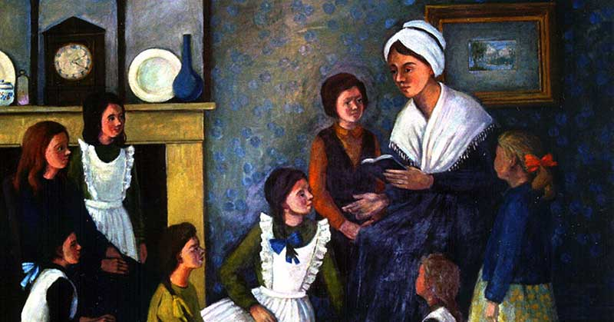
Nano’s decision
A social injustice self-presents
Personal response
Moved by the social injustice
Having a vision - how things can be
A sense of personal responsibility - what am I doing to help?
Review of one’s life – how does my life help or hinder justice here?
Review of circumstances - Am I able to help with the resources I have, in the environment I live in?
Deciding to take action

Slide 26
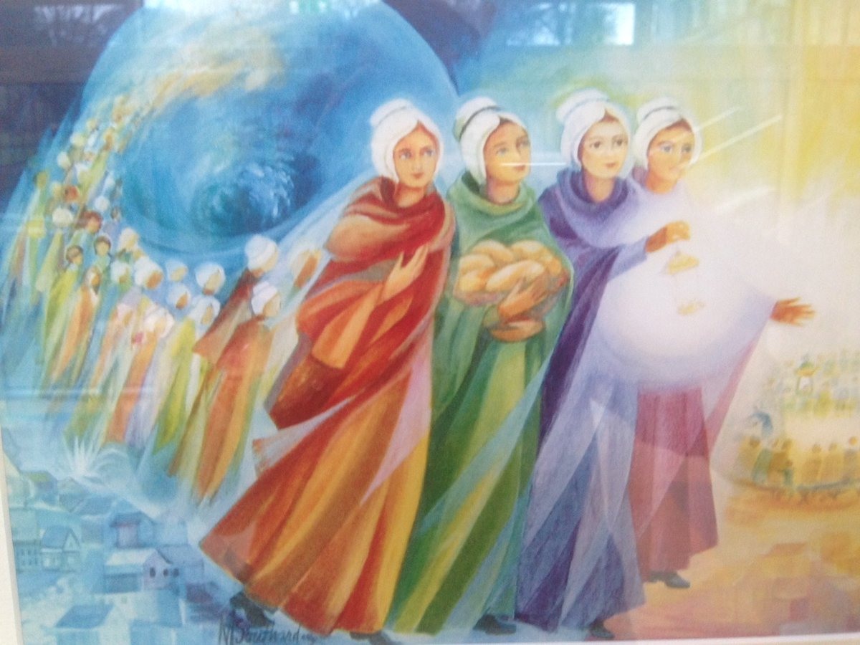
Nano’s decision
Not acting alone
Sought advice and/or support from friends, clerics, confessor.
Joined an institution – a convent in Paris
Eventually left convent to gather non-enclosed women to do the work
Hurdles to overcome
Going against the law by teaching girls
Explaining the work to family – brother, uncle
Self doubt
Money, own health, time, effort
Other unknown but generally referred to by Nano as her “severe trials”

Slide 27
Divine Support for nano’s work – in her own words
“You see it has pleased the Almighty to make me succeed when I had everything, I may say to fight against. I assure you I did not expect a farthing from any mortal towards the support of my schools; and I thought I should not have more than fifty or sixty girls until I got a fortune; nor did I think I should in Cork. I began in a poor, humble manner; and though it has pleased the divine will to give me severe trials in this foundation, yet it is to show that it is his work and has not been efforted by human means." (italics my emphasis)

Slide 28
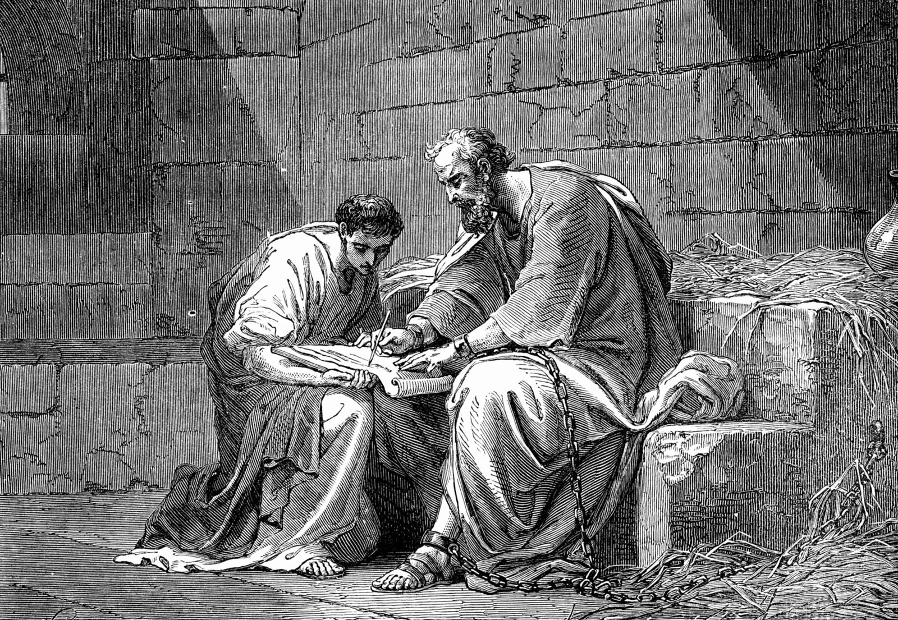
“My grace is sufficient for you, for power is made perfect in weakness.” So, I will boast all the more gladly of my weaknesses, so that the power of Christ may dwell in me. ¹⁰ Therefore I am content with weaknesses, insults, hardships, persecutions, and calamities for the sake of Christ; for whenever I am weak, then I am strong.
2 Corinthians 12:9-10

Slide 29
Nano in the way of the prophets?
Old Testament Prophets
Jesus as Prophet
Called people to return to the covenant with God (repent!)
Revealed the hard truths - scathing of social injustice, sin, idolatry, reliance on religious ritualism
Predicted judgement if they didn’t repent
Pointed always to God and hopeful future where all will be restored
1. Called people to new covenant with God in the preaching of God’s reign
Believe and repent (change of heart)
Believe in Jesus & the vision of the kingdom (now and the future)
Place the the poor and marginalized at the centre of concern
2. Preached in word and deed
3. Hurdles – not believed, tortured, killed
4. Points always to God and God’s reign

Slide 30
Pope francis on prophets
We need the courage of Elijah
https://www.vaticannews.va/en/pope/news/2020-10/pope-francis-we-need-courageous-christians-like-elijah.html
Dante as a Prophet of Hope
https://www.youtube.com/watch?v=TEH75WFjUt8
https://www.youtube.com/watch?v=-MlRP-ZmZV4
Pope Francis as prophetic
Ecological issues – Laudato Si
Division and disunity – Fratelli Tutti

Slide 31
Persecuted for speaking the truth
“When the prophet speaks the truth and touches the heart, or the heart opens or becomes stone, anger and persecutions are unleashed” he said “that’s how life ends for the prophet”.
Grieves for their people
“A true prophet is he who is capable of weeping for his people but at the same time of saying strong things in a direct way” he said.
Provide hope
“Opening the doors of hearts, healing roots, reinforcing the sense of belonging to the people of God in order to go forward… A prophet knows when to scold but knows also how to throw open the doors to hope. A true prophet puts himself on the line”.

Slide 32
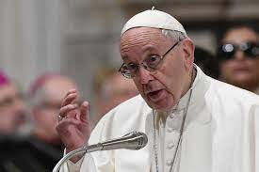
The Church needs prophets
“The Church needs prophets. What's more: it needs each of us to be prophets, not critics… this is something else…
He who just criticizes and is never happy with anything is not a prophet…a prophet is he who prays, looks to God, looks at his people and when the people err, he weeps…
May this service of prophecy never be lacking in the Church.”
Source: https://www.vaticannews.va/en/pope-francis/mass-casa-santa-marta/2018-04/pope-francis-santa-marta-the-church-needs-prophets.html

Slide 33
4. Responding prophetically today

Slide 34
Contemporary Issues in need of prophets
Covid – social distancing, mental health and isolation
Race – Black Lives Matter, racism
Gender – #MeToo, gender diversity
Ecology – SchoolStrike4Climate
How do we respond to these prophetically?

Slide 35
Being prophetic like nano
Being faced with an injustice, in your context
Being moved by it
Having a vision (God’s reign) – what is wrong here? What should it be?
Sense of personal responsibility - what am I doing to help?
Review of one’s life – how does my life help or hinder justice for this person in front of me?
Review of circumstances - Am I able to help with the resources I have, in the environment I live in?

Slide 36
Discerning, asking for advice, praying, researching
Making a decision, having conviction
Acting on a decision (preaching God’s reign in word and deed), holding the vision, never looking back
Not doing it alone
Being prepared to face hurdles
Always pointing to God and God’s reign
Trusting in God

Slide 37
a feminist-systematic theological perspective
She recognized poor girls as marginalized – empowering the powerless
She had a vision of God’s reign where all have equal dignity
– Genesis 1: we are all Imago Dei
– Galatians 3:26-28
“…in Christ Jesus you are all children of God through faith. ²⁷ As many of you as were baptized into Christ have clothed yourselves with Christ. ²⁸ There is no longer Jew or Greek, there is no longer slave or free, there is no longer male and female; for all of you are one in Christ Jesus.”

Slide 38
She had a strong sense of self – her own truth what was tugging at her heart, and listening to it
* The “Magis” in Jesuit terms
* Our restless hearts
”You have made us for yourself O Lord and our hearts are restless until they rest in you.” - Augustine
* A recognition of being from a native woman’s terms
“…The role of women? I would have difficulty with the word role, actually. More and more, as I get older, I see this sort of recognition of being as being more important than the role.”
Indigenous Elder, Shawani Campbell Star to native Indian woman, Kim Anderson

Slide 39
She was beholden to God’s law not simply human law - (informed conscience)
Deep within his conscience a man discovers a law which he has not laid upon himself but which he must obey. Its voice, ever calling him to love and to do what is good and to avoid evil, sounds in his heart at the right moment. . . . For man has in his heart a law inscribed by God. . . . His conscience is man's most secret core and his sanctuary. There he is alone with God whose voice echoes in his depths.”
(CCC 1776)

Slide 40
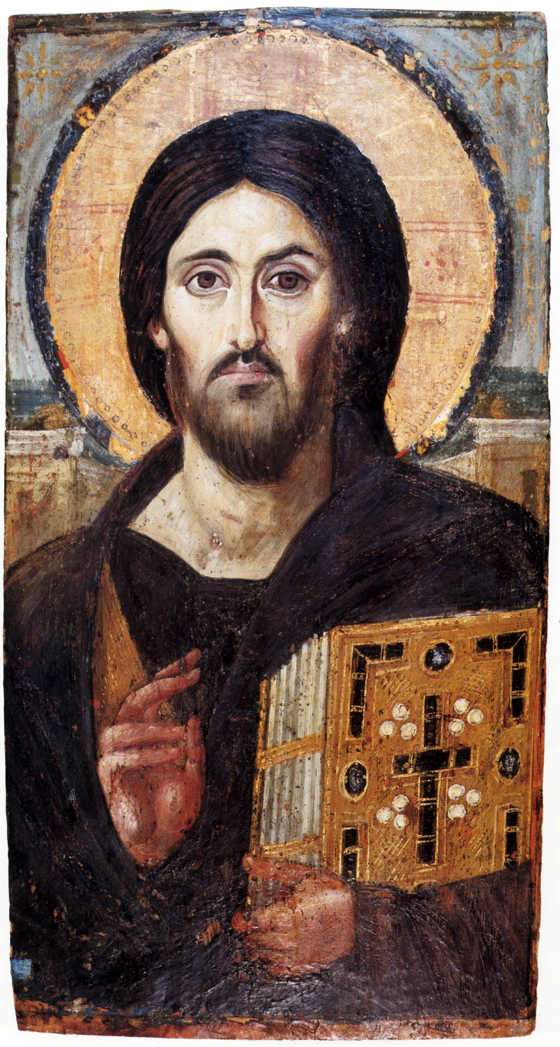
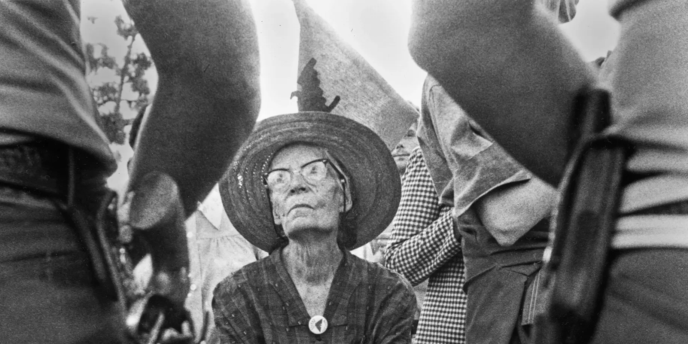
In the way of the prophets
YOU,
baptized
and beloved

