Slide 1


Biblical Prophecy

Slide 2

In Wisdom’s Path
God of the generations,
When we set our hands to labour,
thinking that we work alone,
Remind us that:
On our lips we carry
The words of prophets;
In our veins we carry
The blood of martyrs;
In our eyes we carry
The mystics’ visions; and
In our hands we carry
The strength of thousands.
Jan L Richardson,
Notes:
The GCL course pathway – refer to pic
The course pathway begins at the level of our PD&SC program, which effectively nests at the base of each of our four HE disciplines (in this case GCL), and supports day to day professional work, as well as helping our participants draw conceptual connections and make informed decisions when making later pathway decisions
So in effect therefore, our scaffolding begins at the ground level

Slide 3
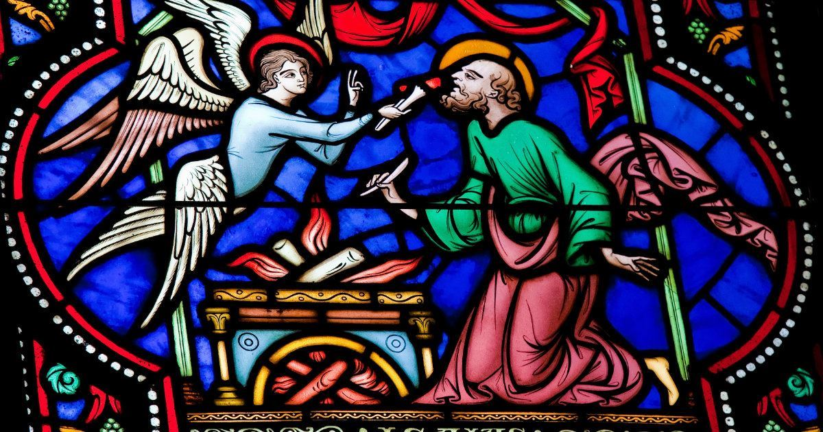
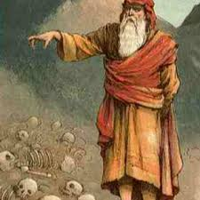
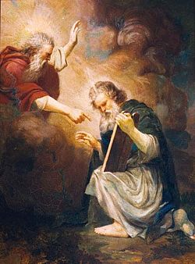
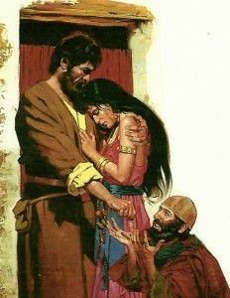
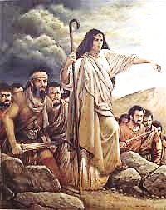
Biblical Prophets are:
the voice and conscience of the People of God
called to speak the word of God into a particular community at a particular time
one of the enduring and unique themes in the biblical tradition
concerned with ethical and communal life
Speak to the balance of Justice and integrity
Isaiah
Ezekiel
Deborah
Hosea
Biblical Prophecy is:
Rooted in Covenantal relationships
commissioned to call people to holiness
Moses
Notes:
The GCL course pathway – refer to pic
The course pathway begins at the level of our PD&SC program, which effectively nests at the base of each of our four HE disciplines (in this case GCL), and supports day to day professional work, as well as helping our participants draw conceptual connections and make informed decisions when making later pathway decisions
So in effect therefore, our scaffolding begins at the ground level

Slide 4
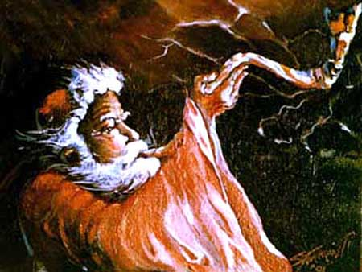
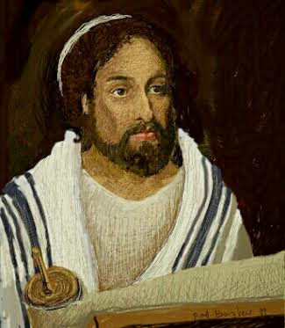
Moses:
The first and greatest of the Jewish prophets.
formed Israel as a nation
gave them an identity as a people who lived their lives ‘under the hand of God.’
Jesus
The ‘eschatological prophet greater than Moses’
Preaches of ‘re-newing’ relationships with God, self and others
extended and yet more intimate
The in-breaking of the Reign of God
parables, miracles, restoration, table-fellowship
Notes:
The GCL course pathway – refer to pic
The course pathway begins at the level of our PD&SC program, which effectively nests at the base of each of our four HE disciplines (in this case GCL), and supports day to day professional work, as well as helping our participants draw conceptual connections and make informed decisions when making later pathway decisions
So in effect therefore, our scaffolding begins at the ground level

Slide 5
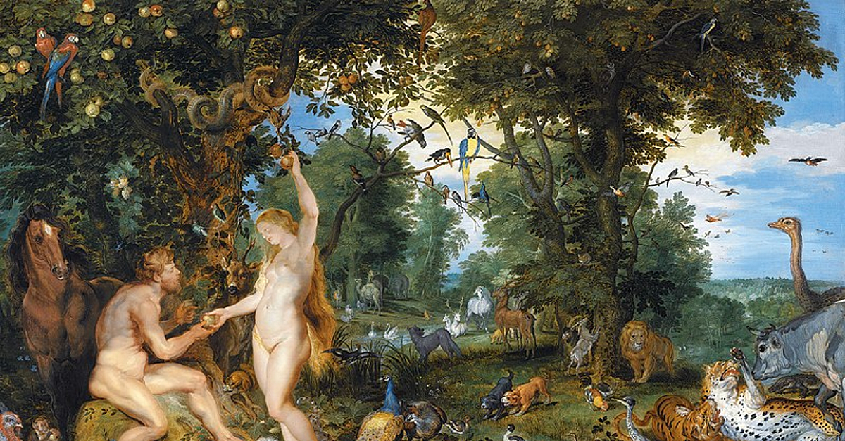
Biblical prophecy draws from the deeply covenantal and radically relational framework of the Biblical tradition
To be ‘the people of God’ is to be
people of the covenant – Holy, Just and Merciful
Whose relationships are both corporate and personal
rather than private and individual
Biblical Covenant affirms human lives are:
Intimately linked to God, to others and the created world
The God of the Covenant -- cannot be ‘owned’ or ‘captured’
“I will be who I will be” “Let your will be done”
Notes:
The GCL course pathway – refer to pic
The course pathway begins at the level of our PD&SC program, which effectively nests at the base of each of our four HE disciplines (in this case GCL), and supports day to day professional work, as well as helping our participants draw conceptual connections and make informed decisions when making later pathway decisions
So in effect therefore, our scaffolding begins at the ground level

Slide 6
Hallmarks of Authentic Prophecy
The signs of true prophecy are not always easy to recognise
Five basic criteria
A prophet will speak on behalf of God, particularly the Reign of God;
The prophetic word will ultimately work for the unity of the community as a whole.
A prophetic word uttered by someone who does not live the prophetic word is without credibility;
A prophetic word that has no connection with the reality of the life of the community is also without credibility;
Prophecy is always public and community-oriented – the whole community must understand
(McBrien, R. Catholicism)
"Jerusalem, Jerusalem, you that kill the prophets and stone those who are sent to you. How I have longed to gather your children, as a hen gathers her chicks under her wings and you refused" (Mat 23:37)
Notes:
The GCL course pathway – refer to pic
The course pathway begins at the level of our PD&SC program, which effectively nests at the base of each of our four HE disciplines (in this case GCL), and supports day to day professional work, as well as helping our participants draw conceptual connections and make informed decisions when making later pathway decisions
So in effect therefore, our scaffolding begins at the ground level

Slide 7
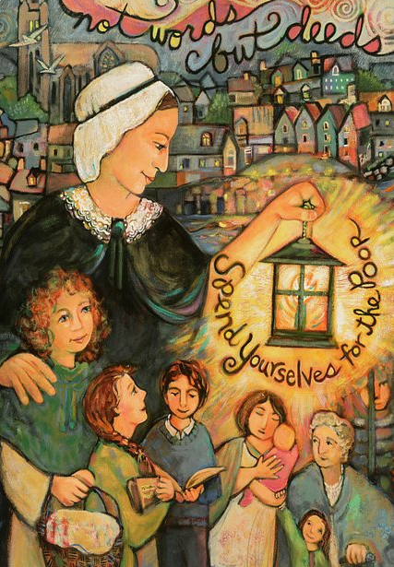
The Church doesn’t have a mission; God’s mission has a Church
Nano – a Prophet for her time
Developed by Sr Margaret Kelly (pbvm)
German sociologist Max Weber
Weber maintains prophets emerge through the experience of being called to mission.
Implicit in the prophetic call to mission is the notion of conversion
essentially an internal re-orientation of perspective
This gives prophets a different – often radical – understanding of and engagement with their world
Prophetic actions and critiques will focus particularly the issues and structures of their own time, place and context.
Notes:
The GCL course pathway – refer to pic
The course pathway begins at the level of our PD&SC program, which effectively nests at the base of each of our four HE disciplines (in this case GCL), and supports day to day professional work, as well as helping our participants draw conceptual connections and make informed decisions when making later pathway decisions
So in effect therefore, our scaffolding begins at the ground level

Slide 8
The Reign of God
A tensive symbol that speaks of the ‘right relationships’ that mark end times
When lives are directed by the Mercy, Justice and Compassion of God
It is both transcendent and concrete
a foundational attitude/orientation rather than a temporal reality.
Parables; miracles etc are reflections/inbreaking of the Reign of God
Radically linked into the covenantal life of Israel
who are called to live their lives as the people of God.
An emphasis on relationships and a deep ‘knowing’ of God.
When lives are directed by the Mercy, Justice and Compassion of God – transcendent order
Both the ‘power’ of God over all creation and
the power God has to change human lives and hearts.
metanoia –
the confidence that the covenant would one day be ‘written in the heart’ of God’s people3
Notes:
The GCL course pathway – refer to pic
The course pathway begins at the level of our PD&SC program, which effectively nests at the base of each of our four HE disciplines (in this case GCL), and supports day to day professional work, as well as helping our participants draw conceptual connections and make informed decisions when making later pathway decisions
So in effect therefore, our scaffolding begins at the ground level

Slide 9
“These people have a rebellious, unruly heart; . . . [but] I will make a new covenant with the House of Israel and the House of Judah. . . . Deep within them I will plant my Law, writing it on their hearts. Then I will be their God and they will be my people. . . . [and] they will all know me, the least no less than the greatest.” (Jr. 5:23 & 31:33)
Peace is not merely the absence of war. Nor can it be reduced solely to the maintenance of a balance of power between enemies. Nor is it brought about by dictatorship. Instead, it is rightly and appropriately called "an enterprise of justice" (Is. 32:7). Peace results from that harmony built into human society by its divine founder, and actualized by [people] as they thirst after ever greater justice. . . Peace must be born of mutual trust between nations rather than imposed on them through fear of one another's weapons.
(The Church in the Modern World no.78 & 82)
Notes:
The GCL course pathway – refer to pic
The course pathway begins at the level of our PD&SC program, which effectively nests at the base of each of our four HE disciplines (in this case GCL), and supports day to day professional work, as well as helping our participants draw conceptual connections and make informed decisions when making later pathway decisions
So in effect therefore, our scaffolding begins at the ground level

Slide 10
The Unity of the Community
The prophetic word will bring the community together.
Even though they may not always like what their prophet is saying.
The prophetic word will often be challenging.
Prophets cajole, threaten and basically remind the community of their covenantal obligations.
Prophets often operate outside the institutional boundaries
standing somewhat apart as critic and judge.
Paul reminds the Ephesians they must “put aside their old self which gets corrupted by following illusory desires” and in regard to what is happening in Galatia Paul is even more incredulous:
Notes:
The GCL course pathway – refer to pic
The course pathway begins at the level of our PD&SC program, which effectively nests at the base of each of our four HE disciplines (in this case GCL), and supports day to day professional work, as well as helping our participants draw conceptual connections and make informed decisions when making later pathway decisions
So in effect therefore, our scaffolding begins at the ground level

Slide 11
“Are you people in Galatia mad? Has someone put a spell on you, in spite of the plain explanation you have had . . . Are you foolish enough to end in outward observance what you began in the Spirit? . . . You were called to freedom; but be careful or this freedom will provide an opening for self-indulgence. . . If you go snapping at each other and tearing each other to pieces, you had better watch or you will destroy the whole community.” (Gal:3:1-2; 5:13-15)
“Every day, human interdependence grows more tightly drawn and spreads by degrees over the whole world. As a result the common good, that is, the sum of those conditions of social life which allow social groups and their individual members relatively thorough and ready access to their own fulfilment, today takes on an increasingly universal complexion and consequently involves rights and duties with respect to the whole human race. Every social group must take account of the needs and legitimate aspirations of other groups, and even of the general welfare of the entire human family.” (The Church in the modern World no 26)
Notes:
The GCL course pathway – refer to pic
The course pathway begins at the level of our PD&SC program, which effectively nests at the base of each of our four HE disciplines (in this case GCL), and supports day to day professional work, as well as helping our participants draw conceptual connections and make informed decisions when making later pathway decisions
So in effect therefore, our scaffolding begins at the ground level

Slide 12
The Call to Authentic Life
Authenticity that is is lived/concrete
Prophetic lives must reflect the message they espouse.
Hosea.
Hosea was commissioned to embody the constancy and faithfulness of God for the unfaithful Israel.
“Go and marry a whore, and get children with a whore, for the country itself has become nothing but a whore by abandoning YHWH.” (Hos 1:2)
God commands Hosea to continue to receive Gomer back as his wife – for as Hosea continues to forgive Gomer and welcome her back God will always forgive Israel.
“I will love Israel with all my heart for my anger has turned from them. I will fall like dew on Israel and they will bloom like the lily.” (Hos 14:4-7)
Notes:
The GCL course pathway – refer to pic
The course pathway begins at the level of our PD&SC program, which effectively nests at the base of each of our four HE disciplines (in this case GCL), and supports day to day professional work, as well as helping our participants draw conceptual connections and make informed decisions when making later pathway decisions
So in effect therefore, our scaffolding begins at the ground level

Slide 13
“You hypocrites! Isaiah prophesied rightly about you when he said: "This people honours me with their lips, but their hearts are far from me; in vain do they worship me, teaching human precepts as doctrines.” (Mat 15:7-9)
“Whatever insults human dignity, such as subhuman living conditions, arbitrary imprisonment, deportation, slavery, prostitution, the selling of women and children; as well as disgraceful working conditions, where men are treated as mere tools for profit, rather than as free and responsible persons; all these things and others of their like are infamies indeed. They poison human society, but they do more harm to those who practice them than those who suffer from the injury” (The Church in the modern World no. 27)
Notes:
The GCL course pathway – refer to pic
The course pathway begins at the level of our PD&SC program, which effectively nests at the base of each of our four HE disciplines (in this case GCL), and supports day to day professional work, as well as helping our participants draw conceptual connections and make informed decisions when making later pathway decisions
So in effect therefore, our scaffolding begins at the ground level

Slide 14
Deeply Connected to Life
Concern with the whole socio-political and religious life of the community.
Because God is deeply interested in every aspect of creation.
In 1 Cor. Paul covers everything from: the community’s eating habits to their sexual relationships; their behaviour in worship to the state of their marriages; the life-style of their children to their involvement in civil courts of law.
Social Justice.
Not just a religious obligation but a commitment to a particular way of life.
Relationship with God is all-consuming and all-encompassing
so the proclamations of biblical prophecy needed to be all-consuming and all-encompassing.
Notes:
The GCL course pathway – refer to pic
The course pathway begins at the level of our PD&SC program, which effectively nests at the base of each of our four HE disciplines (in this case GCL), and supports day to day professional work, as well as helping our participants draw conceptual connections and make informed decisions when making later pathway decisions
So in effect therefore, our scaffolding begins at the ground level

Slide 15
“You shall not wrong or oppress the stranger . . . you shall not abuse any widow or orphan . . . you shall not exact interest from the poor . . . If you take your neighbour’s cloak in pawn, you shall restore it before the sun goes down for it may be your neighbour’s only clothing to use as cover . . And if the stranger or neighbour; the widows, the orphans or the poor cry out to me, I will hear them, for I am compassionate.” (Exodus 20:21-27)
As followers of Christ, we are challenged to make a fundamental "option for the poor" -- to speak for the voiceless, to defend the defenceless, to assess life styles, policies, and social institutions in terms of their impact on the poor. This "option for the poor" does not mean pitting one group against another, but rather, strengthening the whole community by assisting those who are the most vulnerable. As Christians, we are called to respond to the needs of all our sisters and brothers, but those with the greatest needs require the greatest response. (Economic Justice for All no.16)
Notes:
The GCL course pathway – refer to pic
The course pathway begins at the level of our PD&SC program, which effectively nests at the base of each of our four HE disciplines (in this case GCL), and supports day to day professional work, as well as helping our participants draw conceptual connections and make informed decisions when making later pathway decisions
So in effect therefore, our scaffolding begins at the ground level

Slide 16
A Community Affair
Understood by the whole community.
Prophecy understood only by a select few is really Gnosticism
To benefit the whole community prophecy must:
Speak of the Reign of God
Bring the community together
Be embodied in the lives of the prophets
Be rooted in the justice and the mercy of God.
Be ‘recognised’ by the community as saying something deeply true and deeply real about who they are and what they are called to Be
Notes:
The GCL course pathway – refer to pic
The course pathway begins at the level of our PD&SC program, which effectively nests at the base of each of our four HE disciplines (in this case GCL), and supports day to day professional work, as well as helping our participants draw conceptual connections and make informed decisions when making later pathway decisions
So in effect therefore, our scaffolding begins at the ground level

Slide 17
“the [one] who prophecies does talk to people, to their improvement, their encouragement and their consolation. The one with the gift of tongues talks for their own benefit, but the [one] who prophecies does so for the benefit of the whole community.” (1 Cor: 14:1-5)
Those, therefore, who claim their own rights, yet altogether forget or neglect to carry out their respective duties, are people who build with one hand and destroy with the other. Since [humans] are social by nature they are meant to live with others and to work for one another's welfare. . . . . . . A well-ordered human society requires that [people] recognize and observe their mutual rights and duties. It also demands that each contribute generously to the establishment of a civic order in which rights and duties are more sincerely and effectively acknowledged and fulfilled. . . . . . It is not enough, for example, to acknowledge and respect everyone's right to the means of subsistence if we do not strive to the best of our ability for a sufficient supply of what is necessary for his sustenance. Peace on Earth no.28-32
Notes:
The GCL course pathway – refer to pic
The course pathway begins at the level of our PD&SC program, which effectively nests at the base of each of our four HE disciplines (in this case GCL), and supports day to day professional work, as well as helping our participants draw conceptual connections and make informed decisions when making later pathway decisions
So in effect therefore, our scaffolding begins at the ground level

Slide 18
The Prophetic Task
Is to remind communities of the radically covenantal relationship that made them who they are
And therefore must guide their lives.
It is the consolation of the People of God.
“But now, thus says YHWH, who created you, Jacob, who formed you Israel: Do not be afraid, for I have redeemed you; I have called you by name, you are mine. . . . Should you walk through fire, you will not be scorched . . . The rivers will not swallow you up. Because you are precious in my eyes, because you are honoured and I love you.” (Isa 43:1-4)
Notes:
The GCL course pathway – refer to pic
The course pathway begins at the level of our PD&SC program, which effectively nests at the base of each of our four HE disciplines (in this case GCL), and supports day to day professional work, as well as helping our participants draw conceptual connections and make informed decisions when making later pathway decisions
So in effect therefore, our scaffolding begins at the ground level

Slide 19
The Prophetic Challenge
“You must not molest the stranger or oppress them; you know the heart of the stranger for once you lived as strangers in the land of Egypt. You must not be harsh with the widow or with orphans; they will cry out to me and I will hear them. . . . If a man buys a Hebrew slave then he shall free him after seven years; if you strike the eye of any slave and they lose the use of it, they shall be compensated with their freedom, and if a man beats his slave so the slave dies at his hand he shall pay the penalty. . . . Six days you shall do your work, but on the seventh day you shall rest, so that your ox and your donkey may have relief, and your home born slave and the resident alien may be refreshed. You must not charge interest to the poor nor must you side with the majority in defiance of justice . . . If you come upon your enemy’s stray donkey, you must lead it back . . . . In the seventh year let your land, olive groves and vineyards be fallow; take no produce from it, the poor among you may take food from it” (Ex 20-23)
Notes:
The GCL course pathway – refer to pic
The course pathway begins at the level of our PD&SC program, which effectively nests at the base of each of our four HE disciplines (in this case GCL), and supports day to day professional work, as well as helping our participants draw conceptual connections and make informed decisions when making later pathway decisions
So in effect therefore, our scaffolding begins at the ground level

